Slide 1

Back to School Night
Mrs. Barr, Miss Burns,
Ms. Hanley, and Mrs. Roller
Third Grade

Slide 2

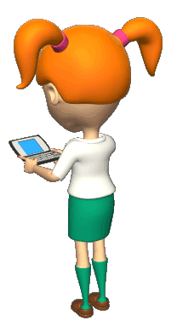
How to Contact Us
Mrs. Barr: jbarr@neshaminy.k12.pa.us
Mrs. Hanley:
jhanley@neshaminy.k12.pa.us
Mrs. Roller:
jroller@neshaminy.k12.pa.us
**Please send in a note in the morning if there is a change in
dismissal procedure.**

Slide 3
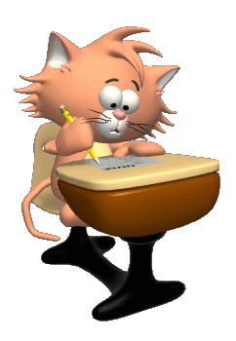
Welcome Parents and
Loved Ones
After the presentation,
you will return to your child’s classroom so that you have time to sign in and sign-up for a November conference.

Slide 4
Please fill out the Parent Contact and Survey forms on your child’s desk.
Your child left a note for you on their desk. Please write a quick note back to your child!

Slide 5

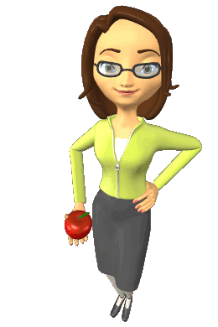
Introductions
Mrs. Barr
-teaching at Albert Schweitzer since 2008
-married with three cats
-1988 graduate of Neshaminy High School
-1993 graduate of West Chester University

Slide 6
Introductions
Ms. Hanley
-teaching at Albert Schweitzer since 2008
-two sons, one grandson, one dog and cat
-1989 graduate of Neshaminy High School (I’m younger ☺)
-2006 graduate of Temple University
-2012 graduate of Cabrini College

Slide 7
Introductions
Mrs. Roller
-Teaching at Schweitzer since 2008
-Married With Children and two cats
-1999 graduate of Bensalem HS (I’m even younger☺)
-2004 graduate of West Chester University
-2011 graduate of Cabrini College

Slide 8
Introductions
Miss Burns
-Student at Bloomsburg University
-Majoring in Early Childhood Education, with a minor in
Educational Technology
-2012 graduate of Neshaminy HS (I’m the youngest☺)
-Graduating from Bloomsburg University, December 2016

Slide 9

Student Expectations
-QUALITY work!
-QUALITY thinking!
-Take risks; don’t be afraid to
make a mistake.
-Try, take a deep breath, and keep trying.
-Do your best everyday!

Slide 10


Teacher Expectations
-To be positive and helpful
-To provide a safe and caring environment
-To challenge students to achieve
-To be fair and understanding
-To keep you informed

Slide 11


SWPBS Expectations
Be Cooperative
Have a positive Attitude
Be Respectful
Show Empathy
Be Safe
.

Slide 12


Open House
Homework Expectations
Homework reinforces skills and concepts taught during the day. Please sign agenda each evening.
Students are expected to read 15 minutes daily; reading log must be signed and dated.
Math homework will be assigned Monday-Thursday.

Slide 13



Homework Expectations
    Occasionally homework will be given in writing, science and social studies.
    If your child does not complete their homework, a homework slip indicating what assignment was missed will be sent home to be signed and returned to school the next day. It is expected that the homework will be completed the following evening.
    Please send in a note if your child had difficulty on the homework, and we will review it with them.

Slide 14

Common Core State Standards
.
The standards clearly communicate what is expected of students at each grade level.
“I Can
Common
Core!”
Each lesson that is taught correlates with a state standard.

Slide 15
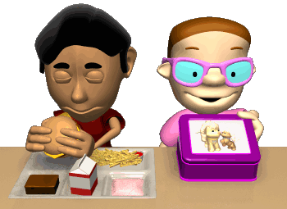
Daily Schedule
8:55-9:10 Arrival
9:10-9:25 Morning Routine
9:25-10:10 Special
10:15-11:15 Math
11:15-12:00 Writing
12:00-12:40 Power 40
12:40-1:40 Lunch/Recess
1:40-2:45 Language Arts
2:45-3:30 Science/Social Studies
3:35 Dismissal

Slide 16


Language Arts
Language Arts consists of a Balanced Literacy program.
Reading Instruction
-Shared Reading
-Guided Reading
Independent Reading
Word Study
Writing Instruction
Independent Writing

Slide 17


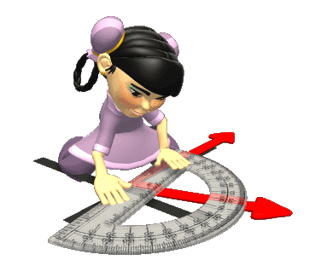
Math in Focus
Problem solving is central.
Less content-greater depth.

Slide 18

Science
http://archive.fossweb.com/modules3-6/index.html
Structures of Life
Earth Materials
Physics of Sound

Slide 19
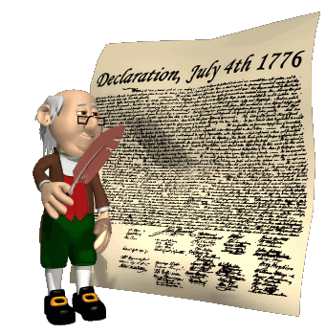
Social Studies
Geography
Economics
History
Government

Slide 20


Prevention Curriculum
Too Good For Drugs
Too Good For Violence

Slide 21
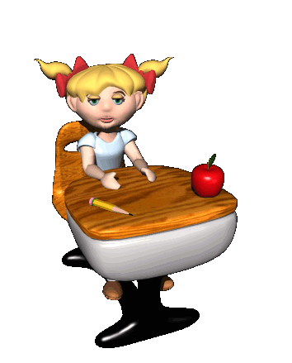
State Assessment Dates
ELA
April 3rd-7th
Math
April 24th-28th

Slide 22

Field Trip
Chaperones must be paid members of the PTO and have their clearances turned in to the office by December.
Chaperones are chosen via a random drawing.

Slide 23
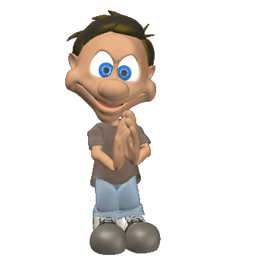
We want excited, curious, hard-working learners.
We are looking forward to a great year with your student.

Slide 24
Thank you
for
coming
this
evening!

