Slide 1
CONTRACEPTION
What types of Birth Control are available to me?

Slide 2
TYPES OF CONTRACEPTION
ABSTINENCE
HORMONAL METHODS
BARRIER METHODS
PERMANENT METHODS

Slide 3
ABSTINENCE
0% Failure Rate
Complete Protection from STI’s
Always available
Always used correctly
FREE!

Slide 4
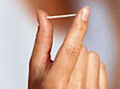
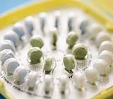
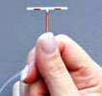
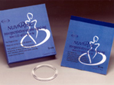
HORMONAL METHODS
IMPLANT
PILL
PATCH
SHOT
IUD
RING

Slide 5
HORMONAL METHODS
Releases Progestin and sometimes estrogen into the system.
Keeps eggs from leaving the ovaries.
Makes a woman's cervical mucus thicker. This keeps sperm from getting to the eggs.
Many different forms:
Pill- 9 out of 100 effectiveness
Implant- 1 out of 100 effectiveness
Patch- 9 out of 100 effectiveness
Shot- 6 out of 100 effectiveness
Ring- 9 out of 100 effectiveness
IUD- Less than 1 out of 100 effectiveness

Slide 6
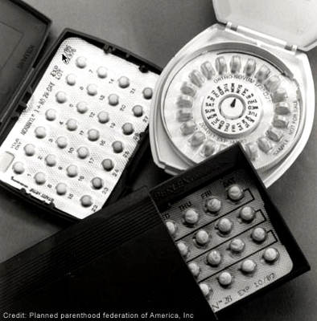
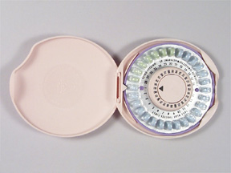
BIRTH CONTROL PILLS
1-2% Failure Rate
No Protection against STI’s
Prescription Use Only
Must be taken daily

Slide 7
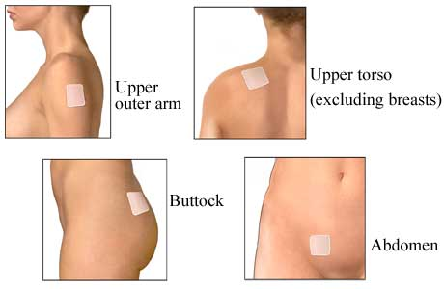
PATCH
1-2% Failure Rate
No Protection against STI’s
Prescription Use Only
New patch must be
applied every week

Slide 8
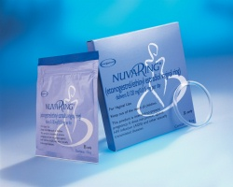
THE RING
1-2% Failure Rate
No Protection against STI’s
Prescription Use Only
New Ring Inserted Each Month

Slide 9
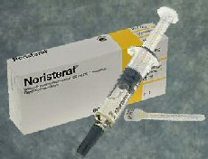
INJECTION
<1% Failure Rate
No Protection against STI’s
Prescription Use Only
One injection every three months

Slide 10
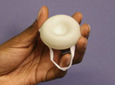
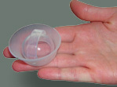
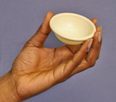
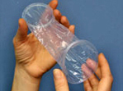
BARRIER METHODS
SPONGE
CAP
MALE
CONDOM
DIAPRAGM
FEMALE CONDOM

Slide 11
BARRIER METHODS
Collects pre-ejaculation and semen when a man ejaculates. Keeps sperm from entering the vagina.
Also prevents transmission of most STI’s and STD’s.
Many different forms:
Sponge- 12 out of 100 effectiveness if no children. 24/100 if yes.
Cervical Cap- 29 out of 100 effectiveness
Male Condom- 18 out of 100 effectiveness
Female Condom- 21 out of 100 effectiveness
Diaphragm- 12 out of 100 effectiveness

Slide 12
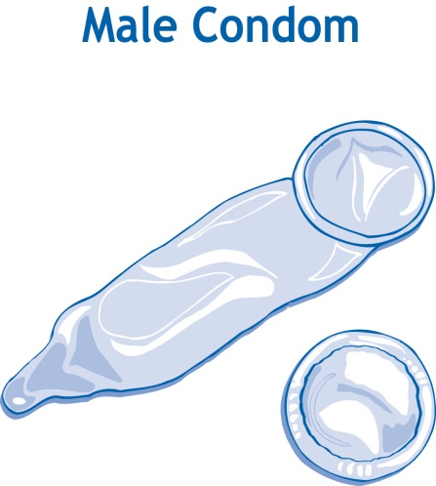
MALE CONDOM
11% Failure Rate
Offers good protection against STI’s
Available over the counter
Applied immediately before intercourse, used once
Cost is inexpensive

Slide 13
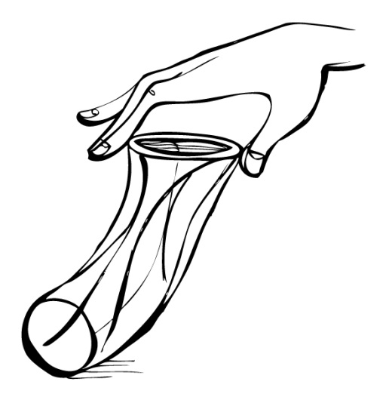
FEMALE CONDOM
21% Failure Rate
Limited protection against STI’s
Available over the counter
Inserted before intercourse, used once
Inexpensive, but more
expensive than male condom.

Slide 14
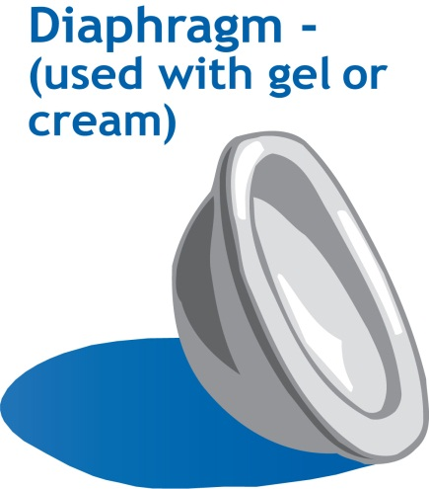
DIAPHRAGM plus SPERMICIDE
17% Failure Rate
No protection against STI’s
Prescription Use Only
Must be left in place for 6 hours after intercourse; can be washed and reused

Slide 15
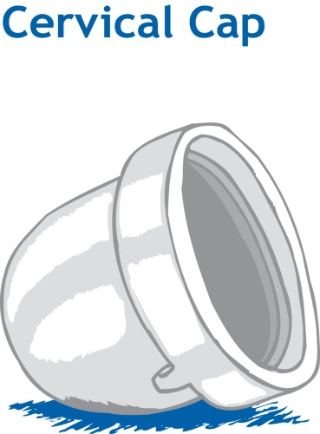
CERVICAL CAP plus SPERMICIDE
17-23% Failure Rate
No Protection against STI’s
Prescription use only
Proper insertion can be difficult; must be left in place for 8 hours after intercourse; can be washed in reused

Slide 16
SHIELD plus SPERMICIDE
15% Failure Rate
No Protection against STI’s
Prescription use only
Must be left in place for 8 hours after intercourse; can be washed and reused

Slide 17
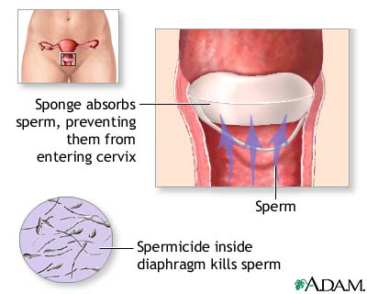
SPONGE
16% Failure rate
No protection against STI’s
Over the Counter
Must be left in place
for 6 hours after
intercourse;
discarded after use

Slide 18
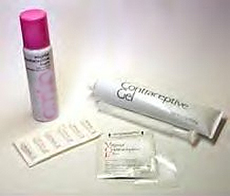
SPERMICIDE ALONE
35% Failure Rate
No Protection against STI’s
Over the Counter
Varies based on type

Slide 19
PERMANENT METHODS
VASECTOMY: Male’s vas deferens are cut to not allow sperm to reach semen
TUBAL LIGATION: tubes are cut and tied to prevent egg from reaching the uterus.
Less than 1 out of every 100 women get pregnant.
No protection against STI’s
Medical Procedure
One time Procedure.

Slide 20
VASECTOMY, TUBAL LIGATION
<1% Failure Rate
No protection against STI’s
Medical Procedure
One time Procedure.
VASECTOMY: Male’s vas deferens are cut to not allow sperm to reach semen.
TUBAL LIGATION: tubes are cut and tied to prevent egg from reaching the uterus.

Slide 21
DO NOT EVER USE!
UNRELIABLE METHODS

Slide 22
FAM: Fertility Awareness Method
Obstaining from intercourse during the days of the female’s cycle where she is most likely to get pregnant.

Slide 23
WITHDRAWAL METHOD
53% Failure Rate
No protection against STI’s
TERRIBLE method of birth control.
NOT FOR TEENS!

