Slide 1
Effects of Alcohol Use on
Underage Individuals.
Utilize Good Decision Making Skills To Promote Healthy Choices and Lifestyles.

Slide 2
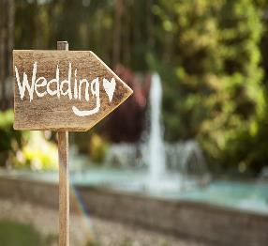
Brainstorm!
List as many events or activities that are strongly associated alcohol.

Slide 3
Using One Word!
When teenagers drink alcohol they expect alcohol to make them feel …

Slide 4
Positive or Negative

Slide 5
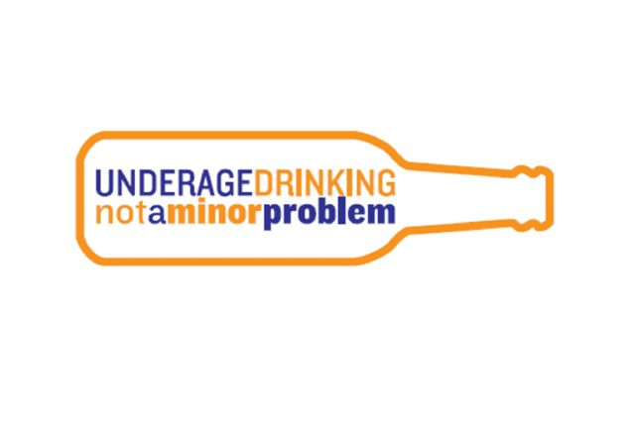
Brainstorm!
List as many consequences of underage drinking.

Slide 6
Categories of Consequences
Academic Financial
Neurological Physical
Social Legal
Consequences for Others

Slide 7
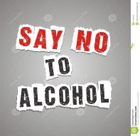
Wrap It Up!
Utilize Good Decision-Making Skills to Promote Healthy Choices and Lifestyles.

Slide 8
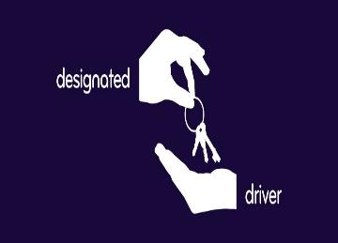
What Choices Can Be Made to Promote a Healthy Lifestyle?
-Say No!
-Wait Until of Age
-Find Other Ways to be Social
-Limit Consumption
-Get a Designated Driver (21 over)

