Slide 1
PREGNANCY
“The Miracle of Life”

Slide 2
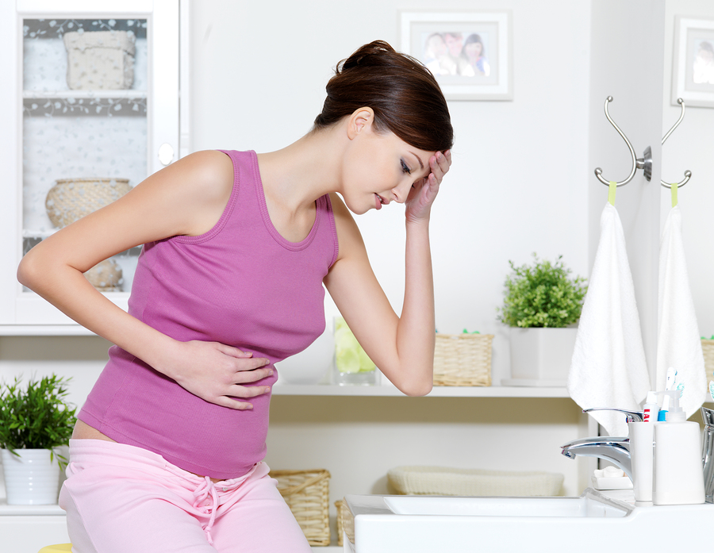
SIGNS OF PREGNANCY
Food Cravings
Headache
Bloated
Overall Tiredness
Backaches
Sore/Swollen Breasts
Implantation Bleeding
MISSED PERIOD
Nausea
“Morning Sickness”

Slide 3
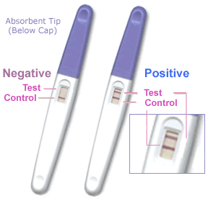
Pregnancy Tests
URINE TEST
BLOOD TEST
ULTRASOUND
WHAT ARE THEY LOOKING FOR?????
HCG:
Human chorionic gonadotropin

Slide 4
HUMAN FERTILIZATION
https://www.youtube.com/watch?v=BFrVmDgh4v4

Slide 5
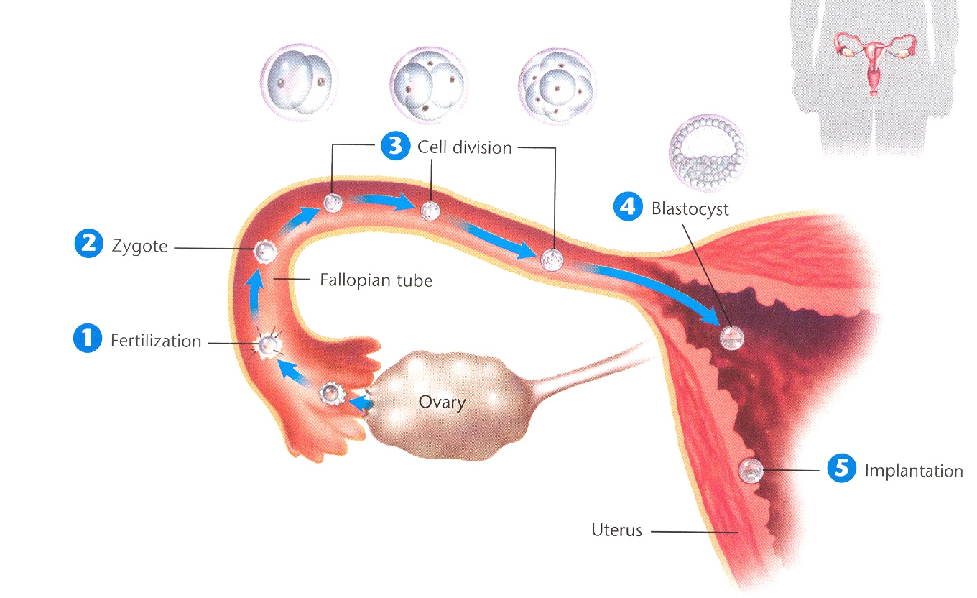
The Beginning of the Life Cycle

Slide 6
FERTILIZATION
-Occurs in the Fallopian Tube
-Begins to undergo cell division.

Slide 7
ZYGOTE
United Egg and Sperm

Slide 8
CELL DIVISION
Original Cell divides.
Becomes an EMBRYO
Always dividing until 9 weeks

Slide 9
The Blastocyst
50-100 cells
Sphere with a hollow center
5 days

Slide 10
Implantation
Process of attachment to the uterine wall

Slide 11
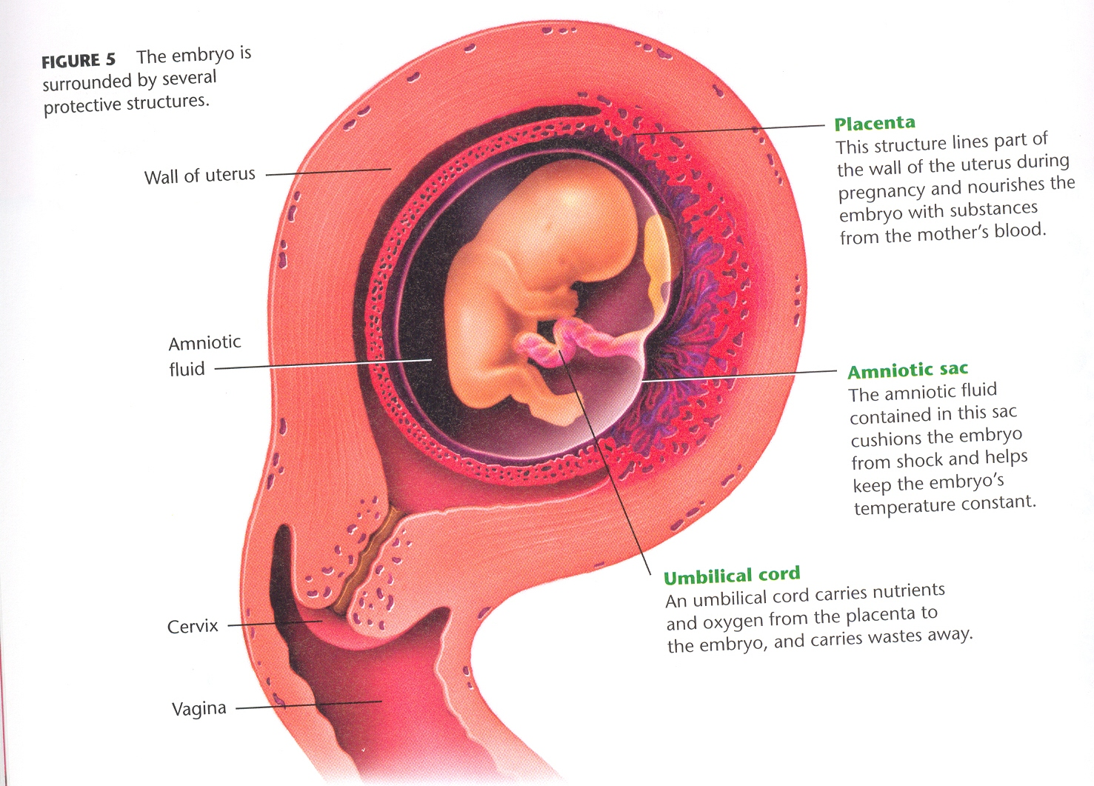
DEVELOPMENT IN THE UTERUS

Slide 12
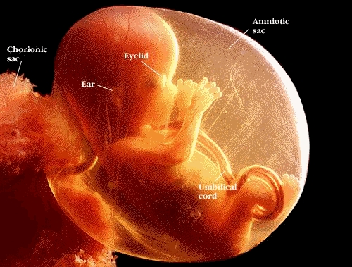
AMNIOTIC SAC
Fluid filled bag
Protects embryo/fetus

Slide 13
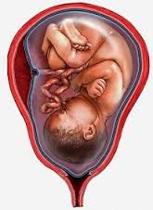
PLACENTA
Oxygen, nutrients, blood from mother
Dangerous substances as well.
Afterbirth

Slide 14
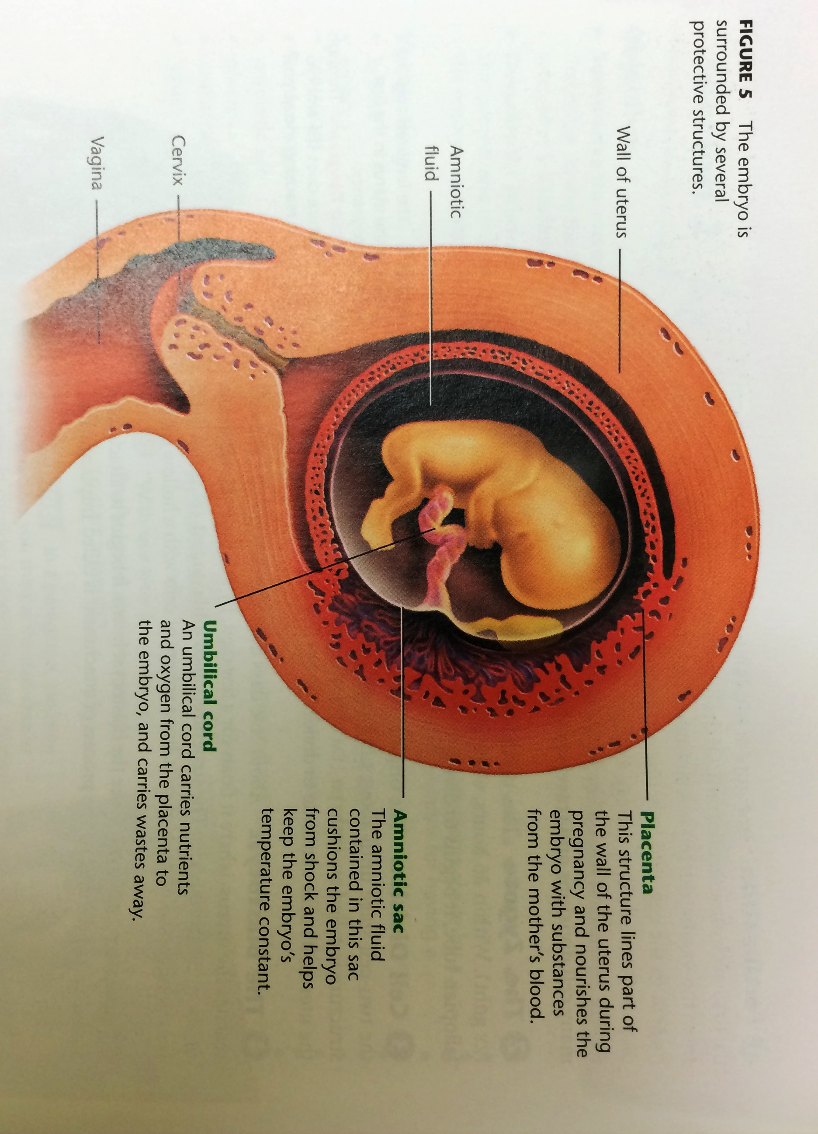
UMBILICAL CORD
After 25 days develops
Ropelike
Lifeline
Carry nutrients/ remove waste.

Slide 15
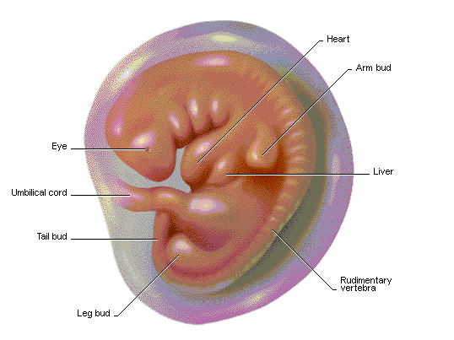
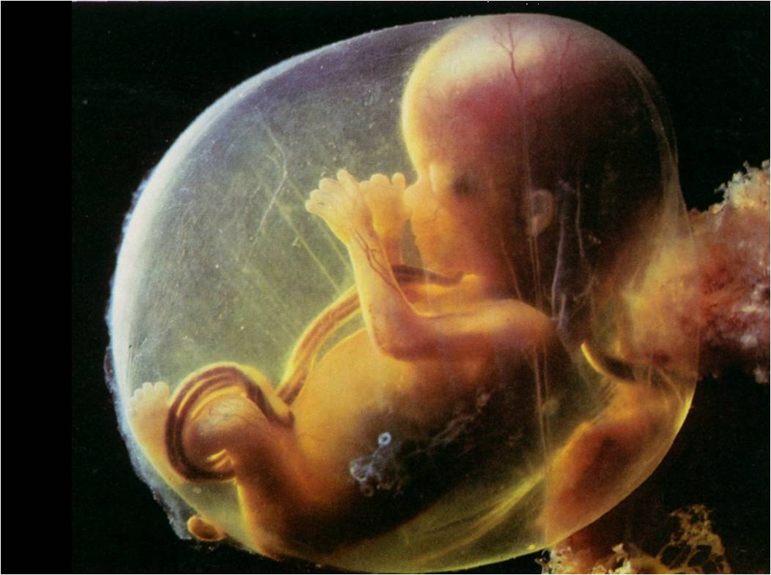
EMBRYO→ FETUS
FETUS:
Start of 3rd month til Birth

Slide 16
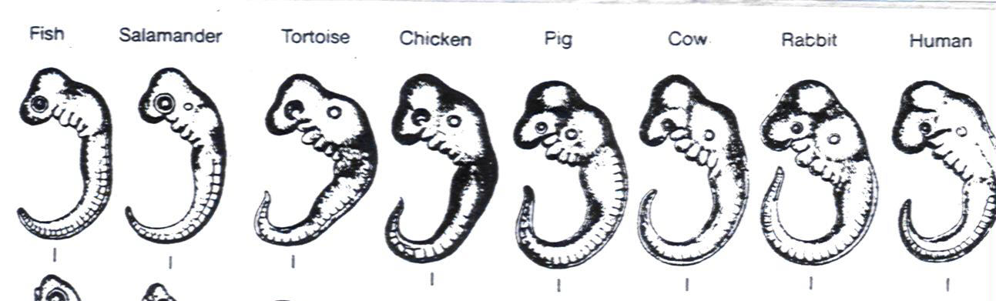

Slide 17
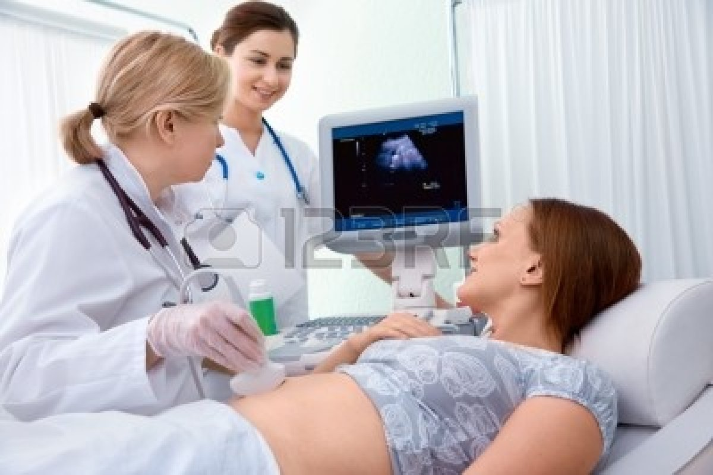
ULTRASOUND
High Frequency Sound Waves used to create images

Slide 18
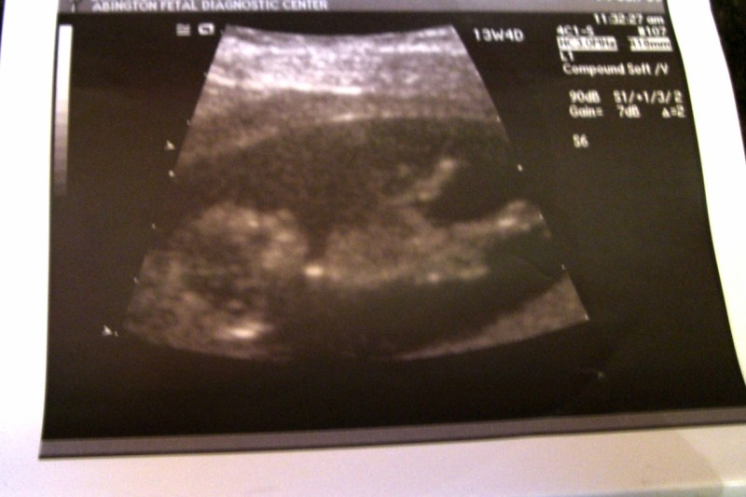

Slide 19
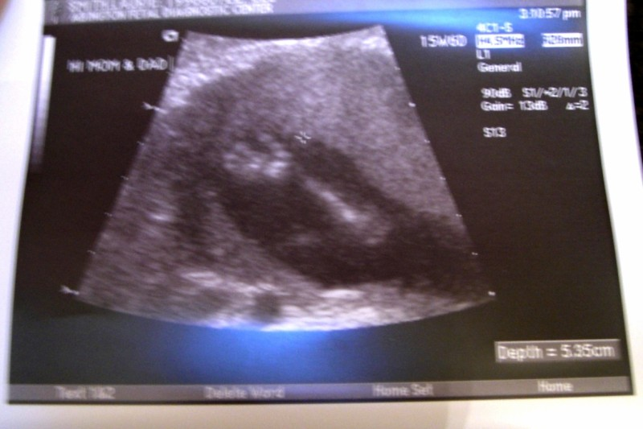

Slide 20
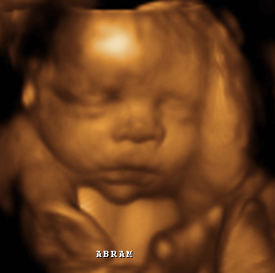
34 weeks

Slide 21

1 month

Slide 22
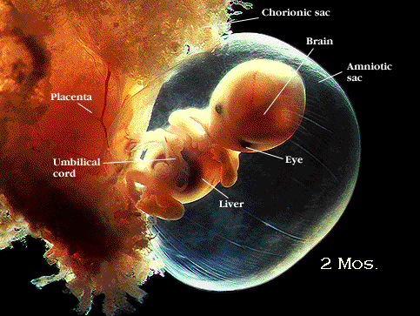
2 months

Slide 23
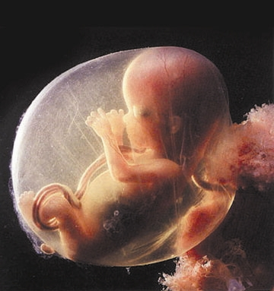
3 months

Slide 24
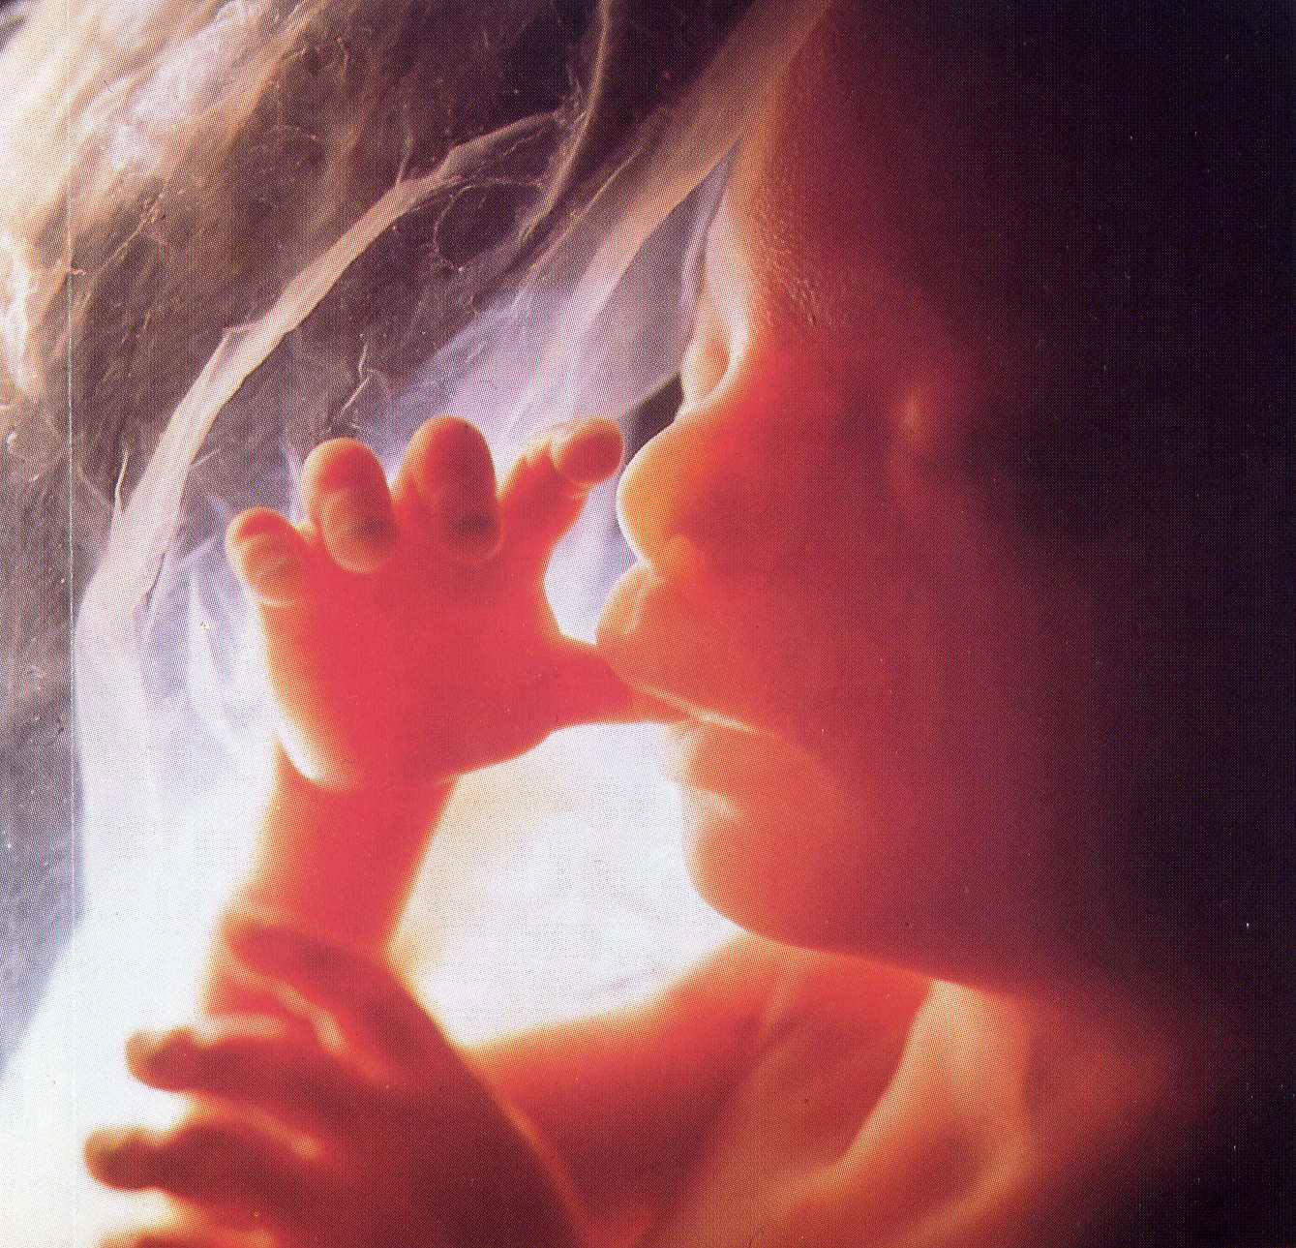
4 months

Slide 25
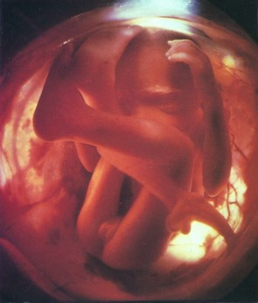
5 months

Slide 26
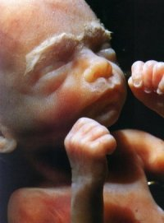
6 months

Slide 27
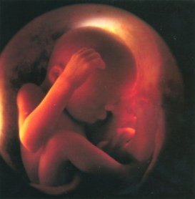
7 months

Slide 28
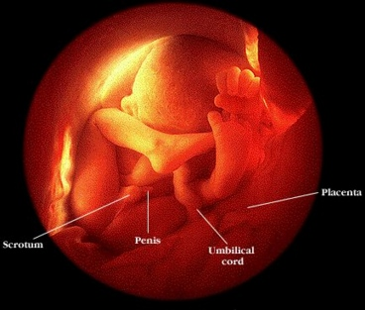
8 months

Slide 29
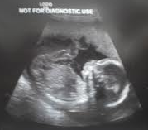
9 months

Slide 31
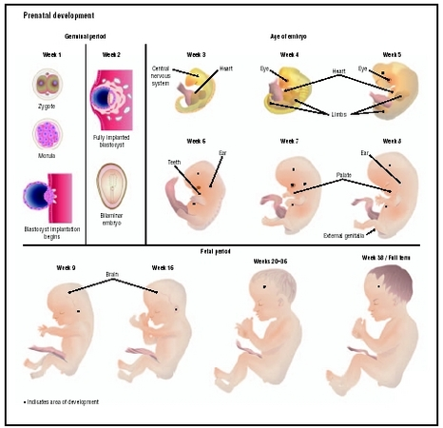

Slide 32
STAYING HEALTHY DURING PREGNANCY

Slide 33
PROPER NUTRITION
Pregnant women need to eat an extra 300 calories per day.
Diet should include essential nutrients especially FOLIC ACID.
Pre-natal vitamins!

Slide 34
EXERCISE
Reduces the risk of gestational diabetes.
Always get doctors approval.
Prepares for labor.

Slide 35
AVOIDING ALCOHOL & DRUGS
Can harm or kill baby
  Even in small amounts.
Consult doctor before taking any medication including cold medicine.

Slide 36
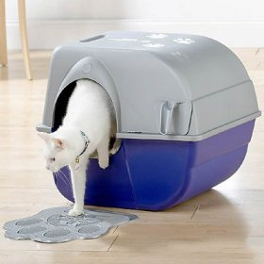
AVOID ENVIRONMENTAL HAZZARDS
X-rays
Lead
Mercury- raw fish
Cat Litter

Slide 37
COMPLICATIONS

Slide 38
ECTOPIC PREGNANCY
The blastocyst implants in the fallopian tube or somewhere else in the abdomen.
The embryo cannot develop normally and may put the mother’s life at risk.
Surgery is necessary.

Slide 39
MISCARRIAGE
The death of an embryo or fetus in the first 20 weeks of pregnancy.
Usually occurs in the first trimester.

Slide 40
PREECLAMPSIA
High blood pressure during pregnancy that prevents the fetus from receiving the necessary oxygen.
Usually treated with bed rest.

Slide 41
GESTATIONAL DIABETES
Diabetes in a pregnant woman.
Develops later in pregnancy and may cause the fetus to grow too large.
Discovered via Glucose Testing

Slide 42
PREMATURE BIRTH
Delivery of the baby before the 37th week.
The earlier the birth, the greater the chance of problems.
23 weeks and older have been known to survive.

Slide 43
