Slide 1
Unhealthy Relationships

Slide 2
LUKA
What do you think the song is about?
What clues or lyrics made you think that?
https://www.youtube.com/watch?v=VZt7J0iaUD0

Slide 3
Abuse
List all of the different types of abuse you can think of.

Slide 4
Definitions
Dating Violence: A pattern of physical, emotional, verbal or sexual abuse that occurs in a dating relationship
Physical Abuse: Intentionally causing physical harm to another person.
Child Abuse: Physical, emotional, verbal or sexual abuse that occurs to a child.
Emotional Abuse: The nonphysical mistreatment of a person.
Sexual Abuse: Forcing a person to engage in any unwanted sexual behavior.
Verbal Abuse: Is the use of words to cause harm to the person being spoken to.

Slide 5
What Would You Do?
Reaction To Women Abusing Men In Public – YouTube
List the types of abuse you see in this clip.

Slide 6
Video
Dating Violence
Physical Abuse
Emotional Abuse
Verbal Abuse

Slide 7
Warning Signs A great way to avoid violence!
٠Your date is jealous when you talk to others
٠Your date makes all the decisions and tries to control what you do
٠Your date has a history of bad relationships
٠You feel isolated from your friends and family
٠You feel less self-confident when you are with your date
٠You change how you behave to avoid an argument

Slide 8
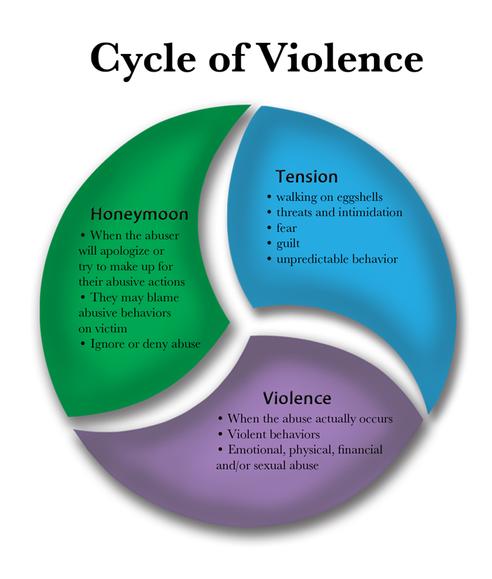

Slide 9
Why Do They Stay?
٠They view the possessiveness or jealousy as romantic
٠They think the behavior is normal because friends are in a similar relationship
٠Females feel it is a sign of masculinity
٠Males may be ashamed to admit they are being abused
٠The teen feels that they deserved to be abused
٠They may fear being along

Slide 10
End the Abuse!
٠First admit that the abuse exists
٠Realize that you are not to blame and you cannot change your abuser’s behavior
٠Seek support from family and friends
٠Call an abuse hotline if you want to talk anonymously
٠Talk to a counselor, teacher, doctor or social worker

Slide 11
Resources
Philadelphia Domestic Violence Hotline: 1-866-723-3014
Pennsylvania Coalition Against Rape (PCAR): www.pcar.org
Rape, Abuse & Incest National Network (RAINN): www.rainn.org
National Sexual Violence Resource Center: www.nsvrc.org
National Center for Victims of Crime: www.nsvrc.org
Information on male sexual abuse: www.malesurvivor.org
Childline (report sexual abuse statewide): 1-800-932-0313
Planned Parenthood: 215-351-5560
Women Against Abuse (Philadelphia DV shelter): 215-386-7777
911 or local law enforcement

