Slide 1
Chapter 10 Vocabulary
Visuals

Slide 2
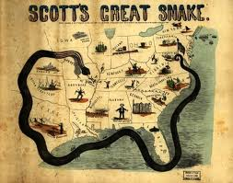
Anaconda Plan

Slide 3
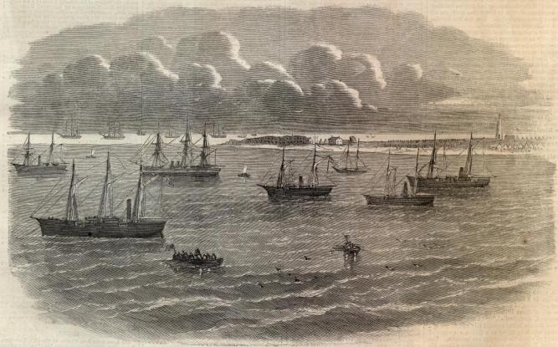
Naval(Navy) Blockade

Slide 4
Emancipation

Slide 5
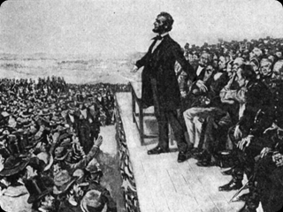
Gettysburg Address (speech)

Slide 6
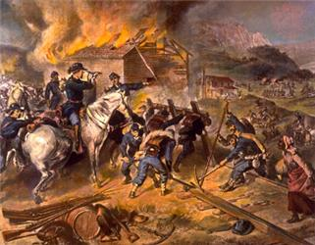
Total War (Sherman’s March to Sea)

Slide 7
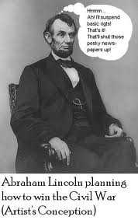
Habeas Corpus

Slide 8
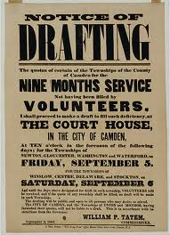
Military Draft

Slide 9
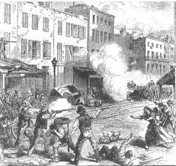
Draft Riots

Slide 10
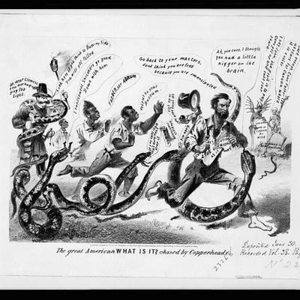
Copperheads

Slide 11
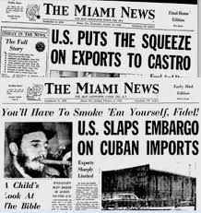
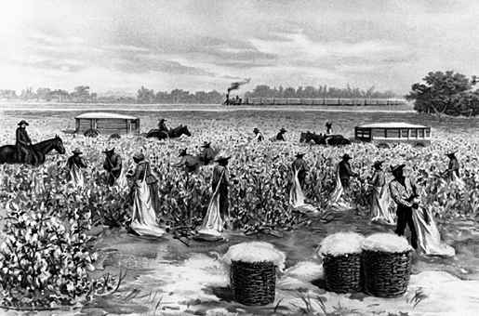
Embargo

Slide 12
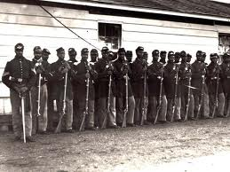
54th Massachusetts Regiment

