Slide 1
Essential Question
What were the important events of the Clinton Presidency?

Slide 2
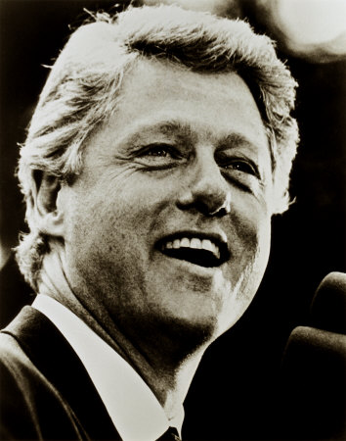
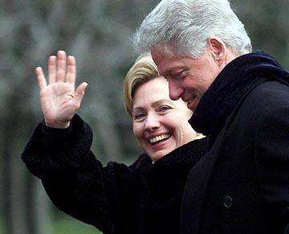
President Bill Clinton 1992-2000

Slide 3
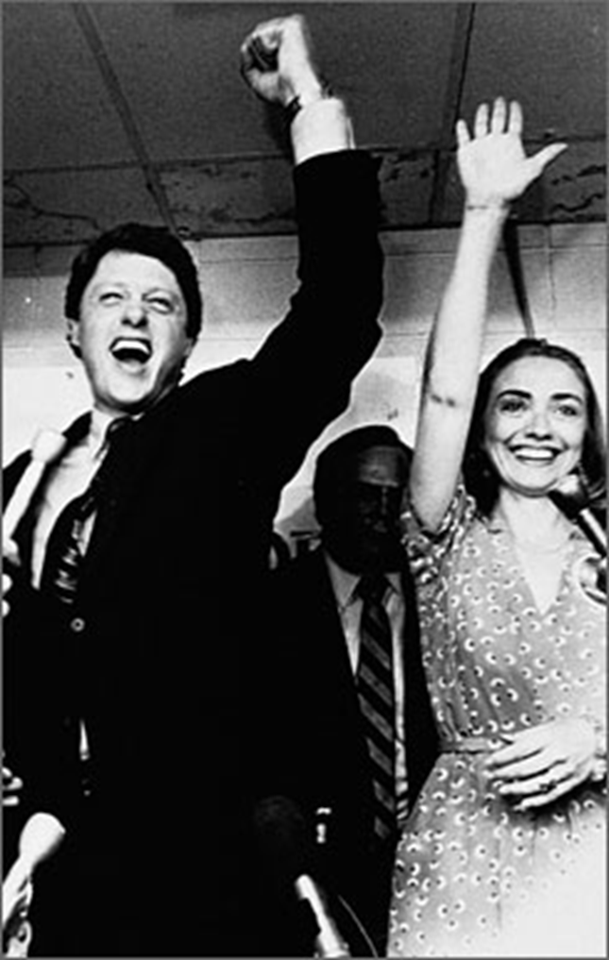
Bill Clinton - Democrat
Arkansas governor 1979-81, 1983-93 – youngest in country (32)
Pushed for middle class tax cuts and a national health care system
Strong alliance with his wife, Hillary Rodham Clinton, when dealing with politics

Slide 4
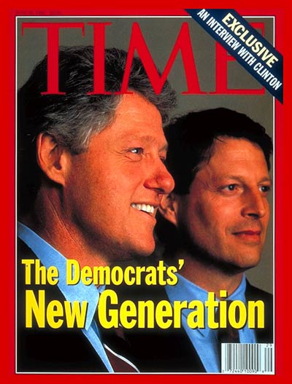
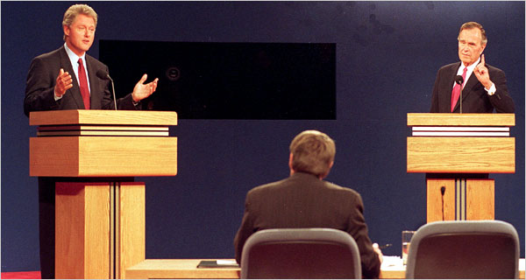
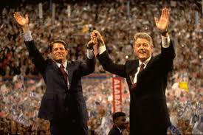
1992 Election
Running mate, Senator Al Gore of Tennessee
Three way race – Clinton (D), George H.W. Bush (R), H. Ross Perot (I) http://www.youtube.com/watch?v=EhVDL_Ah5iI
Clinton presented himself as protector of the middle class

Slide 5
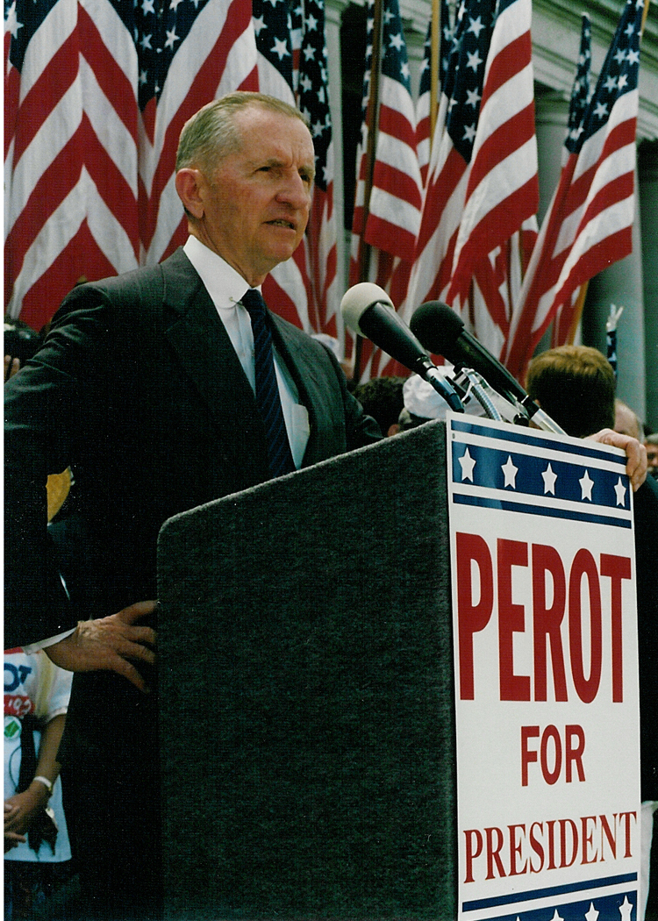
Ross Perot
Texas billionaire
Self-funded Independent Party
Govern by sound business principles
Reduce the Deficit
Opposed free-trade agreements with Mexico and Canada

Slide 6
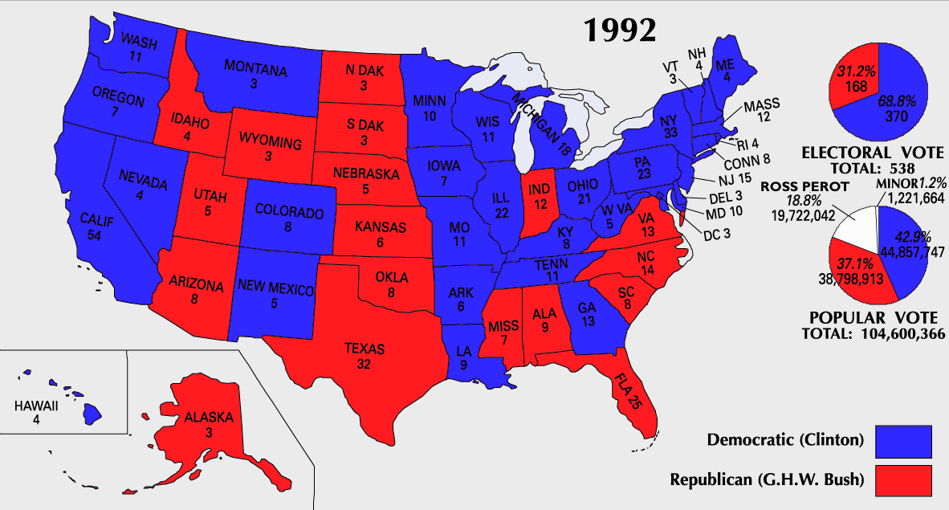
1992 Election

Slide 7
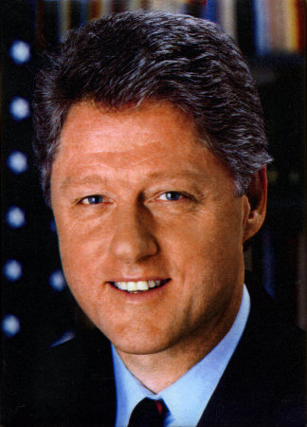
A New Democrat
Centrists who sought to reconcile liberal and conservative ideals
Strong National Defense
Tough Stands on Crime
Free Trade
Welfare Reform
Closer Ties with Corporations
Gov’t necessary but had grown too large and inefficient

Slide 8
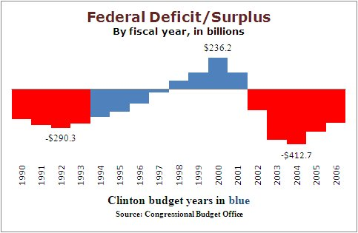
Domestic Policy – Budget Deficit
Increased taxes (went against campaign promise to middle class) to deal with budget deficit
Critics felt tax increase would hurt economy – did not
Presidency longest period of sustained economic growth in U.S. history

Slide 9
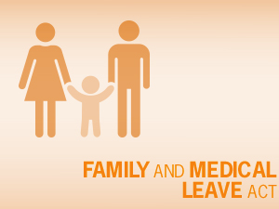
New Domestic Policies
Family Medical Leave Act – Guaranteed most full time employees 12 weeks unpaid leave for birth of child, to recover from serious illness, or care for sick family member
Raised minimum wage
Increased access to college loans and tax credits for higher education

Slide 10
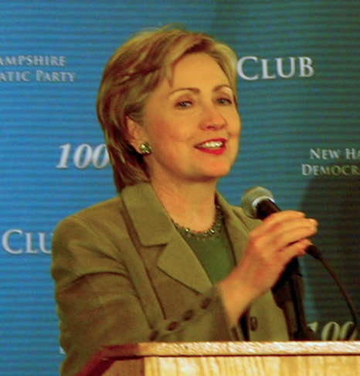
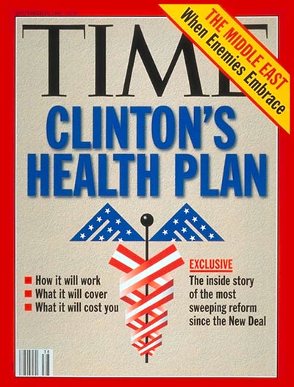
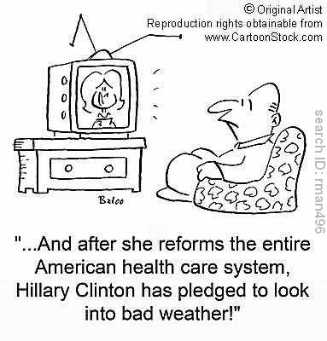
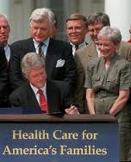
Domestic Policy – Health Care
Costs rising, millions had no health insurance
Hillary Clinton headed special task force proposing a government-sponsored program of health care
Defeated

Slide 11
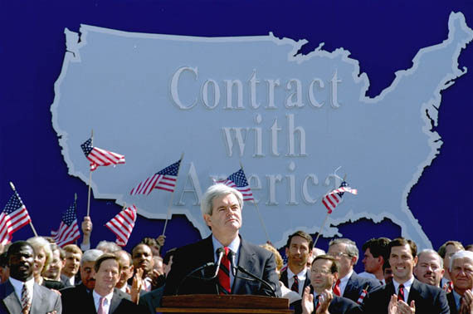
Contract with America
1994 midterm elections
Republicans won a majority in both houses of Congress
Led by Newt Gingrich

Slide 12
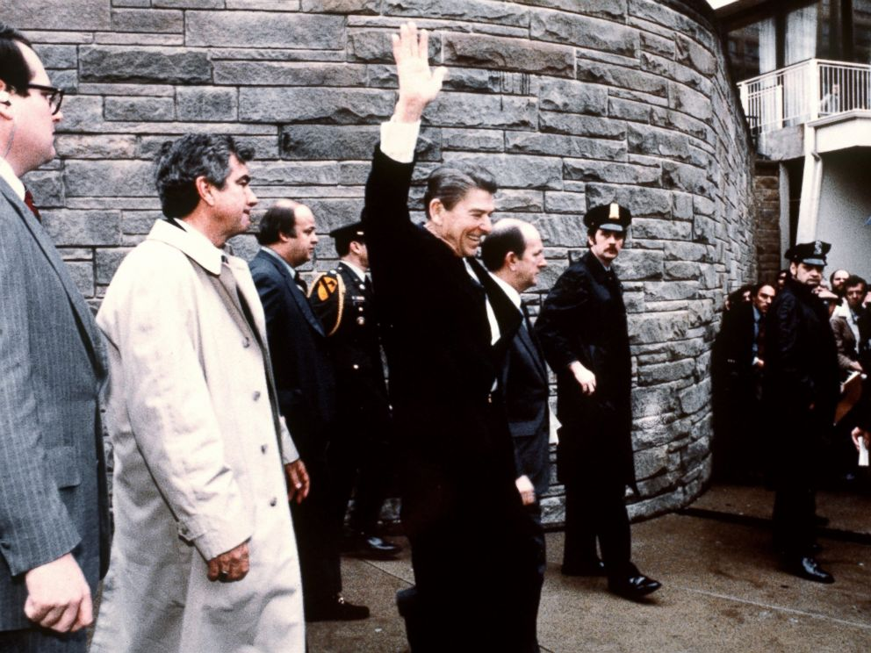
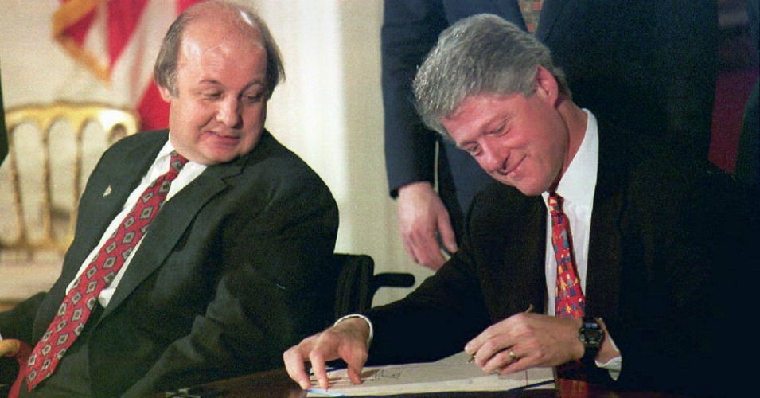
Fighting Crime
Brady Bill – Gun-control act named for presidential aide James Brady, who was wounded in the 1981 assassination attempt on President Reagan.
Congress passed $30 billion anti-crime bill which increased funding for police and banned several kinds of assault weapons.

Slide 13
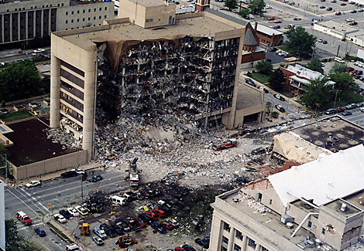
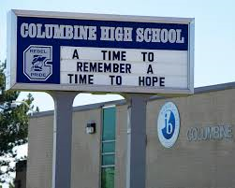
Domestic Violence
1995 - Oklahoma City Bombing – Bombing of the Federal building that killed 168 and wounded more than 800 others by Timothy McVeigh.
1999 - Columbine High School Shooting – 13 Killed and 24 wounded in Colorado High School. First mass shooting in a school. https://www.youtube.com/watch?v=AUSJ6rqEWUY

Slide 14
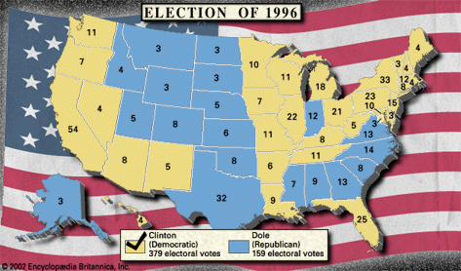
1996 Election
Democrat – Bill Clinton
Republican – Bob Dole, Senator from KS, Decorated WWII Vet.
Reform – Ross Perot

Slide 15
Balanced Budget
1997 – first balanced budget in 24 years
Congress and Clinton worked to shrink the deficit

Slide 16
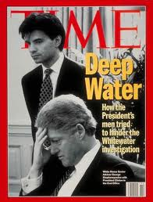
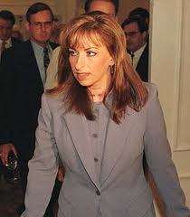
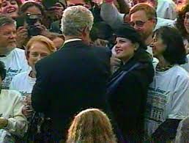
Scandals
Whitewater - Kenneth Starr led investigation into a failed real estate investment of Clintons in 1970s – no formal charges on Clintons
Paula Jones Sexual Harassment case – claimed to have taken place while Clinton was governor and she a state employee – case thrown out
Monica Lewinsky case – Clinton accused of lying under oath about his relationship with Lewinsky while he was president and she a White House intern

Slide 17
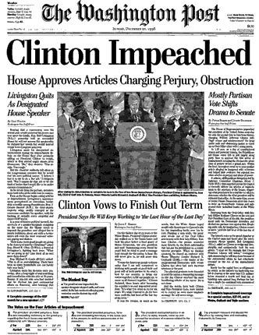
Impeachment
Dec. 19, 1998 – the House passed two articles of impeachment (perjury and obstruction of justice) against Clinton
Senate did not have 2/3 majority to remove Clinton from office

Slide 18
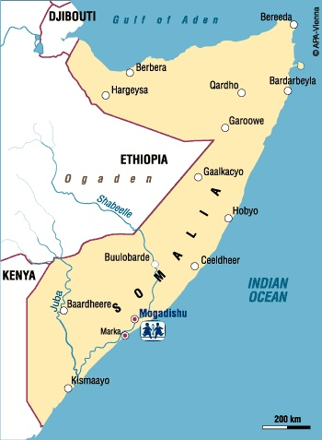
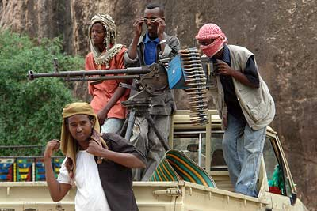
Somalia
Civil War led to collapse of Government and widespread famine
1992-1994 US led multinational force to bring peace and distribute food
Oct. 1993 – 18 American soldiers killed as part of a peacekeeping force (Black Hawk Down)
Withdrew troops shortly after
https://www.youtube.com/watch?v=P6fMLoVATck

Slide 19
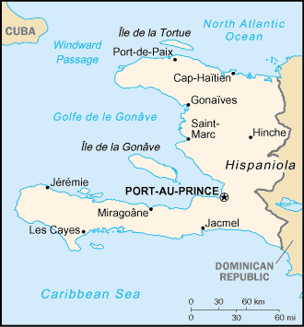
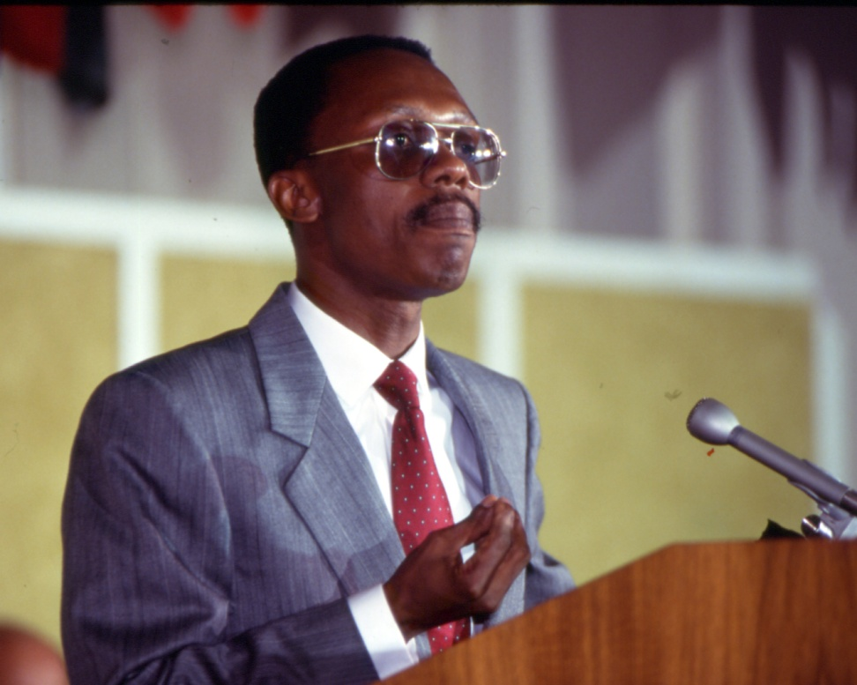
Haiti
Military coup overthrew President Aristide. It sent thousands of Haitians in boats to the U.S.
The military mission changed from a combat operation to a peace-keeping and nation-building operation at that point with the deployment of the U.S.-led multinational force in Haiti
1994, U.S. troops restore Jean-Bertrand Aristide to power

Slide 20
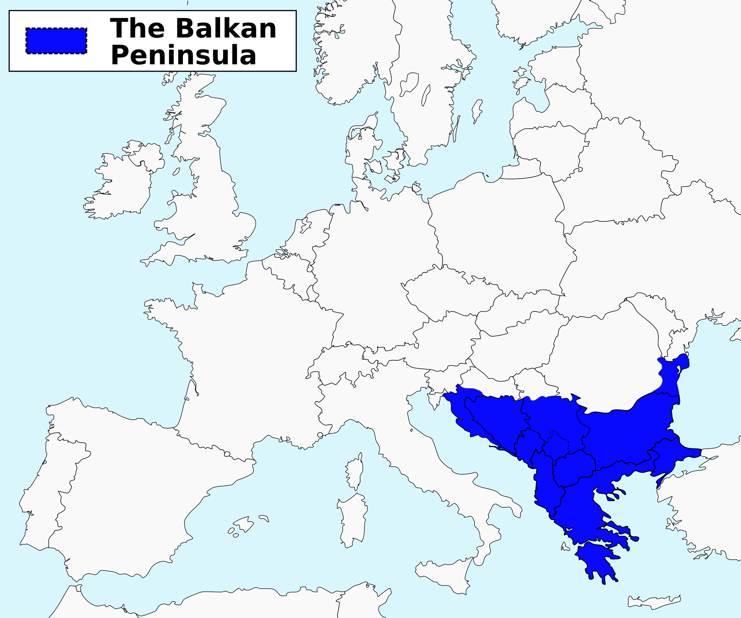
Balkan Crisis
The collapse of communism broke up the country of Yugoslavia
4 of Yugoslavia’s 6 major republics break away
Long suppressed ethnic and religious hostilities erupted
Civil War began in newly independent Bosnia and Herzegovina between Serbs (Eastern Orthodox), Croats (Catholic), and Bosnian Muslims.
Serbs attack Croats and Bosnians - began ethnic cleansing – state sanctioned mass murder, violence
UN (and US) intervenes with humanitarian aid

Slide 21
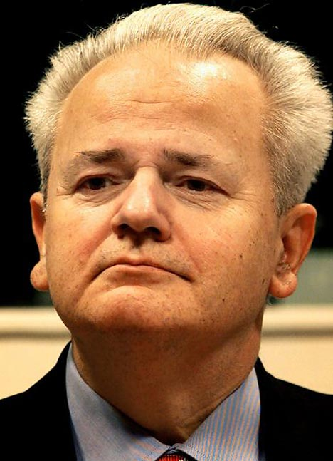
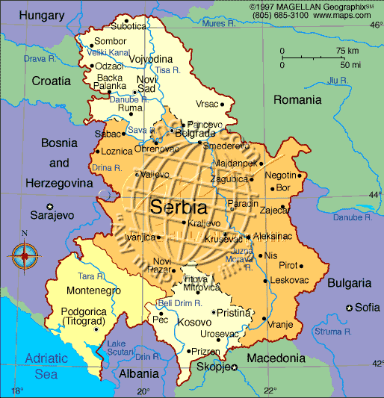
Serbia
Slobodan Milosevic led an ethnic cleansing to remove Muslims from this region
1995 – U.S. sent peacekeeping troops with NATO
Bombed Serbian Stongholds
Dayton Accords – established a federated multi-national Bosnia
Ended ethnic cleansing
War in Bosnia and U.S. Involvement

Slide 22
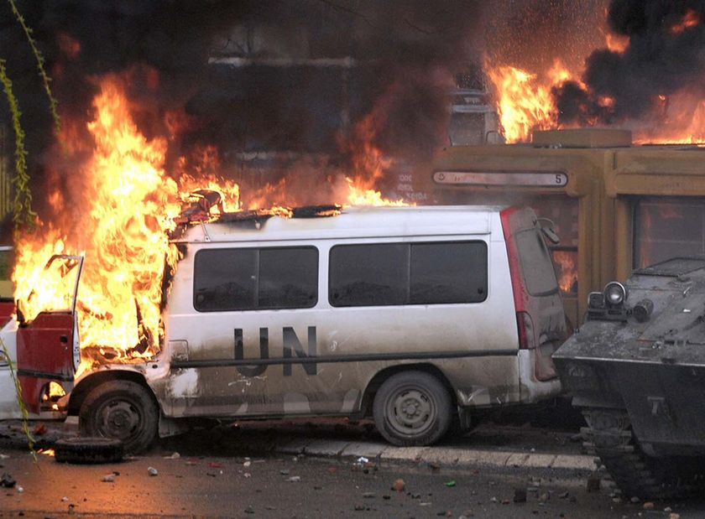
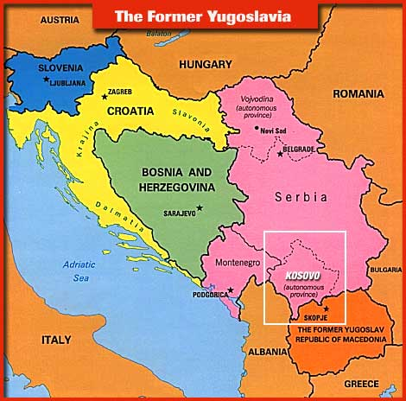
Kosovo
1998 Fighting began again in Kosovo
Russian Orthodox Serbs attempted to drive Albanian Muslims out of the country
US joined with NATO to send troops

Slide 23
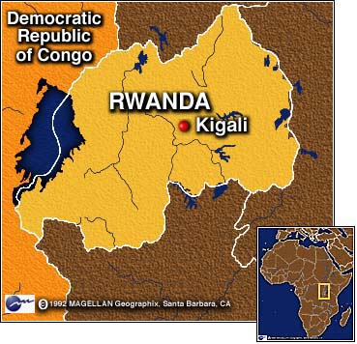
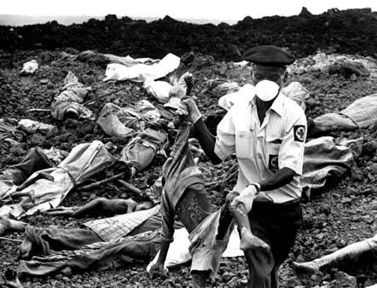
Rwanda
Ethnic genocide killed 800,000 people
Rwanda’s majority Hutu population killed the minority Tutsi population
2,000,000 flee the country
UN forces called in - ineffective
Clinton refused to send troops

Slide 24
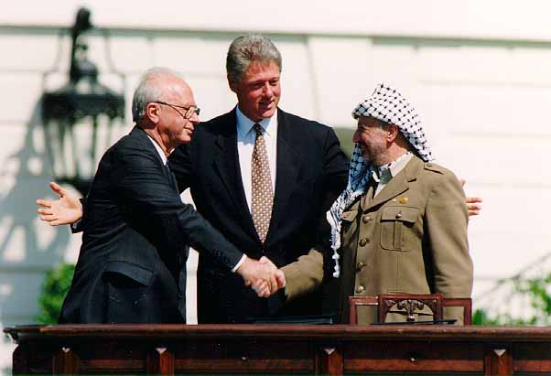
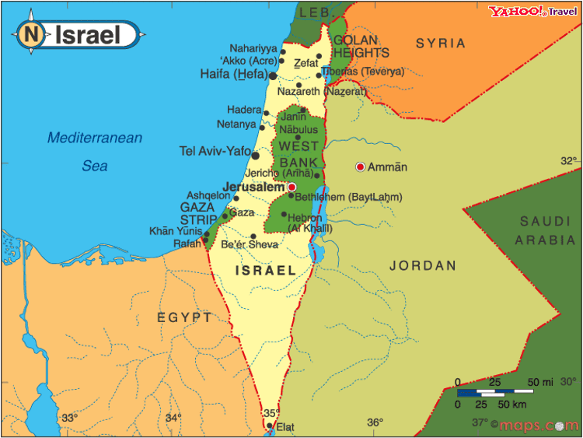
Israel
Oslo Accords (1993) - Peace agreement between Israelis (Rabin) and Palestinians (Arafat)
Promised Palestinian self-rule in Jericho and the Gaza Strip and security for the Israelis
Did not address issues of Israeli settlement of the West Bank
Extremists on both sides had no interest in compromise

Slide 25
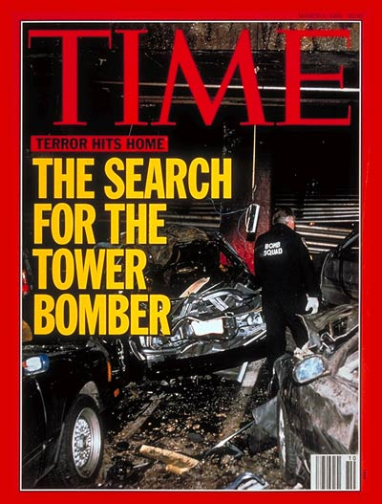
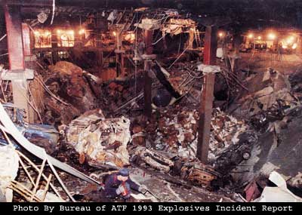
1993 Bombing
World Trade Center bombed by radical Muslims
A truck bomb exploded in the parking garage
6 people killed, hundreds injured

Slide 26
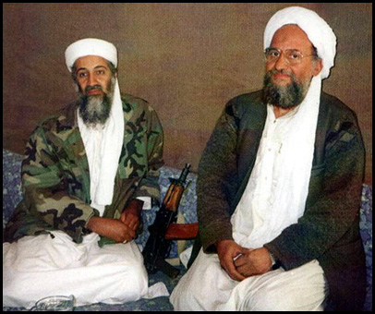
Al Qaeda
Network of terrorists organized by wealthy Osama bin Laden
No policy developed for dealing with Muslim extremists
1998 - American embassies in Nairobi, Kenya and in Dar es Salaam bombed killing 225 and injuring more than 5,500 others

Slide 27
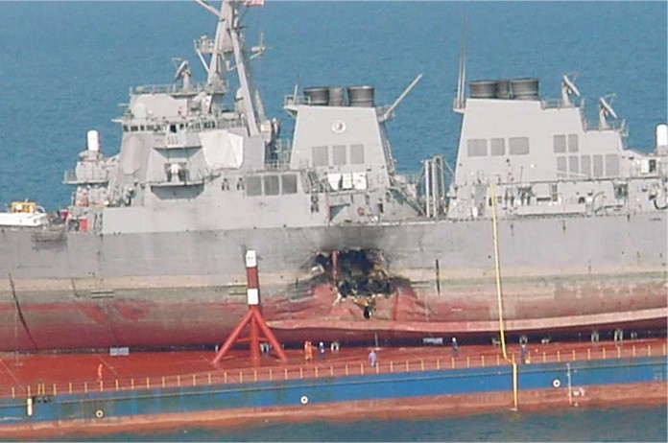
USS Cole
2000, American Warship off the coast of Yemen, in the middle East
Bombed by Muslim terrorists while in port at Yemen
17 American sailors killed

Slide 28
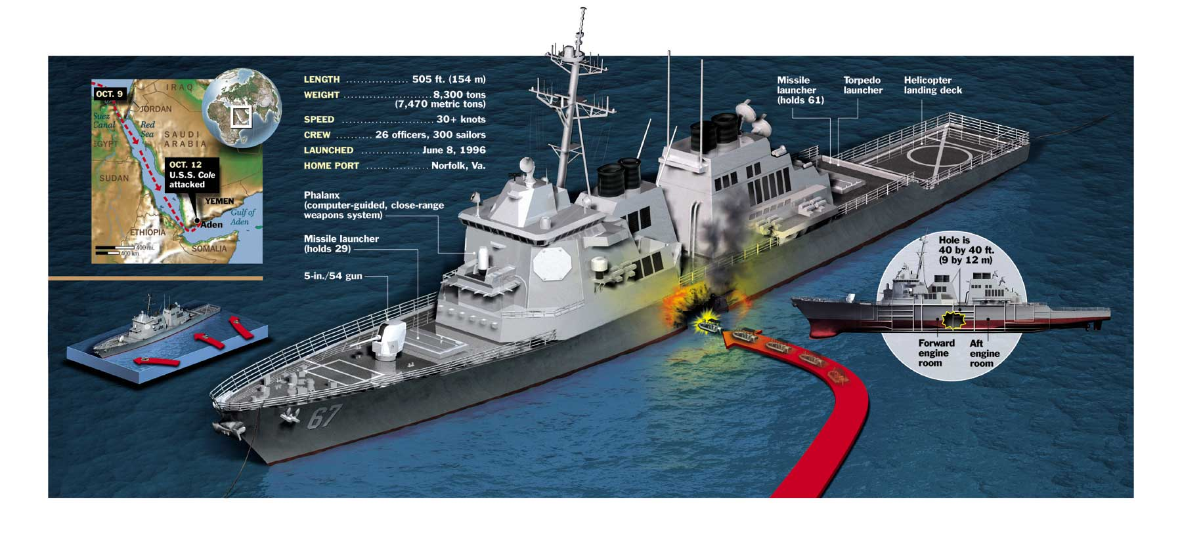

Slide 29
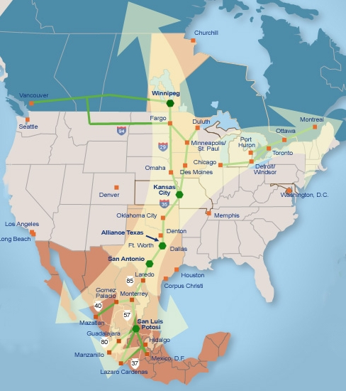
NAFTA
1993 – U.S., Canada, and Mexico formed the North American Free Trade Agreement
Eventual creation of a free-trade zone
GATT:
a revision of General Agreement on Tariffs and Trade (GATT) in 1994.

Slide 30
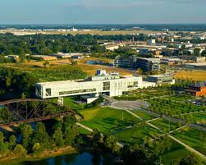
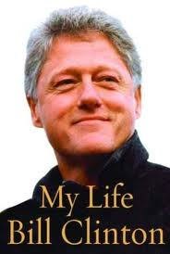
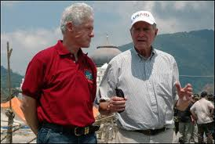
Post-presidency
Autobiography – My Life, New York Times bestseller list
Presidential library –2004, Little Rock, AR
Humanitarian efforts in Africa and Asia, AIDS epidemic
Clinton and former President Bush - humanitarian relief, victims of tsunami along coasts of Indian Ocean (2004)
Clinton involved in relief efforts for victims of Hurricane Katrina (2004) and created the Haiti Fund to support Haitians after the earthquake (2010)

