Slide 1
A NOTE FROM GIANNI
I TEACH 12TH GRADE PSYCHOLOGY
HONORS
REGULAR
I TEACH 10TH GRADE WORLD HISTORY
HONORS
REGULAR
SINCE 1986….1993 HERE @NSD!

Slide 2
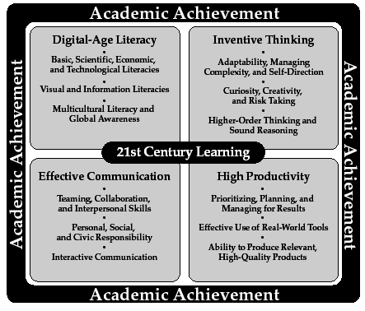

Slide 3
TOOLS FOR SUCCESS
TIME MANAGEMENT
ORGANIZATION
QUALITY PRODUCT
MEETING DEADLINES
PROACTIVE ASSERTIVENESS
PERSONAL RESPONSIBILITY/INTEGRITY

Slide 4
KEY TO SUCCESS FOR GIANNI’S CLASS
BE PREPARED
FOLLOW THE ROUTINE – FIRST 2 THINGS IN CLASS!
PLANNER – CHECK EDMODO
TABLE OF CONTENTS
NO ELECTRONICS OUT UNLESS INSTRUCTED TO DO SO
FOLLOW DIRECTIONS 1ST TIME GIVEN
ENGAGE IN THE DISCUSSION
SHOW WHAT YOU KNOW!

Slide 5
WHAT TO DO WHEN YOU ARE HOME….
1. CHECK EDMODO – TO UPDATE YOUR CALENDARS OR SCHEDULES
2. REVIEW THE DAY’S WORK = DAILY
HIGHLIGHTER, TEXTBOOK , NOTEBOOK , POST ITS
3. PRETEND YOU ARE GIANNI AND USE THE POSTITS TO CREATE 1-3 QUESTIONS PER PAGE OF NOTES(IT IS WHAT I DO)

Slide 6
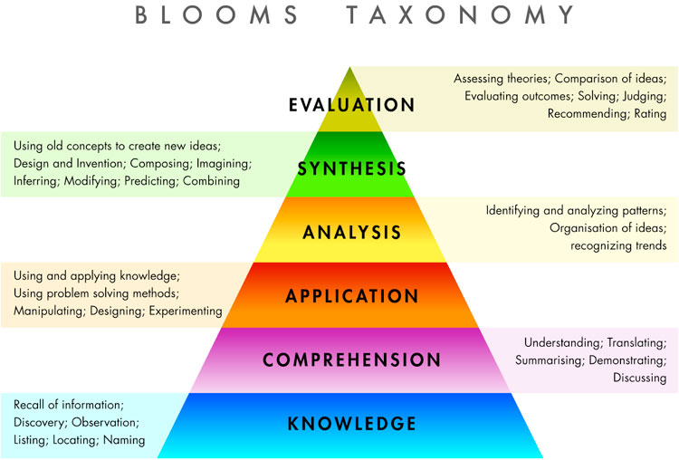
2 MPS= HALF YEAR
1 INTRO PSYCH
6 PERSPECITIVES
2 THE BRAIN
3 PERSONALITY
4 INTELLIGENCE
5 CONSCIOUSNESS
6 HUMAN
DEVELOPMENT
7 MENTAL ILLNESS
TREATMENTS
sgianni@neshaminy.k12.pa.us
WORLD HISTORY/PSYCHOLOGY
THINGS TO KNOW
CLASS IS A REQUIRED
5 QUALITY POINTS TO PASS THE CLASS
GRADE BREAKDOWN
MP GRADES
A=8
B=6
C=4
D=2
FINAL EXAM GRADES
A=4
B=3
C=2
D=1
IDEAL
HUMAN=
CREATIVE
PRODUCTIVE
TEACHES
OTHERS
Nanny McPhee
There is something you should understand about the way I work. When you need me but do not want me, then I must stay. When you want me but no longer need me, then I have to go. It's rather sad, really, but there it is.
TOP 5 ESSENTIALS
1 Check student’s calendar
2 15 min. nightly review
3 Written homework 2-3x
4 5 Interactive Notebook & Text
5 Check website & EDMODO
for
Models, PPTS.,
Uploaded class material &
THE PLANNER!
EXTRA-EXTRA
Edmodo.com
ASK FOR THE CODE!
2 MPS= HALF YEAR
INTRO PSYCH
6 PERSPECITIVES
2 THE BRAIN
PERSONALITY
INTELLIGENCE
CONSCIOUSNESS
HUMAN
DEVELOPMENT
MENTAL ILLNESS
TREATMENTS
6 PERSPECTIVES
sgianni@neshaminy.k12.pa.us
WORLD HISTORY/PSYCHOLOGY
THINGS TO KNOW
CLASS IS A REQUIRED
5 QUALITY POINTS TO PASS THE CLASS
GRADE BREAKDOWN
MP GRADES
A=8
B=6
C=4
D=2
FINAL EXAM GRADES
A=4
B=3
C=2
D=1
Nanny McPhee
There is something you should understand about the way I work. When you need me but do not want me, then I must stay. When you want me but no longer need me, then I have to go. It's rather sad, really, but there it is.
Nanny MacPhee
IDEAL
HUMAN=
CREATIVE
PRODUCTIVE
TEACHES
OTHERS
TOP 5 ESSENTIALS
1 Check student’s calendar
2 15 min. nightly review
3 Written homework 2-3x
4 5 Interactive Notebook & Text
5 Check website for Models, PPTS.,
Uploaded class material & THE ESSENTIAL CLASS
CALENDAR!!!!!
EXTRA-EXTRA
Edmodo.com
Psych=z7zntp

Slide 7
WH=1ST & 2ND MP’S
1 5 THEMES OF GEOGRAPHY
INTRO-GRMA
2 RENAISSANCE
TRANSFER TASK
ISLAMIC EMPIRE
3 REFORMATION
4 EXPLORATION/
SCIENTIFIC
REVOLUTION
5 AGE OF ABSOLUTISM
ENLIGHTENMENT
END OF JANUARY
MIDTERM
WH=3RD & 4TH MP’S
6 FRENCH REV & LATIN AM
7 INDUSTRIAL REVOLUTION
TRANSFER TASK
8 IMPERIALISM
9 GREAT WAR
10 INTERWAR YEARS & WWII
JUNE
FINAL
sgianni@neshaminy.k12.pa.us
WORLD HISTORY/PSYCHOLOGY
IDEAL
HUMAN=
CREATIVE
PRODUCTIVE
TEACHES
OTHERS
IDEAL
HUMAN=
CREATIVE
PRODUCTIVE
TEACHES
OTHERS
Nanny McPhee
There is something you should understand about the way I work. When you need me but do not want me, then I must stay. When you want me but no longer need me, then I have to go. It's rather sad, really, but there it is.
TOP 5 ESSENTIALS
1 Check student’s calendar
2 15 min. nightly review
3 Written homework 2-3x
4 5 Interactive Notebook & Text
5 Check website for Models, PPTS.,
Uploaded class material & THE ESSENTIAL CLASS
CALENDAR!!!!!
EXTRA-EXTRA
Edmodo.com
WH=89u618

Slide 8
VARIOUS TECHNIQUES USED TO ENGAGE THE LEARNER
CURRENT EVENTS EACH MARKING PERIOD
THE USE OF “FLIPPED CLASSROOM”
THE USE OF TECHNOLOGY BASED ASSESSMENT
THE USE OF PERFORMANCE BASED ASSESSMENT
THE EDMODO
2 MPS= HALF YEAR
INTRO PSYCH
6 PERSPECITIVES
2 THE BRAIN
PERSONALITY
INTELLIGENCE
CONSCIOUSNESS
HUMAN
DEVELOPMENT
MENTAL ILLNESS
TREATMENTS
6 PERSPECTIVES

Slide 9
Additional Information:
I am available during my lunch and prep periods
I am the after school tutor on Tuesdays and Thursdays
I am easily reached via email: sgianni@neshaminy.k12.pa.us

