Slide 1
THE ANSWERS

Slide 2
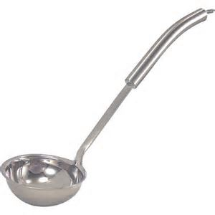
1. Ladle
For reaching to the bottom of deep pots and transferring liquids.

Slide 3
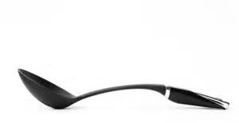
2. Large Spoon
Used to stir and serve

Slide 4
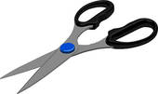
3. Kitchen Shears
Used for a variety of cutting chores, such as snipping string, butcher’s twine, or trimming artichoke leaves.
To be used only in the kitchen with foods, not for household use

Slide 5
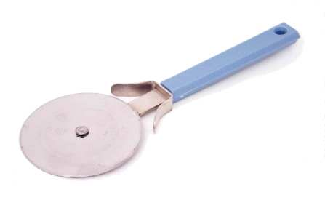
4. Pizza Cutter
For cutting baked pizza into serving pieces. It can also be used to cut pies.

Slide 6
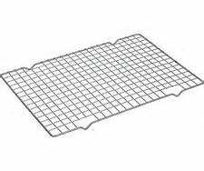
5. Cooling Rack
Allows baked products to cool without damaging the counter.

Slide 7
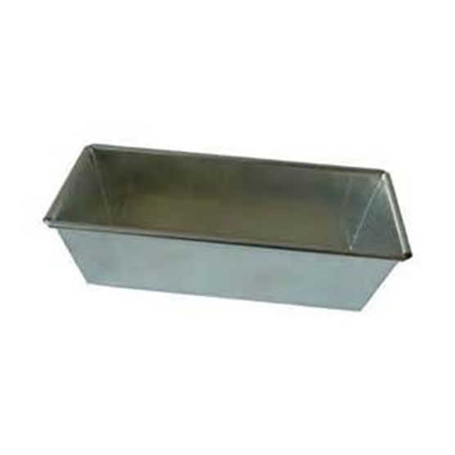
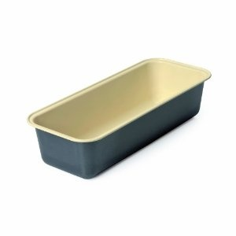
6. Bread or Loaf Pan
Used to bake bread and quick breads in.

Slide 8
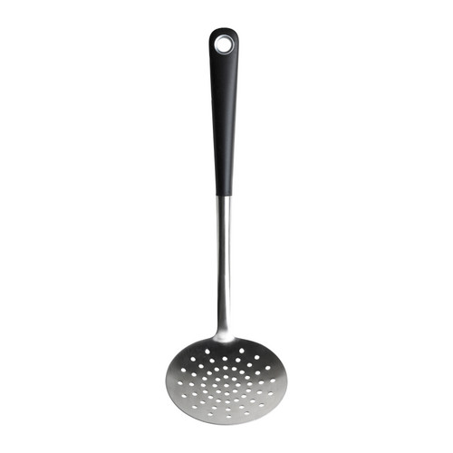
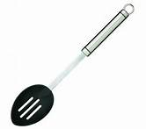
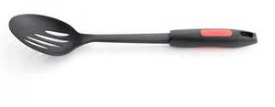
7. Slotted Spoon
Used to transfer solid food from liquid, and to skim impurities from the top of liquids.

Slide 9
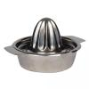
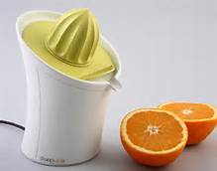
8. Juicer
Used to break up food's fibers (citrus fruits: lemon, orange, lime, etc.), thus releasing their juices

Slide 10
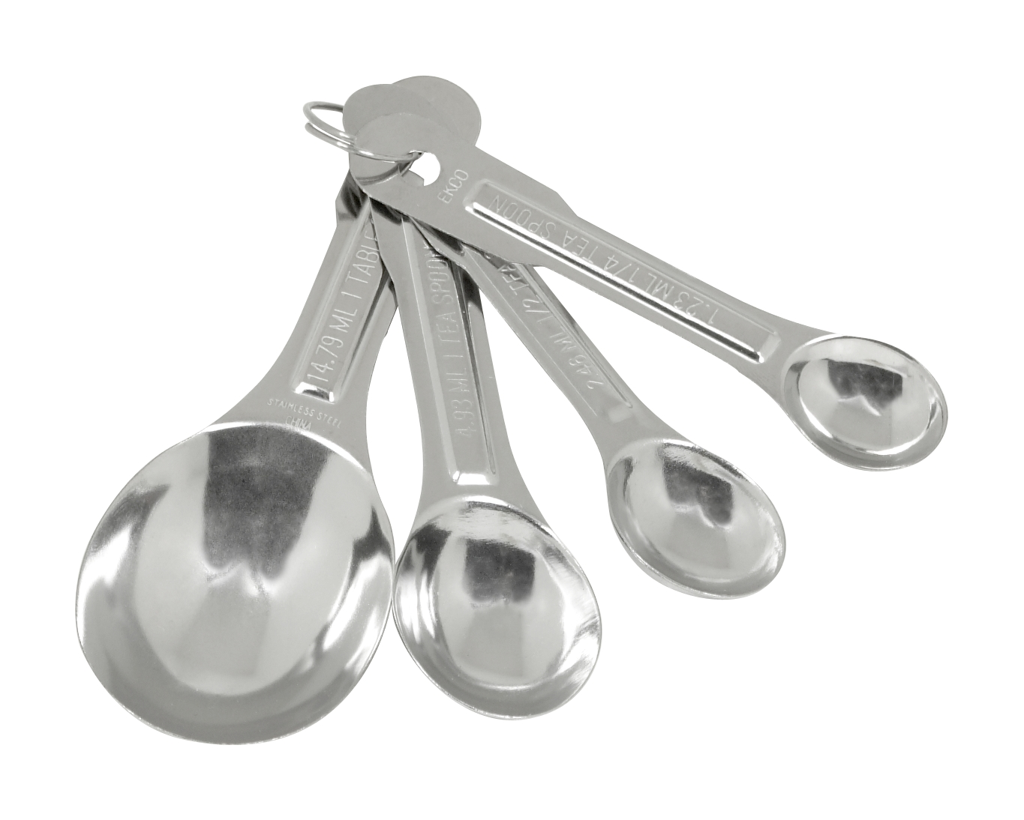
9. Measuring Spoons
A set of individual plastic or metal utensils, ranging in increments of: ¼ teaspoon, ½ teaspoon, 1 teaspoon and 1tablespoon.
Used to measure liquid or dry ingredients

Slide 11
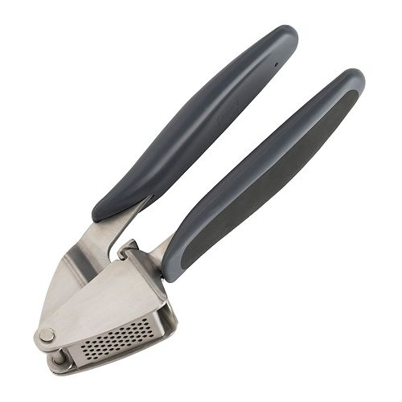
10. Garlic Press
Used to mince garlic by pressing garlic cloves through the fine holes on the garlic press.

Slide 12
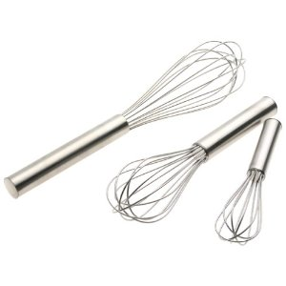
11. Whisks
Used to hand beat, incorporate, whisk, blend, and stir. Not used for heavy batters.

Slide 13
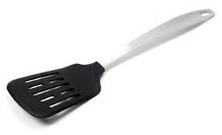
12. Pancake Turner or Spatula
Used to lift and turn foods, such as pancakes and cookies, so they can cook on both sides

Slide 14
13. Chef’s Knife
An all purpose knife, used for chopping, dicing and mincing.

Slide 15
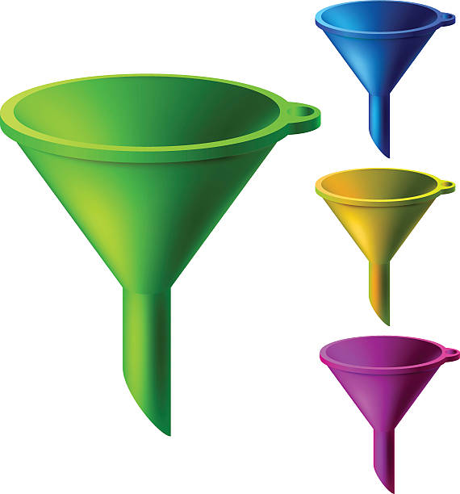
14. Funnel
A funnel is a pipe with a wide
mouth and a narrow stem.
It is used to channel liquid or
fine-grained substances
into containers with a
small opening

Slide 16
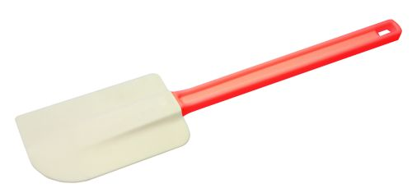
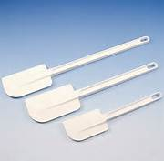
15. Rubber Spatula or Rubber Scraper
Used to scrape food from the inside of bowls and pans.
It is also used to fold in whipped cream or egg whites.

Slide 17
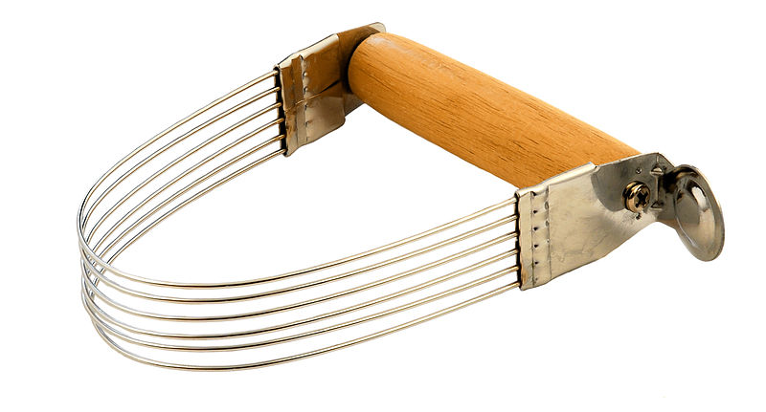
16. Pastry Blender
Used to cut flour into fat, allowing small pieces of fat to be surrounded by flour. This makes pie crusts and pastries flaky.

Slide 18
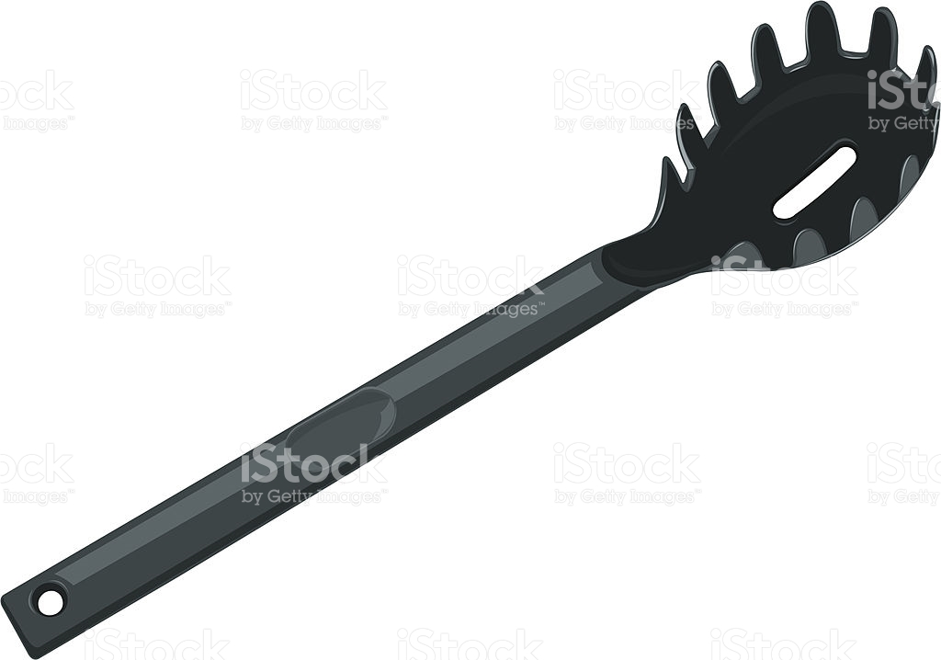
17. Spaghetti Spoon
The Hole in Your Spaghetti Spoon Serves a Handy Purpose. Eyeballing perfect portions of dry pasta is a difficult skill to master—there are kitchen gadgets made for that specific reason alone. ... As you can see from the picture, the hole is the right size to measure out a single portion of spaghetti.

Slide 19
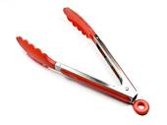
18. Tongs
Metal, wooden, or plastic pinching tools used to grab foods without using your hands or fingers.

Slide 20
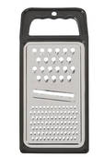
19. Grater
The grater has different sized holes that determine the size of the grated food pieces, from slices to shreds to crumbs

Slide 21
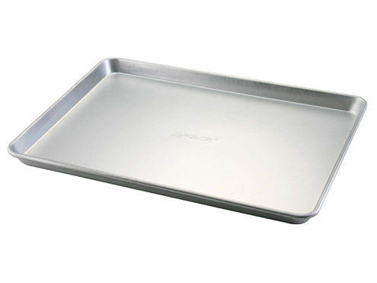
20. Jelly Roll Pan
Specifically made for baking cookies, cakes, and jelly rolls.

Slide 22
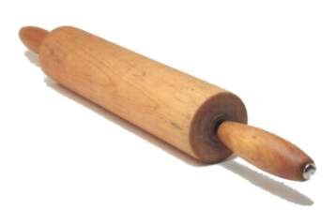
21. Rolling Pin
Is used to stretch and roll dough, such as pie crusts, cookies, and biscuits.
Some have no handles. Some are made of marble

Slide 23
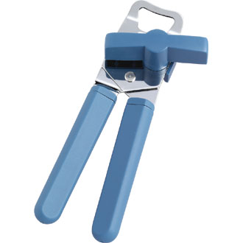
22. Can Opener
Used to remove lids from tops
of cans

Slide 24
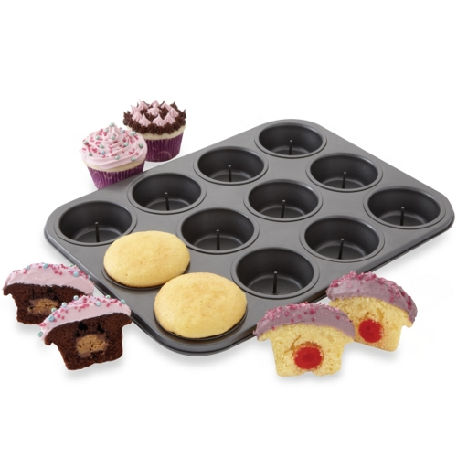
23. Muffin Pan
To make muffins or cupcakes

Slide 25
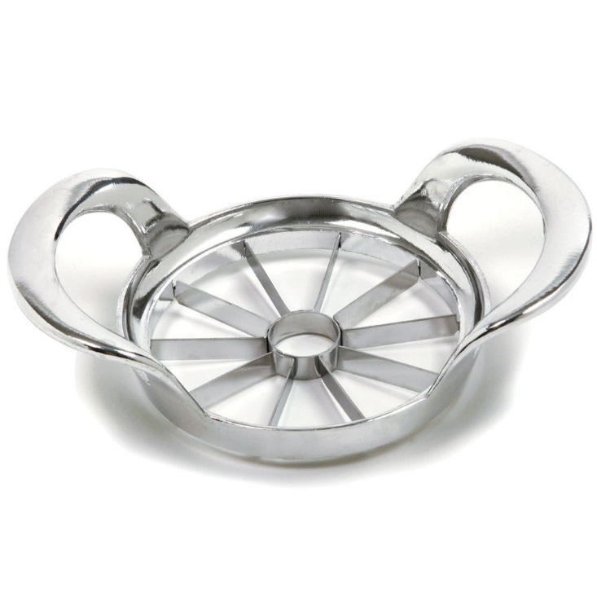
24. Apple Slicer
Slices and cores hard fruits
like apples

Slide 26
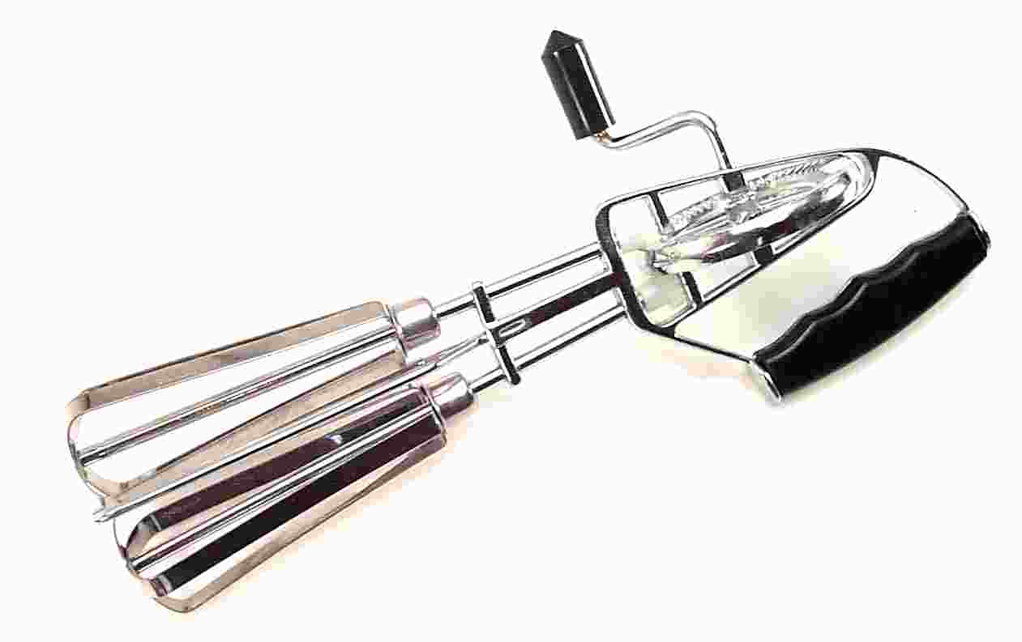
25. Eggbeater / Rotary Beater
Used to beat foods to incorporate air in such foods as eggs, egg whites, whip cream etc.

Slide 27
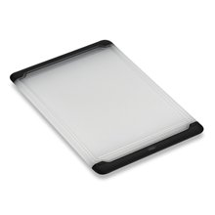
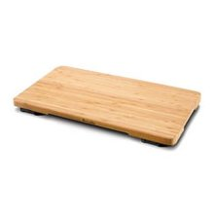
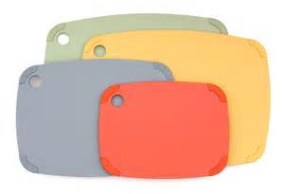
26. Cutting Board
A hard surface on which you place foods to be cut.
These are made of plastic, wood and even glass, and are available in a variety of sizes

Slide 28
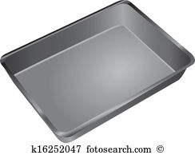
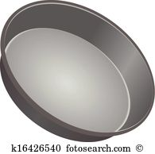
27. Cake Pans
Available in round, square, or
rectangular.
Also available in many sizes and
made from metal, glass,
ceramic, or silicone.

Slide 29
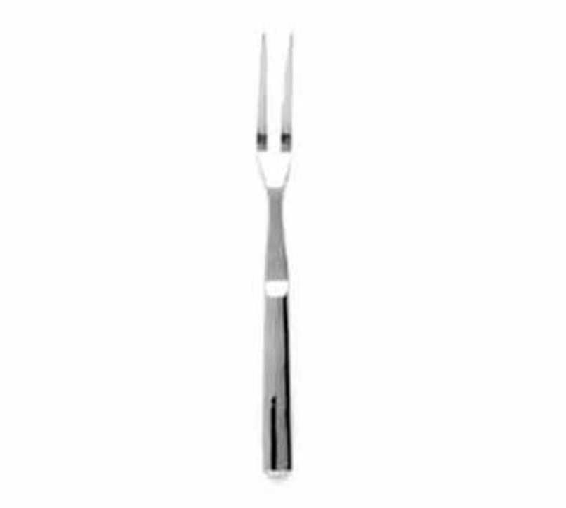
28. Two Tined Meat Fork
Is used to lift and turn meat and other foods. It is also used to hold larger pieces of food when cutting them.

Slide 30
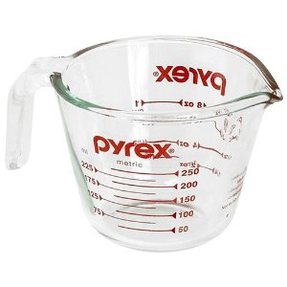
29. Liquid Measuring Cup
These come in 1, 2, 4 and 8 cup capacities. Also available in plastic.
Used for measuring liquid ingredients (milk, water, etc.)
Place on a leveled surface and check at eye level for accurate measuring

Slide 31
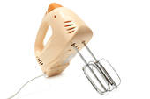
30. Electric Hand Mixer
Used to mix foods that require time and endurance: whipping cream, whipping egg whites, mixing batter, etc.

Slide 32
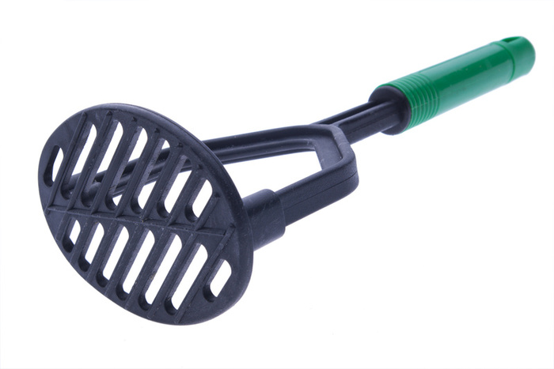
31. Masher or Ricer
Used to break up solid foods: boiled fruits or vegetables.

Slide 33
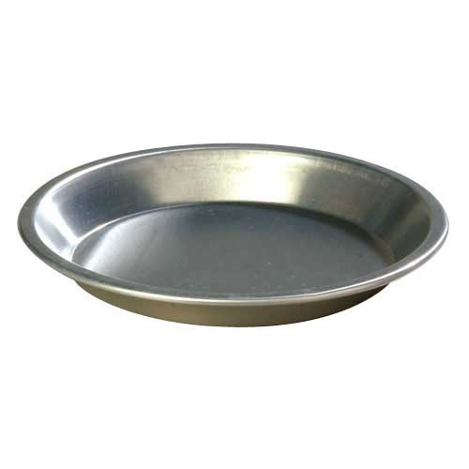
32. Pie Pan
Used to bake pies.
Sides are sloped in a pie pan, whereas the sides are straight in a cake pan.

Slide 34
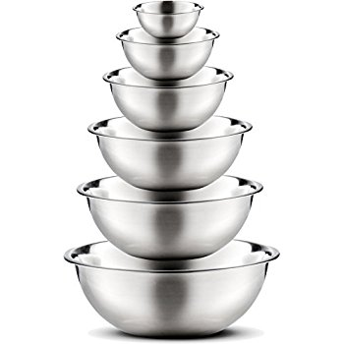
33. Mixing Bowls
Holds ingredients as you mix .
May have a lip, straight or angled
sides. Can be made from glass,
metal, or plastic.

Slide 35
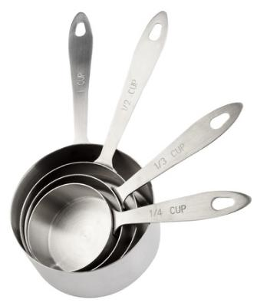
34. Dry Measuring Cups
Used for measuring dry ingredients.
Measuring cups come in ¼ c, 1/3 c, ½ c, and 1 cups

Slide 36
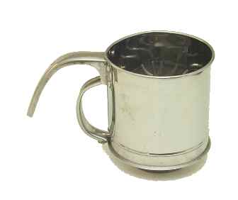
35. Sifter
Used to aerate, combine, and eliminate lumps in foods such as flour, powdered sugar, and cocoa.

Slide 37
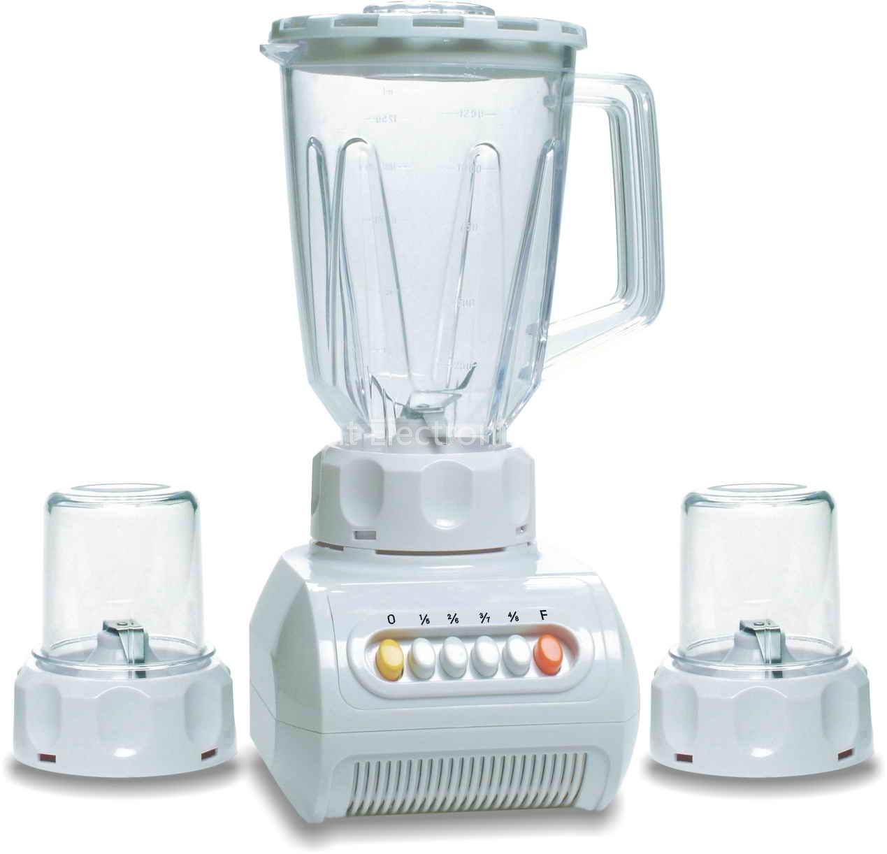
36. Blender
Used to liquefy foods quickly: sauces, soups, etc.

Slide 38
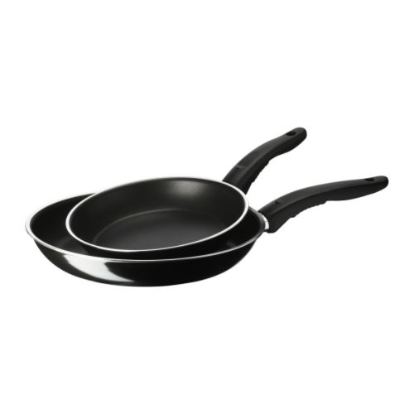
37. Sauté, Frying Pan, or Skillet
Used to sauté and fry foods. The slope-sided pan allows the chef to flip items without using a spatula.

Slide 39
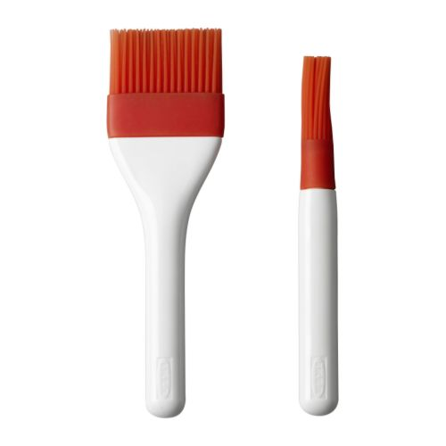
38. Pastry Brush
Used to brush sauce onto food, glazes on desserts, greasing cake pans, etc.

Slide 40
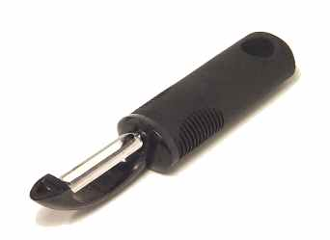
39. Vegetable Peeler
Used to peel the skin off fruits and vegetables. It can also be used to make delicate garnishes, such as carrot curls and chocolate curls.

Slide 41
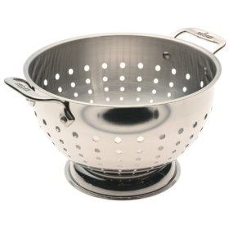
40. Colander
Used for rinsing and draining foods.

Slide 42
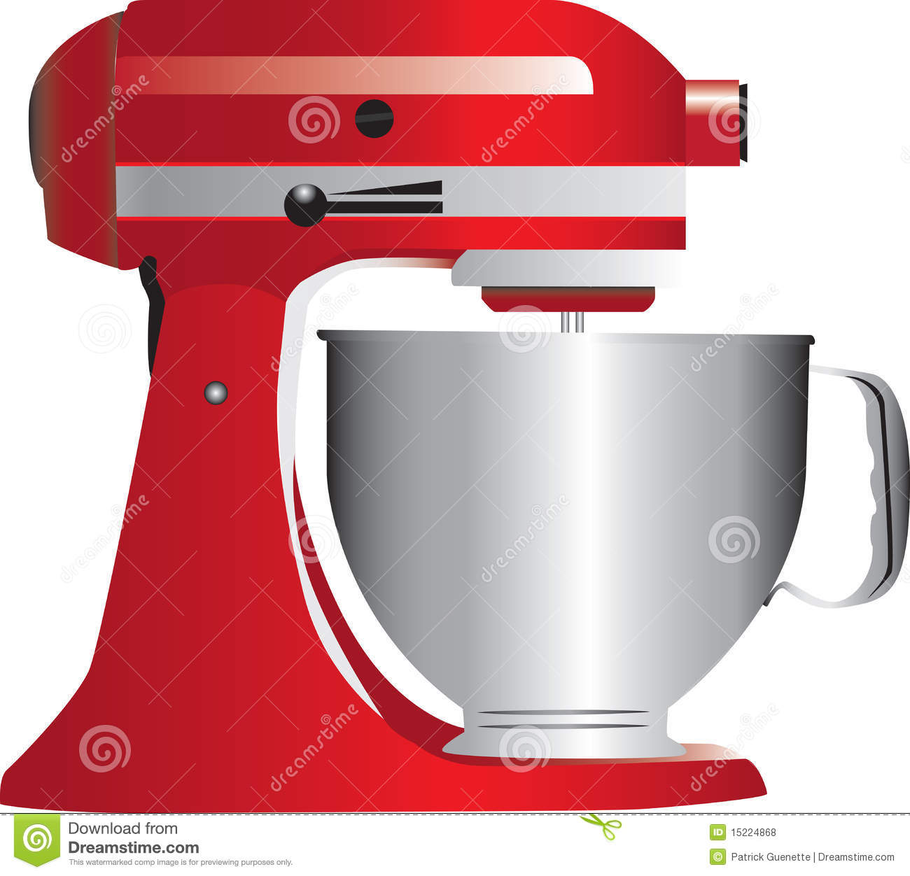
41. Stand Mixer
Hands free mixing appliance
Used for blending, beating and
whipping ingredients.

Slide 43
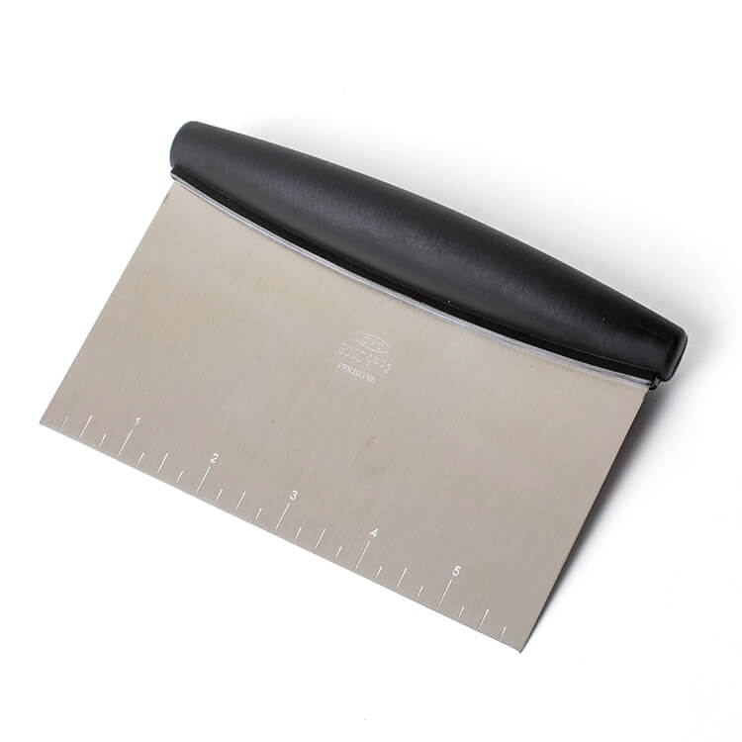
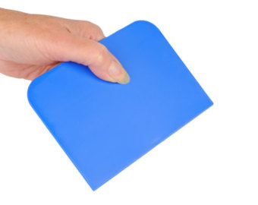
42. Bench Scraper
Bakers and pastry chefs use this tool to help pick up, turn, and portion dough

Slide 44
43. Sauce Pan
Primarily used for heating and cooking food in liquid.
Sauce pans come in many sizes in order to accommodate a variety of needs.

Slide 45
44. Straight Edge Spatula
Used for leveling dry measuring cups and spreading icing on cakes.

Slide 46
45. Casserole Dish
Baking dishes with high sides
and covers.
Designed to go from freezer
to oven to tabletop.

Slide 47
46. Double boiler
To heat or melt delicate foods, such as butter, chocolate, and puddings.

Slide 48
47. Strainer or Sieve
Strainer can be used to drain pastas, vegetables, and stocks, or sift foods like powdered sugar, flour, chocolate etc.

