Slide 1
Communists Take Power in China

Slide 2
Early Source of Distrust…
European nations (and US) carved out “spheres of influence” throughout 1800’s
President Wilson did not intervene when Japan gained territory during WWI despite belief in self-determination
Two political parties competed for power until 1920’s (Nationalists & Communists)

Slide 3
Rise of Nationalists…
By 1928 Jiang Jieshi (Chiang Kai-shek) called himself ruler
recognized by US and became important trade partner

Slide 4
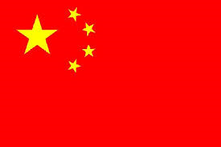
Communists Wage War Against Nationalists
1927-1937: Communist forces led by Mao Zedong wage war against the Nationalist Government

Slide 5
Japan Invades China
1937-1945: Japan invades China as part of WWII
The two parties form a united front to fight the invading Japanese

Slide 6
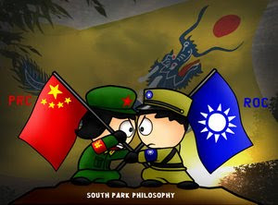
WWII Ends, Civil War Continues
The two sides continued fighting after the War
The Communists had gained control of much of northern China
The Nationalists controlled much of the South and the major cities

Slide 7
U.S./U.S.S.R. Take Sides
The United States supported the Nationalists
The Soviet Union supported the Communists
Helped increase the fear of Communism spreading

Slide 8
Communists are Victorious
Reasons Why Communists Won
Reasons Why Nationalists Lost
Nationalists lost popularity
Policies led to widespread economic hardship
Corruption in government
Foreign Influence (U.S.), Imperialist powers
Support of the Peasants – they suffered from brutal landlords and heavy taxes
Women wanted equal rights – women treated as second class citizens
Guerilla Tactics

Slide 9
Nationalist Flee Homeland
Nationalists lose revolution and establish a government in exile on the island of Taiwan
U.S. continue to support government as the rightful representatives of China

Slide 10
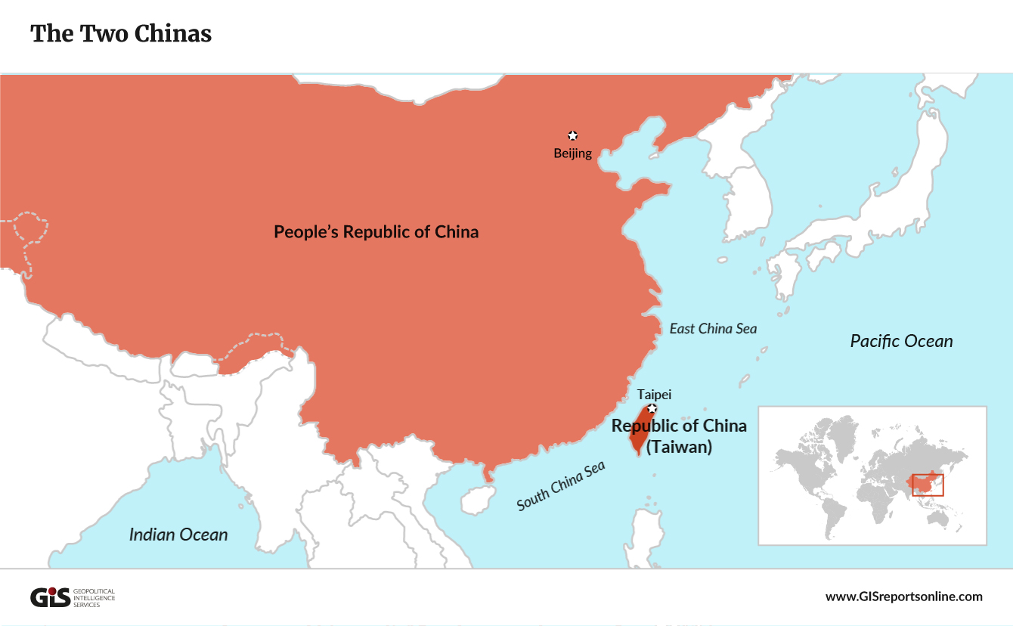
People’s Republic Of China
Communists establish the People’s Republic of China
America leaders saw it as a communist threat to all of Asia

Slide 11
The Great Leap Forward
An attempt to make a superhuman effort to increase farm and industrial output
Created Communes, to increase agricultural output
Set up small-scale “back-yard” industries to produce steel and other products
Disaster – produced low-quality , useless goods and decreased farm production
Along with natural disasters led to mass starvation – tens of millions starve to death

Slide 12
Great Leap Forward
https://www.youtube.com/watch?v=hlbB3cmgPmo
What new information about the Great Leap Forward did you learn from the video?

Slide 13
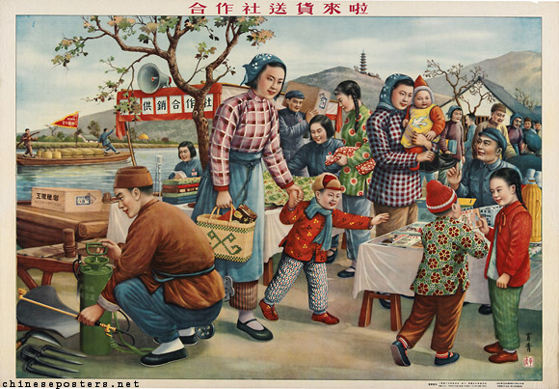
Communist Propaganda of the Great Leap Forward
Do the people look happy in the picture? Should they be?

Slide 14
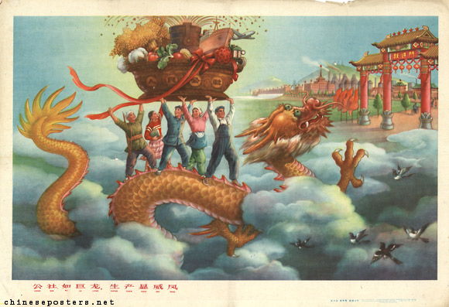
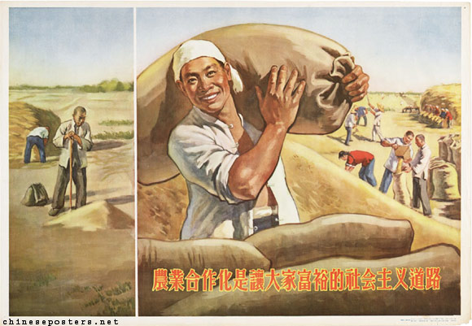
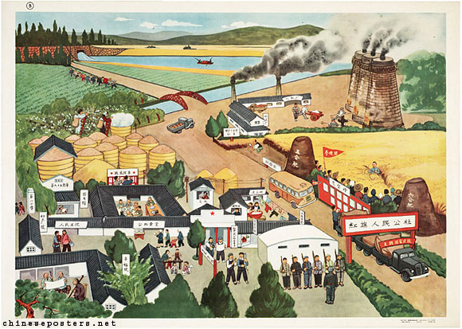
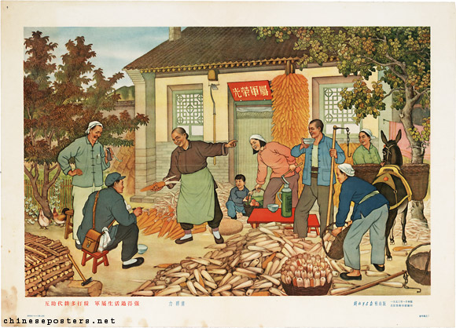
Communist Propaganda of the Great Leap Forward

Slide 15
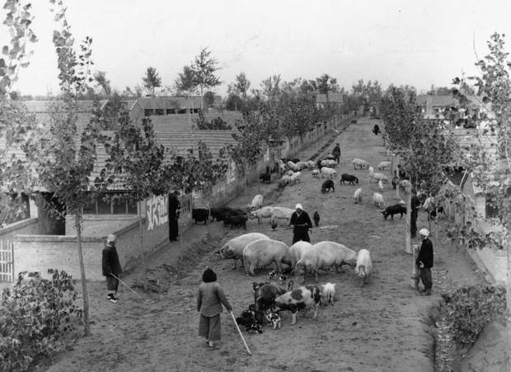
Great Leap Forward

Slide 16
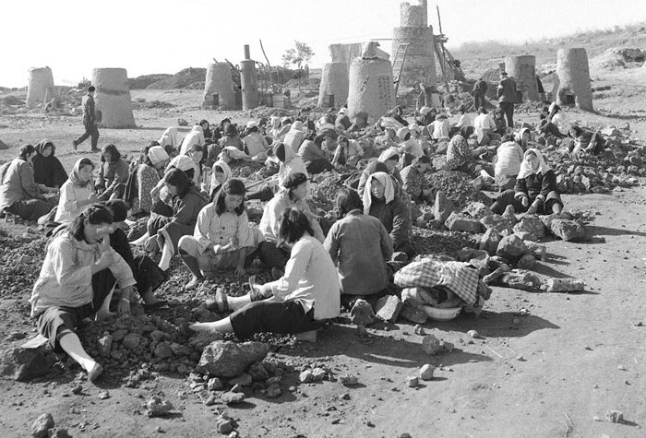
Great Leap Forward

Slide 17
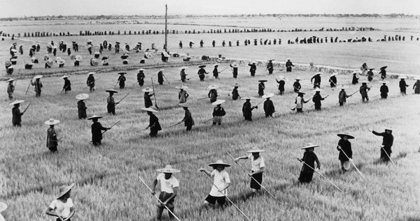
Great Leap Forward

Slide 18
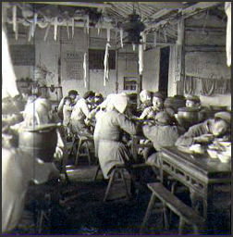
Great Leap Forward

Slide 19
Great Leap Forward
How do the real pictures of the Great Leap Forward compare to the communist propaganda pictures?
What would be the advantages and disadvantages of living and working on a collective farm?

Slide 20
Cultural Revolution
Its goal was to purge China of “bourgeois” tendencies – those against communist values
He encouraged young Chinese to experience the revolution firsthand

Slide 21
The Red Guard
Millions of young Chinese joined militia groups called the Red Guard
They attacked those they considered “bourgeois”
The accused were publically humiliated or beaten, sometimes killed

Slide 22
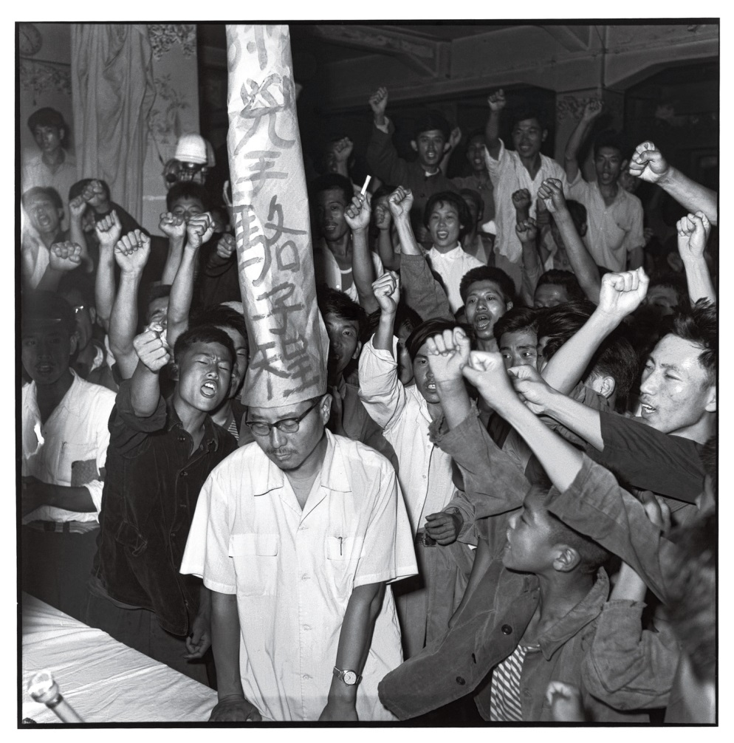
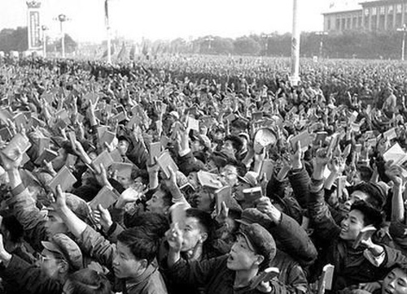
Cultural Revolution

Slide 23
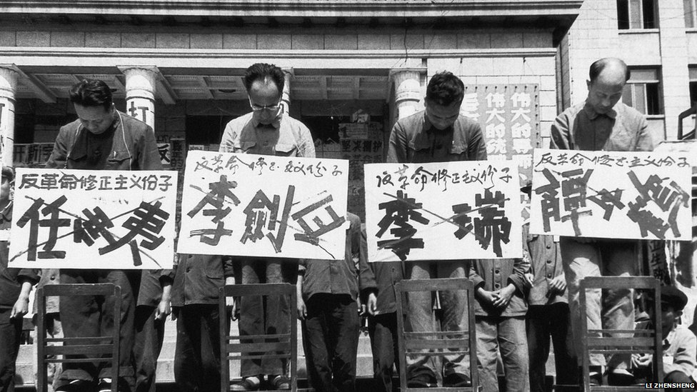
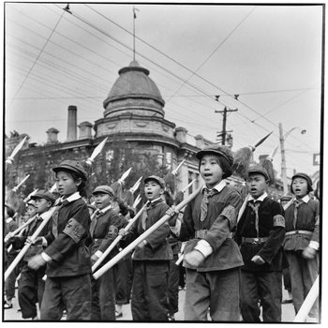
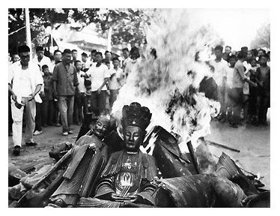
Cultural Revolution

Slide 24
Cultural Revolution
https://www.youtube.com/watch?v=LGpmVs0_Dbc

Slide 25
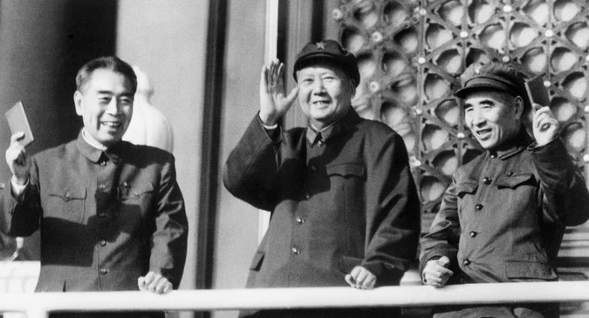
Cultural Revolution Comes to an End
Skilled workers and managers were forced to leave their jobs and do manual labor on rural farms or labor camps
Schools and factories closed
The economy slowed and civil war threatened
Finally Mao had the army restore order

Slide 26
China Before and After the Revolution Women
Before
After
Subservient to men
wealthy arranged marriages
women could not initiate divorce, had to run away or commit suicide
Viewed as equals to men
You could marry who you wanted
Divorce became legal

Slide 27
China Before and After the Revolution Education
Before
After
Most couldn’t read or write
-Only land-owning families could afford to educate (usually only sons)
-Once passed tests, could be government officials
-Even if could afford school, couldn’t afford loss of income
-Schools set up from grades 1-6 for math, reading, writing, history and agricultural theory and garden work.
-Boys AND girls attend, although more boys
-School was not mandatory, some kids kept home to work.

Slide 28
China Before and After the Revolution Health
Before
After
Limited knowledge and chronic food shortages
-had to travel far to a Doctor
-many died at an early age
-foot binding caused infections
Improved health conditions, taught about importance of good hygiene
-clinics were established - vaccines were given
-foot binding outlawed
-prenatal and postnatal care for women and babies

Slide 29
China Before and After the Revolution Work/Land
Before
After
-Peasants rented land from landlords
-men worked from dawn to dusk in fields, women in the home.
-children began working as soon as they could walk
-despite hard work, could barely afford to live and never had enough to eat.
-high taxes and rents for land.
-cooperative farms- shared responsibilities –
-could also have personal farms for their own needs.
-large-scale projects could get done now- dams, irrigation systems
-men were able to have 4 days off per month, women – 6.
-cooperative childcare to watch children while they worked in the fields.

Slide 30
China Before and After the Revolution Government
Before
After
Changes in leadership didn’t affect most Chinese peasants prior to revolution
Peasants mostly reported to their landlords
Could lose land and be beaten if couldn’t pay or they were displeased with them.
Couldn’t participate in government and nothing they could do to protect themselves against harsh landlords
Revolution brought the downfall of local landlords. Communist party makes decisions.
Limits on individual freedoms (cultural rev)
Working persons belonged to labor groups which made decisions about what to grow, when to cultivate, who gets how much
Women participated but not a lot of women
Communist officials influenced local affairs

Slide 31
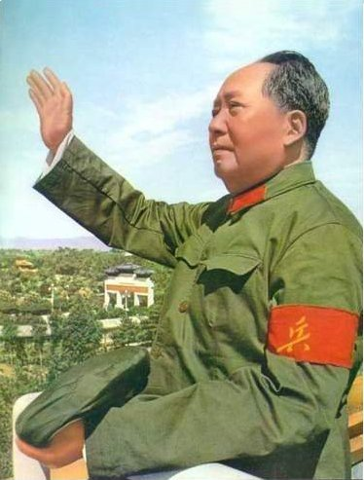
Turn to a seat partner and discuss again: do you believe Mao Zedong (Communism) was good for China?
Use examples discussed in your reasoning.

