Slide 1
Cookies
What is your favorite?
What are your family cookie traditions?
Do you know the origins of cookies?

Slide 2
ORIGINS
Discovered as a mistake…using cake batter to test the temperature of a test oven.
DUTCH WORD: “KOEKJE”
Small or little cake

Slide 3
EACH COUNTRY HAS ITS OWN NAME
In the USA we have thin, sweet, soft, or crisp cookies
ENGLAND/AUSTRALIA Biscuits
latin ( bis coctum) twice baked
SPAIN Galletas
GERMANS Keks/ Platzchen
(christmas cookie)
ITALY Amaretti & Biscotti
There are several names to identify various forms of cookies

Slide 4
EARLY HISTORY
Recorded in the 7th Century PERSIA / IRAN
Luxurious cakes and pastries in large and small versions were well known in the Persian Empire.
Historians say SUGAR originated either in the lowlands of Bengel or elsewhere in Southeast Asia.

Slide 5
SUGAR
The availability of sugar spread to Persia then to the Eastern Mediterranean.
With the Muslim invasion of Spain, then the Crusades & the developing Spice Trade….
The cooking techniques & ingredients of Arabia spread into Northern Europe.
By the end of the 14th C. one could buy little filled wafers on the streets of Paris!

Slide 6
History (cont.)
During the Renaissance, cookbooks were filled with cookie recipes.
During the 17th & 18th C. Being a baker was a managed profession by Guilds or professional associations.
Guilds regulated the quality and quantity of Goods Baked!

Slide 7
Two Types of Cookie Dough
Soft Doughs
Stiff Doughs

Slide 8
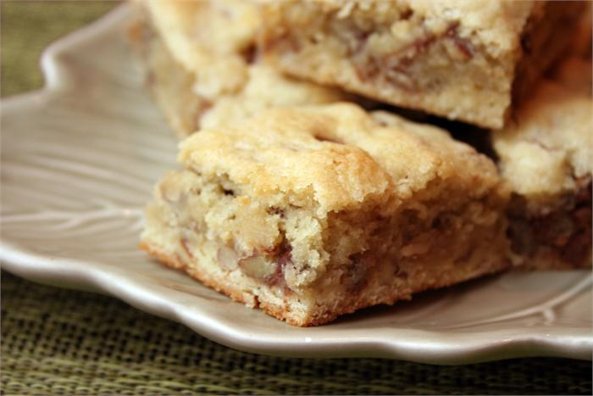
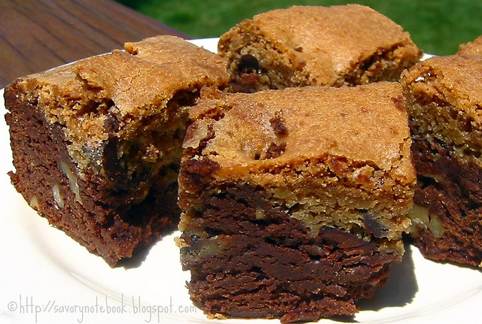
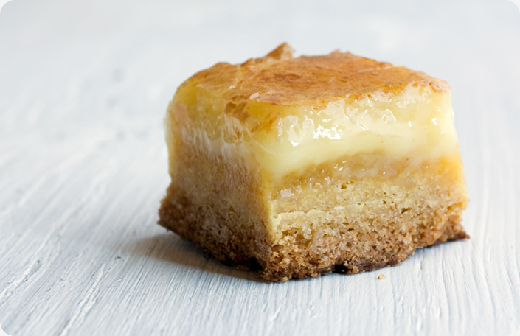
Soft Dough…Bar Cookie…
Blondie
Brownie
Gooey Butter Bar

Slide 9
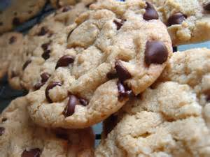
Soft Dough…Drop Cookie…Chocolate Chip

Slide 10
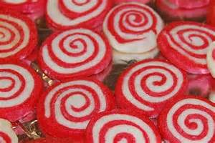
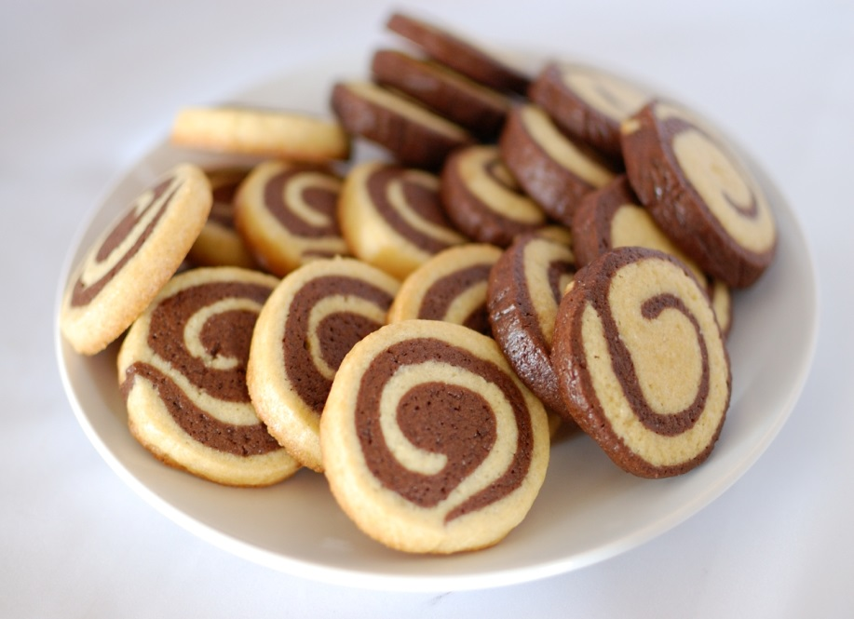
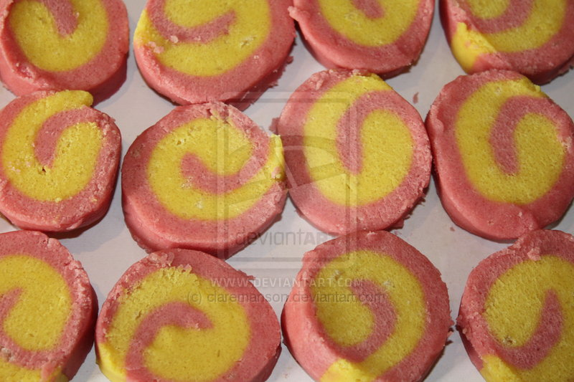
Stiff Dough...
Refrigerator Cookie
Pinwheel

Slide 11
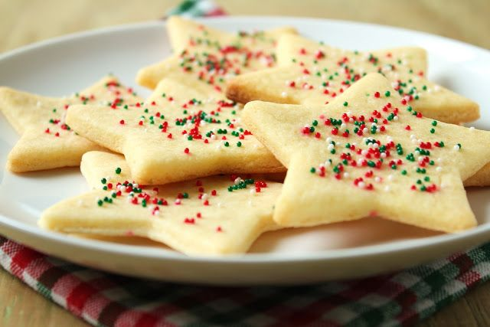
Stiff Dough…Rolled Cookie…Sugar

Slide 12
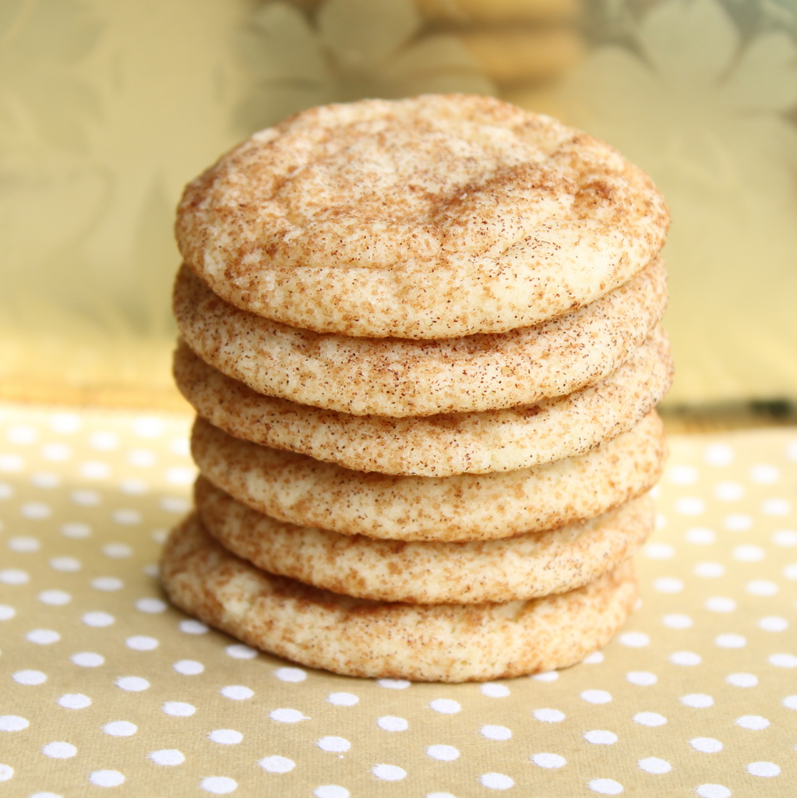
Stiff Dough -Molded Cookie -Snickerdoodle

Slide 13
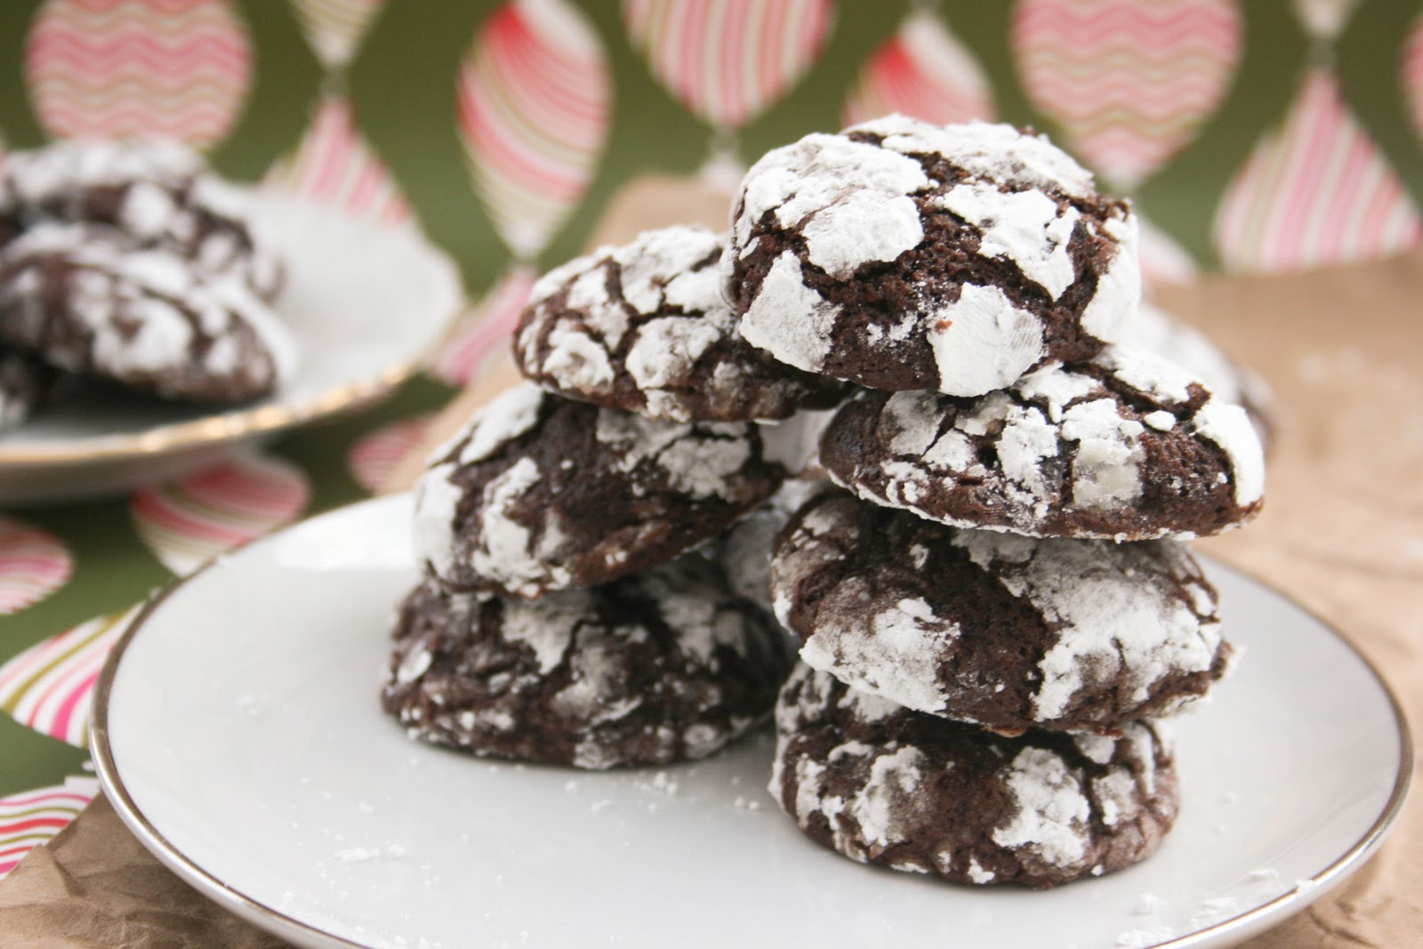
Stiff Dough- Molded Cookie- Chocolate Crinkle

Slide 14
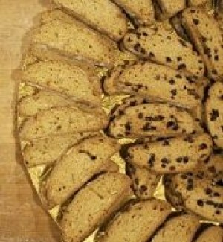
Stiff Dough -Molded Cookie –Kamish Bread or Biscotti

Slide 15
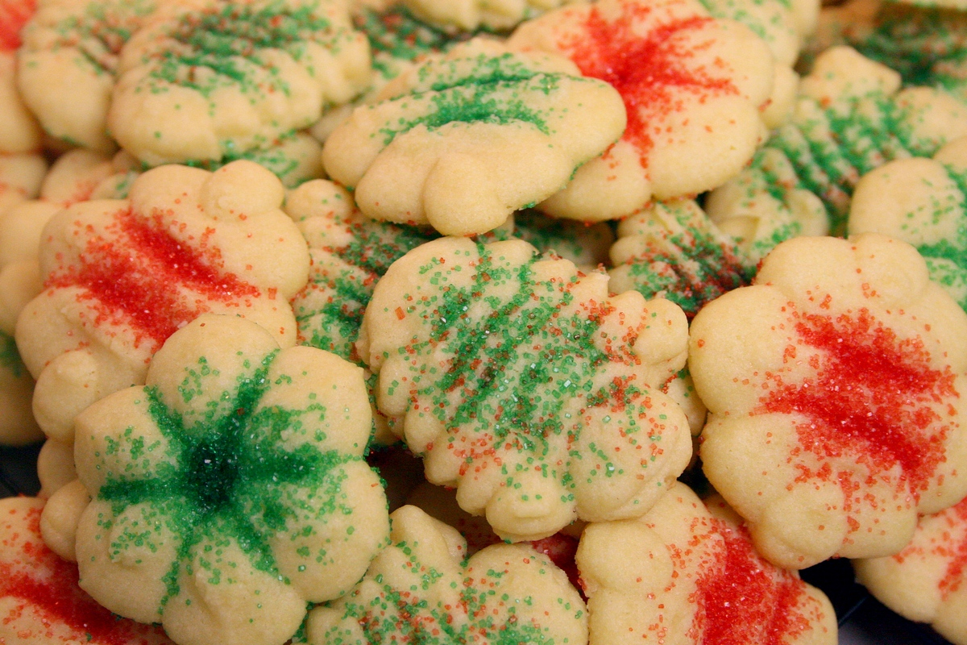
Stiff Dough…Pressed Cookie…Spritz

Slide 16
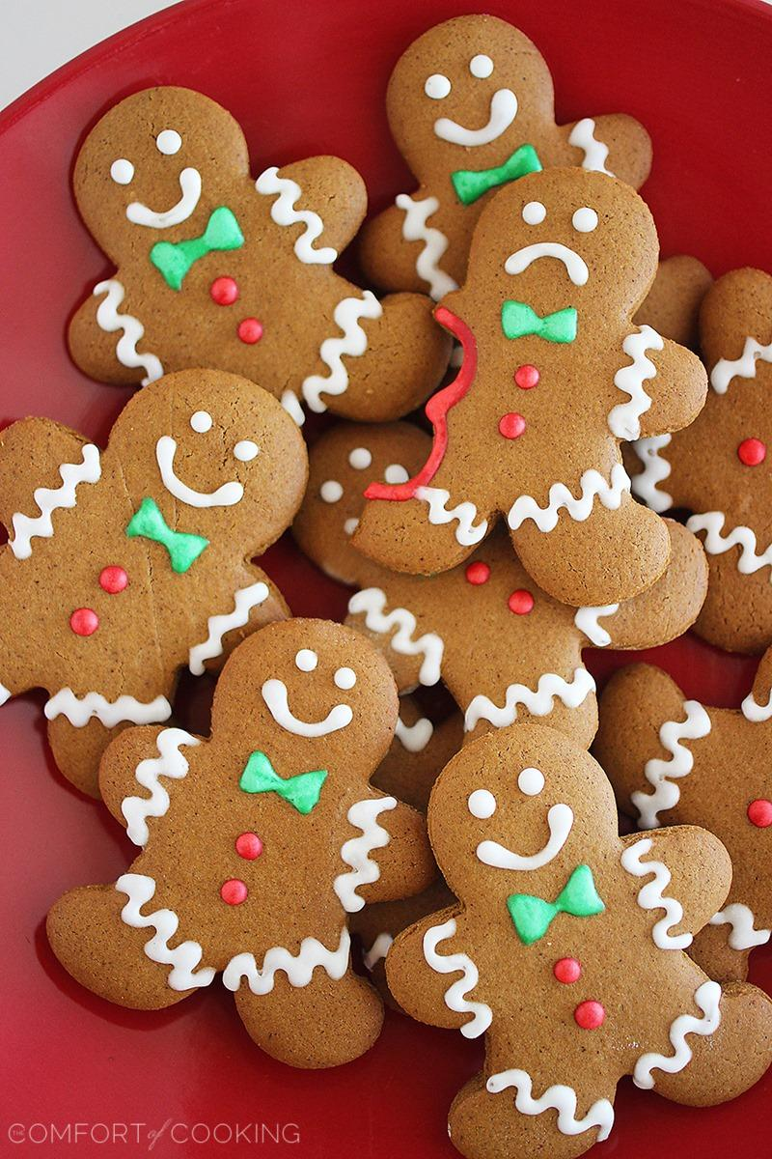
The difference between a
soft dough and a stiff dough is
the amount of flour.
A stiff dough has more
flour than a soft dough

Slide 17
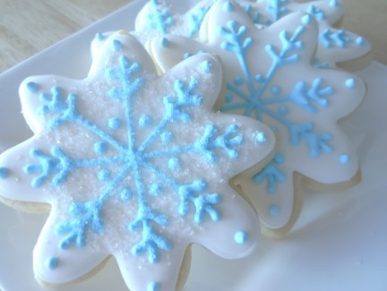
FIVE STEPS IN MAKING COOKIE DOUGH
Get all ingredients at room temperature
not more than 2 hours
Cream the butter & sugar, then add the eggs & flavorings
Sift the dry ingredients together
Add the dry ingredients to the wet ingredients (sugar-butter mixture)
Add any extra ingredients

Slide 18
Ingredients and Purpose
Flour- Forms structure or framework
Sugar- Adds sweetness, tenderness, texture, browning
Butter/ Shortening- Provides, tenderness, texture, richness
Salt- Brings out flavor of ingredients
Liquid- Adds moisture to bind ingredients together
Baking Powder or Baking Soda- Makes items rise, leavening agents
Egg- Adds texture, flavor, color, structure, and leavening
Flavorings- Gives cookie distinctive flavor

Slide 19
Shape and Description
Bar…Dough is spread into pan/then cut into squares
Drop…Dough is pushed from spoon onto pan
Molded…Dough is shaped with hands
Pressed…Dough is forced through cookie press
Refrigerator…Dough is shaped into roll, refrigerated, sliced while cold, and then baked
Rolled…Dough is rolled flat and cut with cookie cutters

Slide 20
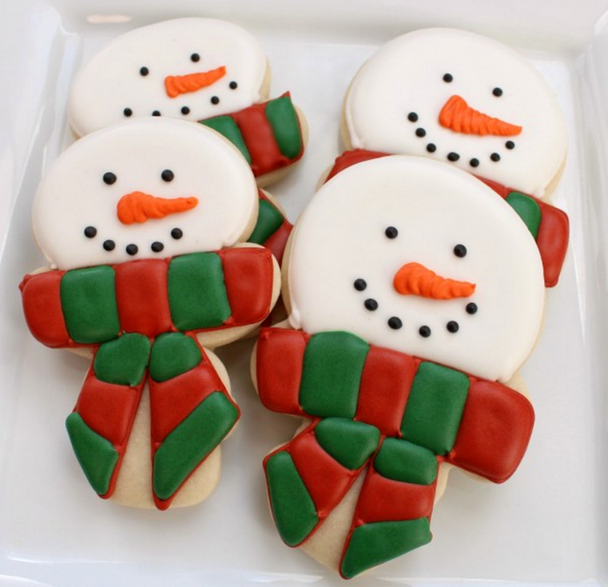
When is a cookie done?
Two clues to a cookie’s doneness are:
1. Color – slightly browned
2. Texture - softness

Slide 21
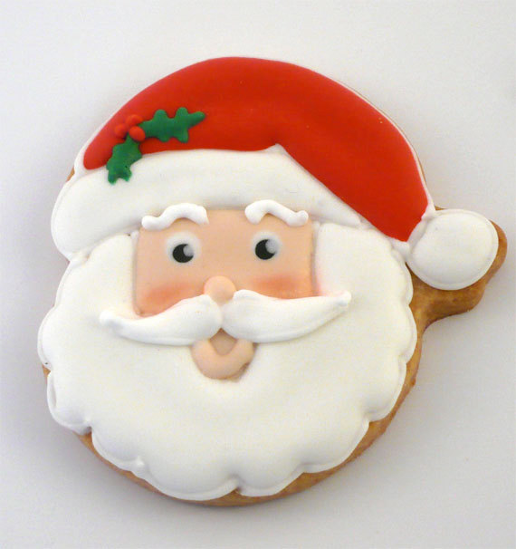
GREASED OR UNGREASED?
If there is a lot of fat in the dough, the baking sheet does not need to be greased.

Slide 22
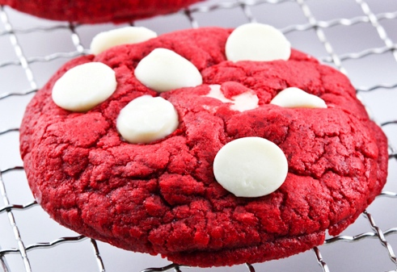
HOW TO STORE COOKIES
All cookies need to be stored in
covered containers.
Soft Cookies: air-tight container to retain softness
Crisp Cookies: loose covered container

Slide 23
RULES FOR MAKING PERFECT COOKIES
Start with ingredients at room temperature
Use shiny cookie sheets without sides (better heat circulation)
Preheat oven
Use regular butter or margarine, better qualities or brands
Size and shape cookies evenly so they cook at the same time
Use cool cookie sheets

Slide 24
7. Do not allow sheets to touch oven wall, heat must circulate
8. Use spray or shortening to grease pan if required (butter smokes easily)
9. Leave about 2” between cookies
10. Start with minimum cooking time, you can always add more
11. Remove cookies from hot sheet immediately
12. Put on flat surface to cool to prevent bending

Slide 25
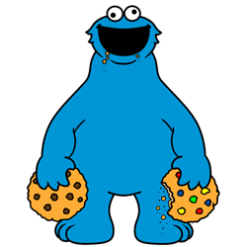
The Chemistry of COOKIES !

Slide 26
Cookie Schedule:
Week of 11/27… Molded cookies
Week of 12/4…Drop cookies and
bar cookies
Week of 12/11…Cake box cookies,
Rolled and refrigerated cookies,
also specialty types.
Cookie party on 12/20

Slide 27
Also during these weeks we
will be completing worksheets,
taking and correcting a content
test, making egg nog, preparing
cookie trays, and completing a
reflection sheet on the entire unit.

