Slide 1
American Ideals
What are America’s founding ideals, and why are they important?

Slide 2
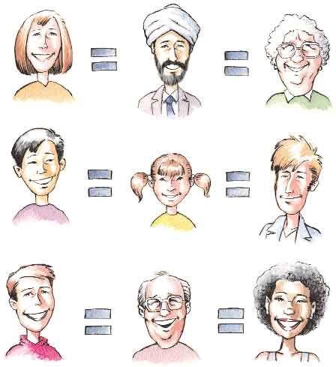
EQUALITY
DEFINITION:
All people are treated and valued the same regardless of gender, age, disability, political views, and race

Slide 3
Equality
1776
Christianity thought that all people are equal in God’s eyes
Rejected the inequality found in Europe (social classes; no social mobility)
Colonists still had slaves and women were treated unequally.
Today
Progress has been made
Slavery ended
Women
Today, individuals argue that equality still can be improved upon
Education
Job opportunities
Medical care

Slide 4
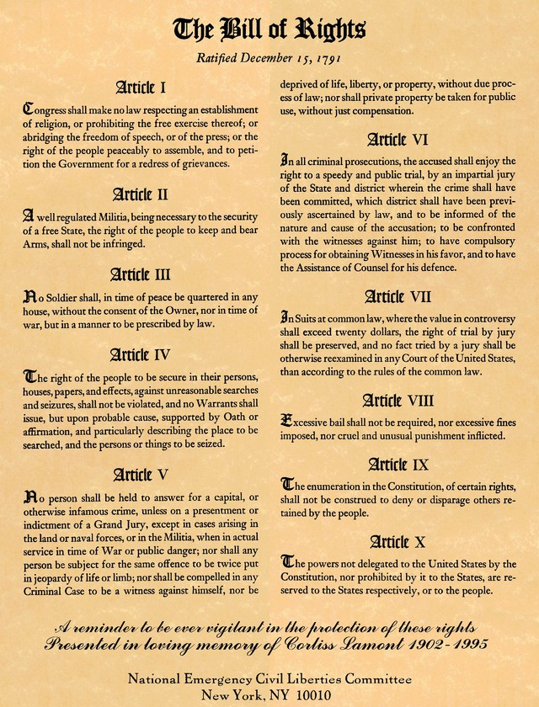
Rights
Definition:
Powers and/or privileges granted to people either by agreement among themselves or by law.
-speech
-religion
-press
-assemble
-bare arms

Slide 5
Rights
1776
Natural
Universal
Belonging to all humankind
Life
Liberty
Property
Today
Bill of Rights
Vote, speak freely, religion, equal justice
Debates still ongoing for an expansion of rights
Health care
Clean environment

Slide 6
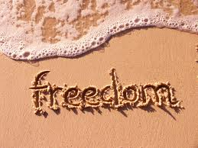
Liberty
Definition:
Freedom
-Speech
-Religion
-Travel
- Political

Slide 7
Liberty
1776
Colonist fought for freedom against Britain
Freedom of gov’t to interfere with one’s life
1/5 of the population was enslaved
Today
Ability to make own choices but limits must be placed on those choices
Who they are
How they live
What they believe
Who should set those limits??

Slide 8
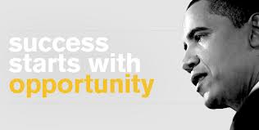
Opportunity
Definition:
The chance to do achieve a dream

Slide 9
Opportunity
1776
“Every man may be master and owner of his owne labour and land.”
John Smith, 1607
Lured many colonists to the new land (America)
Today
Opportunities still draws people to the USA
Education
Job
Live in peace
Is true opportunity available to all???

Slide 10
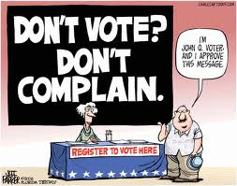
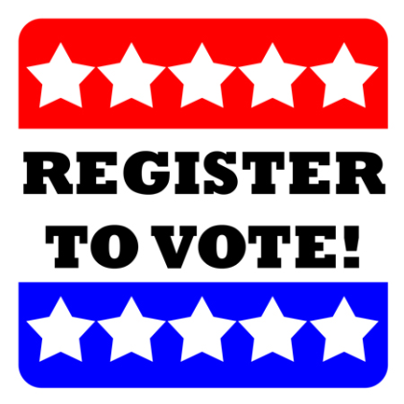
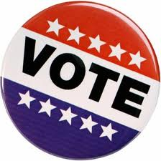
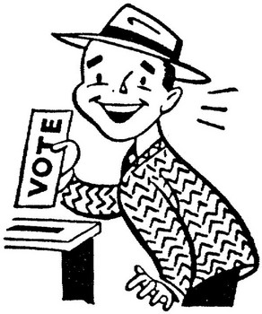
Democracy
Definition:
A system of government in which the people have the power.
USA:
Citizens vote for individuals they feel will best represent their beliefs and ideas in congress

Slide 11
Democracy
1776
More concerned with colonies (13)
Only white, land owning men could vote and hold office
Today
Women, African Americans, and other minority groups can vote and hold office
Any citizen 18 years
Many Americans do not vote ☹

