Slide 1
Thermodynamics

Slide 2
First Law of Thermodynamics
Energy is neither created nor destroyed.
In other words, the total energy of the universe is a constant; if the system loses energy, it must be gained by the surroundings, and vice versa.
Use Fig. 5.5

Slide 3
Hess’s Law
ΔH is well known for many reactions, and it is inconvenient to measure ΔH for every reaction in which we are interested.
However, we can estimate ΔH using ΔH values that are published and the properties of enthalpy.

Slide 4
Hess’s Law
Hess’s law states that “If a reaction is carried out in a series of steps, ΔH for the overall reaction will be equal to the sum of the enthalpy changes for the individual steps.”

Slide 5
Hess’s Law
Because ΔH is a state function, the total enthalpy change depends only on the initial state of the reactants and the final state of the products.

Slide 6
Enthalpies of Formation
An enthalpy of formation, ΔH_{f}, is defined as the enthalpy change for the reaction in which a compound is made from its constituent elements in their elemental forms.

Slide 7
Standard Enthalpies of Formation
°
Standard enthalpies of formation, ΔH_{f}, are measured under standard conditions (25°C and 1.00 atm pressure).

Slide 8
Calculation of ΔH
C₃H₈ (g) + 5 O₂ (g) ⎯→ 3 CO₂ (g) + 4 H₂O (l)
Imagine this as occurring
in 3 steps:
C₃H₈ (g) ⎯→ 3 C_{(graphite)} + 4 H₂ (g)
3 C_{(graphite)} + 3 O₂ (g) ⎯→ 3 CO₂ (g)
4 H₂ (g) + 2 O₂ (g) ⎯→ 4 H₂O (l)

Slide 9
Calculation of ΔH
C₃H₈ (g) + 5 O₂ (g) ⎯→ 3 CO₂ (g) + 4 H₂O (l)
Imagine this as occurring
in 3 steps:
C₃H₈ (g) ⎯→ 3 C_{(graphite)} + 4 H₂ (g)
3 C_{(graphite)} + 3 O₂ (g) ⎯→ 3 CO₂ (g)
4 H₂ (g) + 2 O₂ (g) ⎯→ 4 H₂O (l)

Slide 10
Calculation of ΔH
C₃H₈ (g) + 5 O₂ (g) ⎯→ 3 CO₂ (g) + 4 H₂O (l)
Imagine this as occurring
in 3 steps:
C₃H₈ (g) ⎯→ 3 C_{(graphite)} + 4 H₂ (g)
3 C_{(graphite)} + 3 O₂ (g) ⎯→ 3 CO₂ (g)
4 H₂ (g) + 2 O₂ (g) ⎯→ 4 H₂O (l)

Slide 11
Calculation of ΔH
C₃H₈ (g) + 5 O₂ (g) ⎯→ 3 CO₂ (g) + 4 H₂O (l)
The sum of these equations is:
C₃H₈ (g) ⎯→ 3 C_{(graphite)} + 4 H₂ (g)
3 C_{(graphite)} + 3 O₂ (g) ⎯→ 3 CO₂ (g)
4 H₂ (g) + 2 O₂ (g) ⎯→ 4 H₂O (l)
C₃H₈ (g) + 5 O₂ (g) ⎯→ 3 CO₂ (g) + 4 H₂O (l)

Slide 12
Calculation of ΔH
We can use Hess’s law in this way:
ΔH = Σ n ΔH_{f(products)} - Σ m ΔH_{f(reactants)}
where n and m are the stoichiometric coefficients.
°
°

Slide 13
Ex.
Calculate ΔH for :
2C_{(s)} + H_{2(g)} → C₂H_{2(g)} given the following:
Correct mols and divide so function of coefficients mols for wanted product is one
C₂H_{2(g)} + 5/2O_{2(g)} → 2CO_{2(g)} + H₂O_{(l)} ΔH = -1299.6kJ
C_{(s)} + O_{2(g)} → CO_{2(g)} ΔH = -393.5kJ
H_{2(g)} + 1/2O_{2(g)} → H₂O_{(l)} ΔH = -285.9kJ
Rearrange the equations so similar to algebra:

Slide 14
Calculate ΔH for :
NO_{(g)} + O_{(g)} → NO_{2(g)} given:
NO_{(g)} + O_{3(g)} → NO_{2(g)} + O_{2(g)} ΔH = -198.9kJ
O_{3(g)} → 3/2O_{2(g)} ΔH = -142.3kJ
O_{2(g)} → 2O_{(g)} ΔH = 495.0kJ

Slide 15
Using Σ to calculate ΔH
C₃H₈ _{(g)} + O₂ _{(g)} ⎯→ CO₂ _{(g)} + H₂O _{(l)}

Slide 16
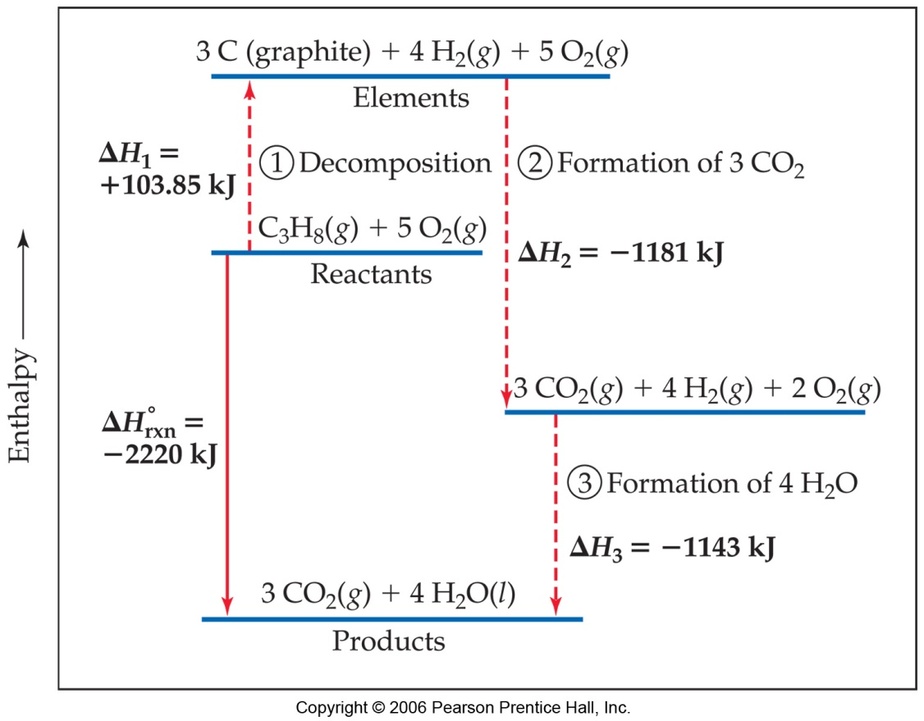
Calculation of ΔH
C₃H₈ (g) + 5 O₂ (g) ⎯→ 3 CO₂ (g) + 4 H₂O (l)
ΔH = [3(-393.5 kJ) + 4(-285.8 kJ)] - [1(-103.85 kJ) + 5(0 kJ)]
= [(-1180.5 kJ) + (-1143.2 kJ)] - [(-103.85 kJ) + (0 kJ)]
= (-2323.7 kJ) - (-103.85 kJ)
= -2219.9 kJ

Slide 17
Lets apply this to the Mg lab we did
1st react Mg_{(s)} + 2HCl → MgCl₂ + H₂ ΔH₁
2nd react MgO_{(s)} + 2HCl → MgCl₂ + H₂O ΔH₂
Hess’s Law states: ΔH₃ = ΔH₁ + ΔH₂
So: ΔH₁ + ΔH₂ = ΔH_{f}º (MgO) + ΔH_{f}º (H₂) - ΔH_{f}º (Mg) - ΔH_{f}º (H₂O)
By definition: ΔH_{f}º (H₂) and ΔH_{f}º (Mg) are 0 because elements are at std.state
ΔH_{f}º(MgO) = ΔH₁ + ΔH₂ - ΔH_{f}º (H₂O)

Slide 18
To see how well you did check the values you deduced for the ΔH_{f}º in exp. 1 and 2
You need the following:
ΔH_{f}º(MgO)_{(s)} = -601.7kJ
ΔH_{f}º(H₂O)_{(l)} = -285.9kJ
ΔH_{f}º(HCl)_{(aq)} = -167.4kJ
ΔH_{f}º(MgCl₂)_{aq} = -775.6kJ

Slide 19
First Law of Thermodynamics
You will recall from Chapter 5 that energy cannot be created nor destroyed.
Therefore, the total energy of the universe is a constant.
Energy can, however, be converted from one form to another or transferred from a system to the surroundings or vice versa.

Slide 20
Spontaneous Processes
Spontaneous processes are those that can proceed without any outside intervention.
The gas in vessel B will spontaneously effuse into vessel A, but once the gas is in both vessels, it will not spontaneously

Slide 21
Spontaneous Processes
Processes that are spontaneous in one direction are nonspontaneous in the reverse direction.

Slide 22
Entropy
Entropy (S) is a term coined by Rudolph Clausius in the 19th century.
Clausius was convinced of the significance of the ratio of heat delivered and the temperature at which it is delivered,
q
T

Slide 23
Entropy
Entropy can be thought of as a measure of the randomness of a system.
It is related to the various modes of motion in molecules.

Slide 24
Entropy
Like total energy, E, and enthalpy, H, entropy is a state function.
Therefore,
ΔS = S_{final} − S_{initial}

Slide 25
Entropy
For a process occurring at constant temperature (an isothermal process), the change in entropy is equal to the heat that would be transferred if the process were reversible divided by the temperature:
q_{rev}
T
ΔS =

Slide 26
Entropy Changes
In general, entropy increases when
Gases are formed from liquids and solids.
Liquids or solutions are formed from solids.
The number of gas molecules increases.
The number of moles increases.

Slide 27
Gibbs Free Energy
−TΔS_{universe} is defined as the Gibbs free energy, ΔG.
When ΔS_{universe} is positive, ΔG is negative.
Therefore, when ΔG is negative, a process is spontaneous.

Slide 28
Gibbs Free Energy
If ΔG is negative, the forward reaction is spontaneous.
If ΔG is 0, the system is at equilibrium.
If ΔG is positive, the reaction is spontaneous in the reverse direction.

Slide 29
Standard Free Energy Changes
Analogous to standard enthalpies of formation are standard free energies of formation, ΔG°.
_{f}
ΔG° = ΣnΔG°(products) − ΣmΔG°(reactants)
_{f}
_{f}
where n and m are the stoichiometric coefficients.

Slide 30
Free Energy Changes
At temperatures other than 25°C,
ΔG° = ΔH° − TΔS°

