Slide 1
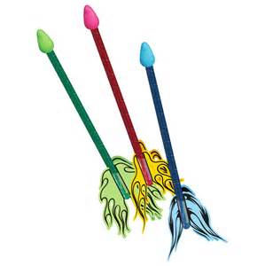
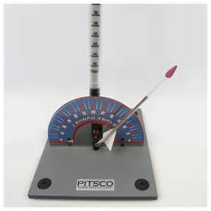
Straw Rocket Activity
5th Grade

Slide 2
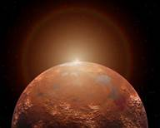
Background Scenario
You are an Aeronautical Engineer who works for NASA. You are a member of a team who has been working on developing a long-range rocket which will carry a number of astronauts and their equipment to Mars. The Rocket will be carrying transportation vehicles but fuel supplies are VERY limited so landing the rocket close to the “target zone” is extremely important. The Mars Rocket is nearly complete and ready to launch but NASA is concerned about how close your team can “land” the Mars Rocket in the “target zone.” So now you and your team will design and model a series of “test rockets” to practice the Mars landing procedures.

Slide 3
Lets Summarize Our Scenario
You are an Aeronautical Engineer who has been hired by NASA to design a rocket that will carry much needed transportation vehicles to Mars. However, the rocket must land close to the designated “target zone” due to the lack of fuel the rocket will have left once it reaches Mars’ orbit! Precision is key!

Slide 4
Before We Move On…
Who can tell me what a Design Brief is again?
The written plan that identifies the problem to be solved, it’s criteria, constraints and parameters.

Slide 5
Problem Statement!
Using only the given materials listed, create a rocket which when launched from a given launch area will successfully land in the designated “target area.”

Slide 6
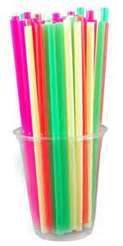
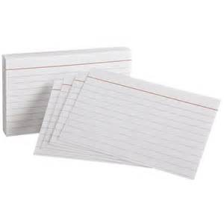
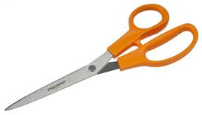
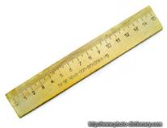
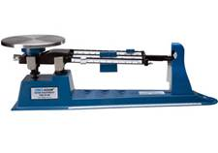
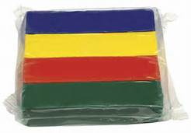
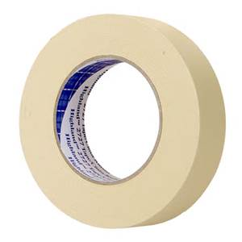
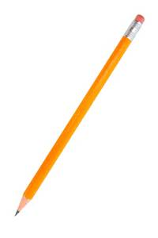
Straw Rocket Design Brief
Materials:
1 Plastic Straw
1-2 Index Cards
Clay
Masking Tape
Tools:
Scissors
Ruler
Pencil
Triple Beam Balance
Parameters / Constraints:
The straw body of the rocket must remain 20 cm long.
The finished rocket must contain between 2 to 4 fins physically attached to the rocket itself.
The nosecone (clay) may not weight more than 10 grams.

Slide 7
Straw Rocket Design Brief
Variables: (You may alter or change the following) Wawa C.I
The Size and Shape of the Fins.
The total number of Fins (2,3 or 4).
The weight of the nosecone.
Both the Launch Angle and Launch Magnitude of the Launcher.
Pre-testing Procedure:
Each student will be given appropriate lab time to test and re-test their preliminary design ideas before selecting and creating their final design idea. (5 attempts per student to start)
Testing Procedure:
During the Final Testing Phase, each student will be given three (3) attempts to "land" their rocket in the "target area".

Slide 8
Time to THINK!
Using the information found in the Design Brief above, answer the following questions…
1) What item listed in the materials list do you think you will use for the rocket's body?
2) Can the pair of scissors be used as part of the rocket?
3) Restate one of the three variables that the students will be able to alter or change?

Slide 9
Question # 1
What item listed in the materials list do you think you will use for the rocket's body?
Straws

Slide 10
Question # 2
Can the pair of scissors be used as part of the rocket?
No, the scissors are actually an extension of you, the person using them. They are a tool not a material and used to assist you in solving your problem.

Slide 11
Question # 3
Restate one of the three variables that you will be able to alter or change on your rocket?
The Size and Shape of the Fins.
The total number of Fins (2,3 or 4).
The weight of the nosecone.

Slide 12
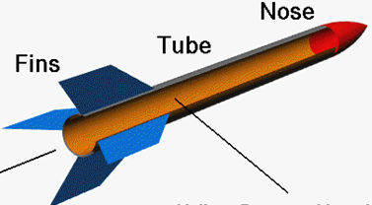
Rocket?
A rocket consists of 3 main parts.

Slide 13
Important Scientific / Mathematical Terms To Consider…
Force
Launch Angle
Launch Magnitude
Model
Solar System
Thrust
Variable
Velocity

Slide 14
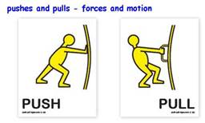
Force
An interaction between masses
Tells you how strong and the direction of something being pushed or pulled.

Slide 15
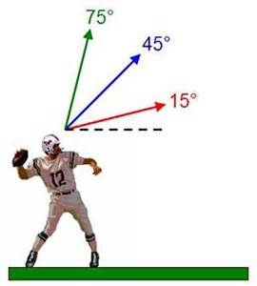
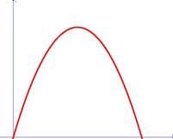
Launch Angle
The angle, measured in degrees, used to set the rocket's intended path (parabola) towards the target.
Parabola?

Slide 16
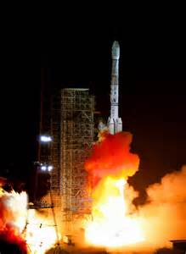
Launch Magnitude
The strength of force used at launch to set the rocket into motion.
The greater the force the greater the velocity.
Launch 1:23 – 3:00

Slide 17
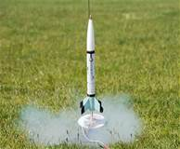
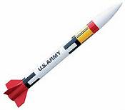
Model
An explanation or representation of an object, system or process that cannot be easily studied.

Slide 18
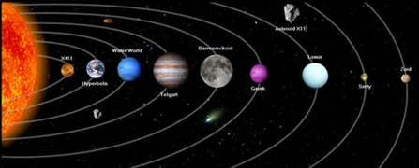
Solar System
The Sun and the planets and other celestial bodies that orbit it.

Slide 19
Thrust
The propulsive force of a jet or rocket engine.
What makes the rocket GO!
Straw Rockets (Compressed air)
Actual Rockets (Rocket Fuel)
Solid Fuel
Powered Aluminum and an oxidizer
Liquid Fuel
Sub 0 liquid Oxygen and Hydrogen.

Slide 20
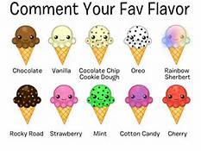
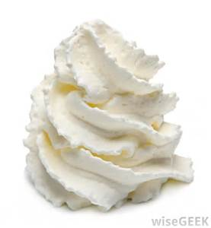
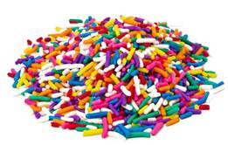
Variable
A quantity or function that may or does change.
Sprinkles? Chocolate Syrup? Whip Cream?

Slide 21
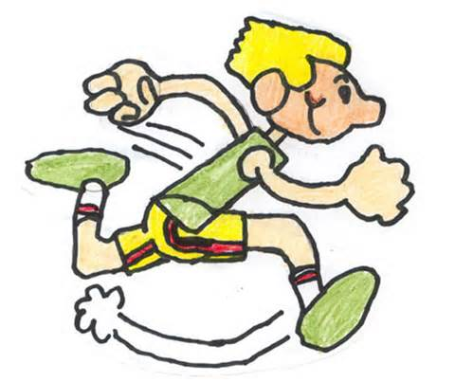
Velocity
The rate (time) at which an object “changes position”
Indicates a direction
Vector quantity
Ex.
The boy ran South down the street at 8 mph.

Slide 22
Time to THINK!
Using the vocabulary words listed in the Key Terms section, fill in the blanks with the correct term.
Key Terms Word Bank
Force Thrust Launch Magnitude
Variable Model Launch Angle
Solar System Velocity

Slide 23
Question # 1
Since building full-sized rockets is a costly and time consuming process, Engineers often build physical _____________________ to show the look or function of the rocket to use for testing purposes.
MODELS

Slide 24
Question # 2
In order to put a rocket into orbit, Engineers must use rocket engines powerful enough to provide enough _____________ to get the rocket outside of Earth's gravitational forces.
THRUST

Slide 25
Question # 3
When a student changes from 3 fins to 4 fins to help with stability this is an example of changing a __________________.
VARIABLE

Slide 26
Question # 4
SOLAR
Mars is the 4th planet in our_________________ _______________.
SYSTEM

Slide 27
Question # 5
If a student's rocket consistently falls short of the target area, the student could try changing the rocket's launch _________________.
(Two answers could fit).
MAGNITUDE
ANGLE

Slide 28
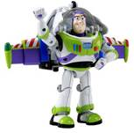
BONUS!
Which unit of measurement would most likely be used to measure the distance from Earth to the planet Mars?
Miles
Light Years are used to measure things outside of the solar system
5,880,000,000,000 miles = 1 Light Year.

Slide 29
And For What We Have Been Waiting For…
IT’S TIME TO DESIGN!

Slide 30
Thumbnail Sketches (Fin Design)
Sketch 1
Sketch 2
Sketch 3
Sketch 4

Slide 31
Final Drawing (Fin Design)
At this point you will need to choose which Fin Design you most want to try
from your thumbnail sketches.
1. Draw that Final Design Idea below
2. Cut the Fin Design out with the pair of scissors and then use
it as a template to cut out your fins on the index card.
Note: You may want to try more than one Fin Design so you
may use the other boxes to create other templates.
Final Fin 1
Final Fin 2
Final Fin 3

Slide 32
OPEN LAB DAY!

Slide 33
Things to Keep In Mind During Open Lab!
Make sure after each practice test of your rocket….
Fill in your testing chart correctly
Weigh your nosecone with Triple Beam Balance
Sketch Fin Design
Modify your rocket in a manner that you feel will improve your results.
Each student is guaranteed a minimum of 5 attempts

Slide 34
FINAL TEST DAY!
Each student will be given 3 chances in a row to fire their rocket and hit the “target zone.”
You will NOT be allowed to modify your rocket at this point.
You MAY adjust your launch angle.

Slide 35
Reflection
1) Did you complete the challenge in the allotted tries during final testing (3); meaning was your rocket successful?
2) After having tested your rocket several times during the “open lab” periods, what was your MOST SIGNIFICANT modification, adjustment or variable you changed in an attempt to make your rocket successful?
3) What might you do differently if you were asked to complete this project again?
4) What might you do the same if you were asked to complete this project again?
5) Did you enjoy this project? Why or Why Not?

Slide 36
Reflection
If your rocket continues to fall short of the target zone, what could we increase in order for the rocket to make it to its destination? (Think About Our Science Vocabulary)
Thrust, Launch Angle, Launch Magnitude, Force
How many hours would it take a rocket traveling 100 miles per hour heading from Earth to Mars at a total distance of 4,000 miles?
4,000 miles
100 miles per hour
=
40 hours

