Slide 1
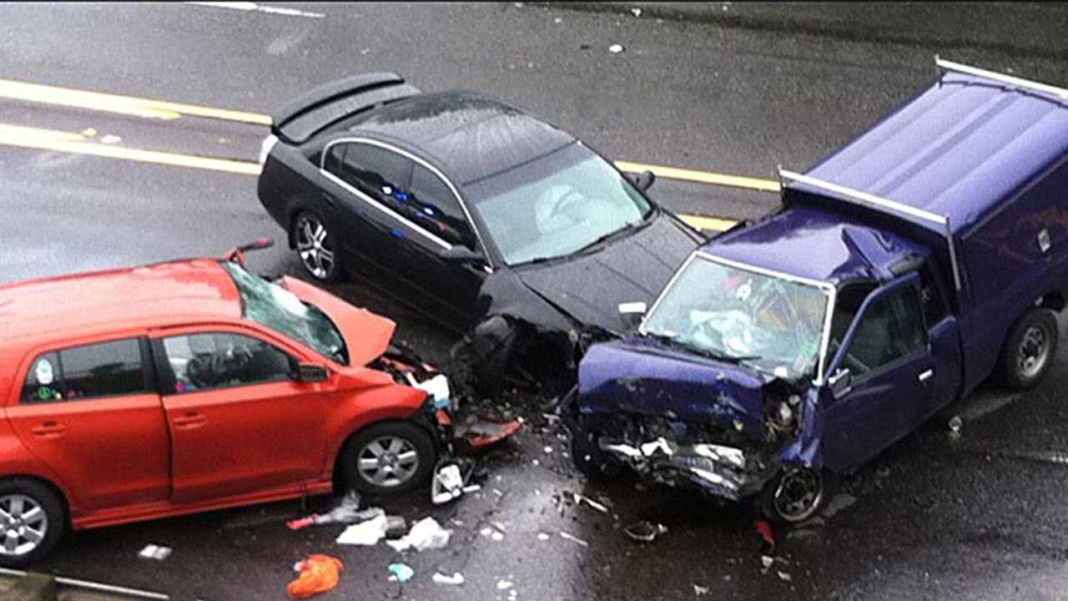
Crash Test Car

Slide 2
Accident prevention
Brakes
Antilock Brakes
Lights
Back up cameras
Mirrors
Lane deviation warnings
Automatic slowdown
Driverless Cars

Slide 3
Statistics
Over 37,000 people die in road crashes each year
An additional 2.35 million are injured or disabled
Over 1,600 children under 15 years of age die each year
Nearly 8,000 people are killed in crashes involving drivers ages 16-20
Road crashes cost the U.S. $230.6 billion per year, or an average of $820 per person
Road crashes are the single greatest annual cause of death of healthy U.S. citizens traveling abroad

Slide 4
What helps us survive when accident occurs!

Slide 5
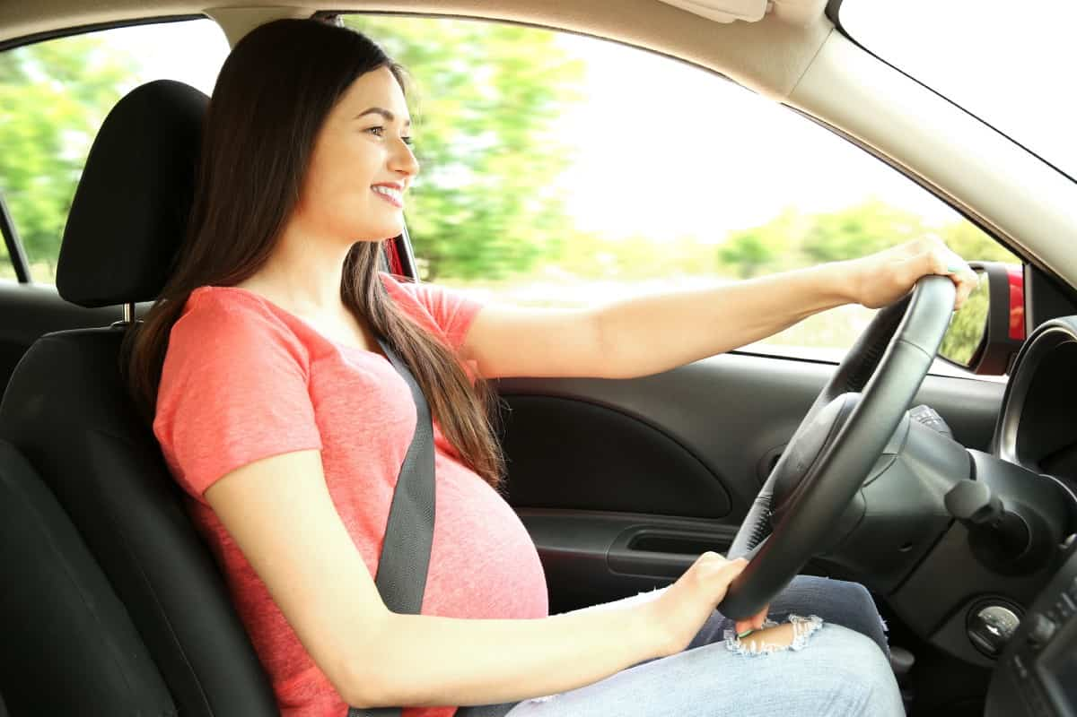
Seatbelts

Slide 6
Seatbelts limit the forward motion of an occupant, stretch to absorb energy, to lengthen the time of the occupant's negative acceleration in a crash, reducing the loading on the occupants body. They prevent occupants being ejected from the vehicle and ensure that they are in the correct position for the operation of the airbags.

Slide 7
Airbags

Slide 8
Airbags inflate to cushion the impact of a vehicle occupant with various parts of the vehicle's interior. The most important being the prevention of direct impact of the driver's head with the steering wheel and door pillar.

Slide 9
Laminated Windshield

Slide 10
Laminated windshields remain in one piece when impacted, preventing penetration of unbelted occupants' heads and maintaining a minimal but adequate transparency for control of the car immediately following a collision. Tempered glass side and rear windows break into granules with minimally sharp edges, rather than splintering into jagged fragments as ordinary glass does.

Slide 11
Safety Cell

Slide 12
Safety Cell - the passenger compartment is reinforced with high strength materials, at places subject to high loads in a crash, in order to maintain a survival space for the vehicle occupants.

Slide 13
Crumple Zones

Slide 14
Crumple zones absorb and dissipate the force of a collision, displacing and diverting it away from the passenger compartment and reducing the negative acceleration impact force on the vehicle occupants. Vehicles will include a front, rear and maybe side crumple zones too.

Slide 15
Side Impact Beams

Slide 16
Side impact protection beams, also called anti-intrusion bars.

