Slide 1
GEO-CHALLENGE
Early Humans

Slide 2
Essential Geographic Understandings
Learning Targets
“I Can” locate the five oceans and seven continents on a map of the world
“I Can” locate the region known as the Middle East.
“I Can” identify key physical features including the Nile River, Great Rift Valley, Mediterranean Sea, Tigris River, and Euphrates River
“I Can” locate the region known as the Fertile Crescent and the Nile River valley.
“I Can” provide two or more examples of the impact of physical geography on the rise of civilization
“I Can” create a mnemonic device can help me recall important geographic items (i.e. the five oceans and seven continents)

Slide 3
THINK – PAIR – SHARE
There are
7 continents
and
5 oceans on our planet.
How many of them can you name? (Prove it)

Slide 4
Preview
Turn to your PP: Preview Practice activity in your ISN.
From memory, draw a map of the world.
What counts is that you do the best of your ability.
Label if possible
3 Minutes on the Clock!!!

Slide 5
Preview
Part Two of your PP: Preview Practice
Directions: Use the map on the screen to identify as many continents and bodies of water as you can.
3 Minutes on the Clock!!

Slide 6
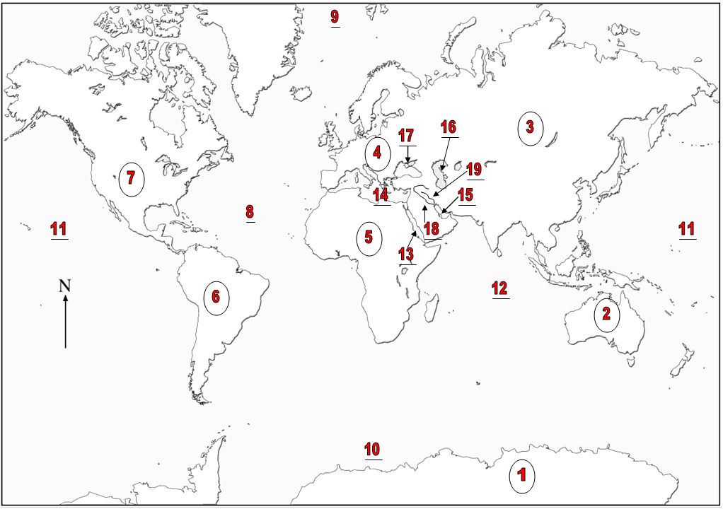
GEO-CHALLENGE
Early Humans

Slide 7
Preview
Part Two of your PP: Preview Practice
WE WILL DOUBLE CHECK USING DIFFERENT MAP

Slide 8
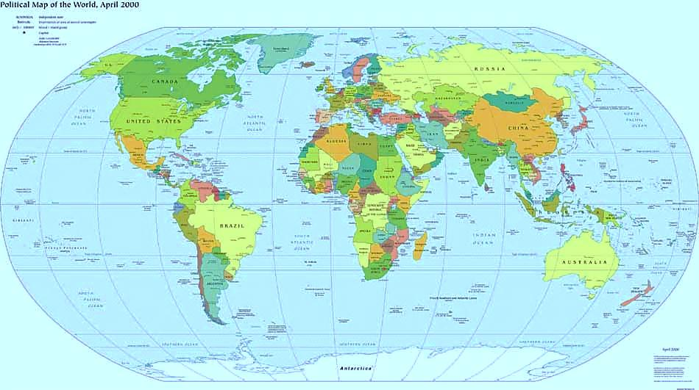
Name That Continent
4
7
3
5
6
2
1

Slide 9
Name That Ocean
9
8
11
12
10

Slide 10
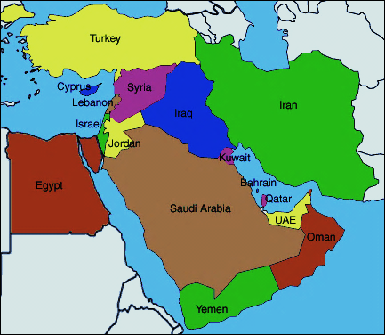
Name That Body of Water
4
14
15
13

Slide 11
Name That Body of Water
17
16
4
Notes:
11

Slide 12
Name That Body of Water
4
19
18
Notes:
12

Slide 13
Name That Continent
4
Europe
3
7
North America
Asia
5
Africa
South America
6
2
Australia
1
Antarctica

Slide 14
Name That Ocean
9
Arctic
8
Atlantic
11
Pacific
12
Indian
10
Southern

Slide 15
Name That Body of Water
4
14
Mediterranean Sea
Persian Gulf
15
13
Red Sea

Slide 16
Name That Body of Water
17
Black Sea
Caspian Sea
16
4
Notes:
16

Slide 17
Name That Body of Water
4
Tigris River
19
18
Euphrates River
Notes:
17

Slide 18
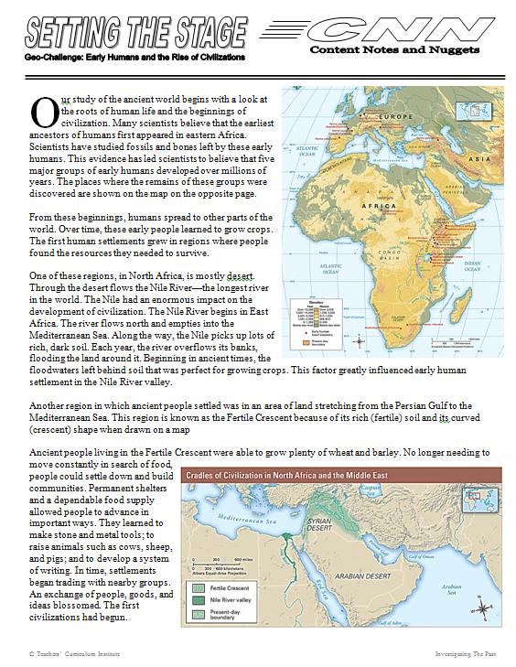
Setting The Stage
We will learn about the development of our early human ancestors over time and the gradual change from hunting and gathering
societies to farming
societies, and the resulting rise of civilization.
Let’s allow Siri to read this to us

Slide 19
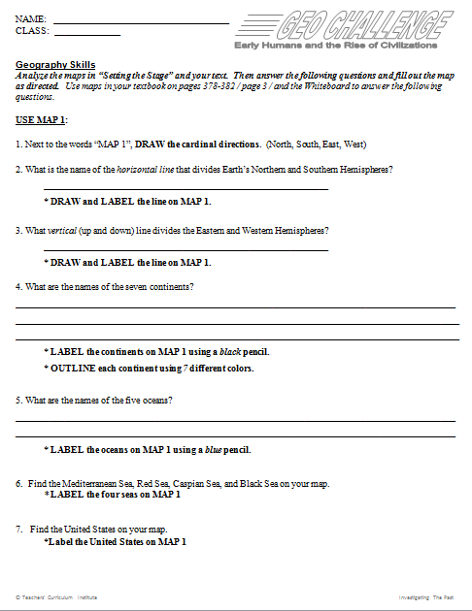
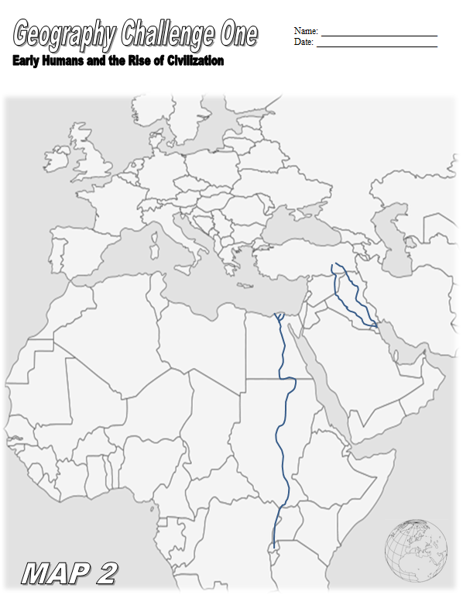
Geo Challenge 1
In partnerships, students will…
review some basic world geography information,
interpret a specialty map about early hominids and,
label maps.

Slide 20
Geo Challenge 1
LABEL MAP 1
DRAW a compass rose if missing
2. What is the name of the
horizontal line that divides
Earth’s Northern and Southern
Hemispheres?
3. What vertical line divides the Eastern and Western Hemispheres?
Equator
Prime Meridian
DRAW AND LABEL THE ITEMS ON MAP 1

Slide 21
Geo Challenge 1
Complete MAP 1
Move on to questions four, five, six, seven for MAP 1
2. Label MAP 1 as instructed
Equator
Prime Meridian

Slide 22
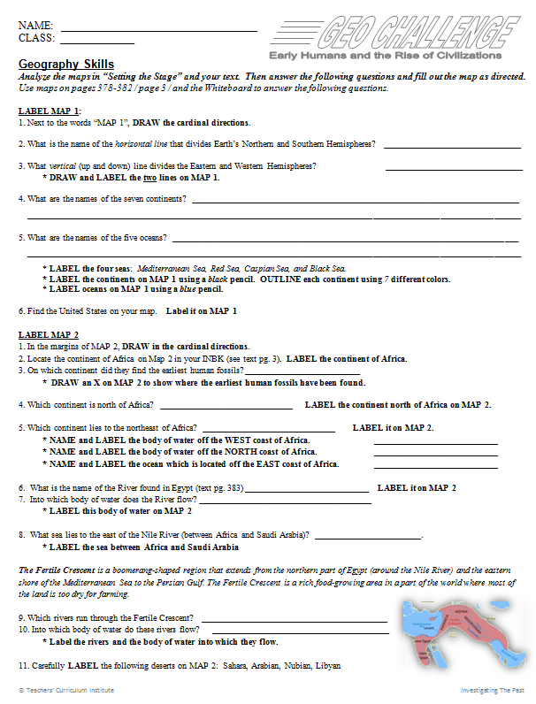
Geo Challenge 1
Complete MAP 2
Move on to questions one – eleven on MAP 2.
2. Label MAP 2 when asked.

Slide 23
Geo Challenge 1
WITH YOUR PARTNER…
Complete the Geo-Challenge!
Assessment at end of the week on all materials we covered with “Left Eye” Lever and the Geo-Challenge.
Absolute vs. Relative Location
Latitude and Longitude
Elements of a Map
Continents and Oceans
other locations on Geo-map

Slide 24
Geo Challenge 1
WITH YOUR PARTNER…
When all discovery questions are answered and Maps are labeled…
Respond to the critical thinking questions on the back.

Slide 25
GEO-CHALLENGE
ANSWERS

Slide 26
Geo Challenge 1
LABEL MAP 1
1. Next to the words “MAP 1”, DRAW the cardinal directions.
2. What is the name of the horizontal line that divides Earth’s Northern and Southern Hemispheres? Equator
3. What vertical (up and down) line divides the Eastern and Western Hemispheres? Prime Meridian
* DRAW and LABEL the two lines on MAP 1.

Slide 27
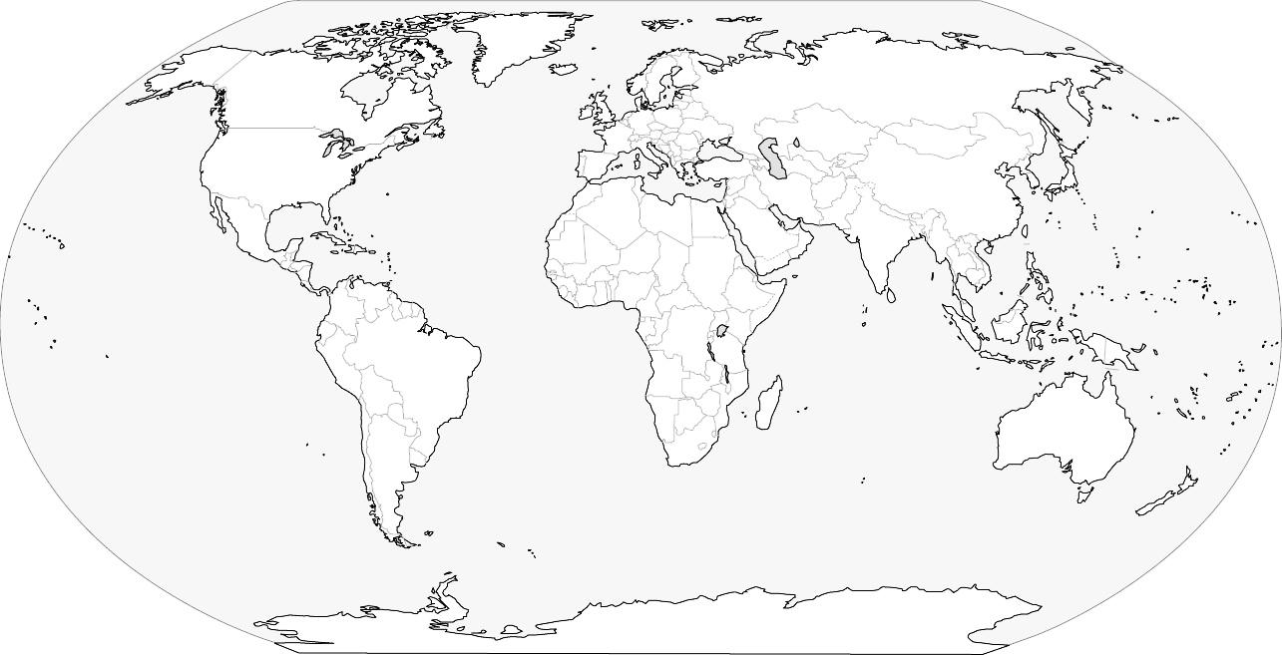
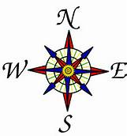
Geo Challenge 1
Equator
Prime Meridian

Slide 28
Geo Challenge 1
LABEL MAP 1
4. What are the names of the seven continents? The seven continents are North America, South America, Europe, Asia, Australia, Africa, Antarctica.
5. What are the names of the five oceans? The five oceans are the Southern, Atlantic, Indian, Pacific, and Arctic.
* LABEL the four seas: Mediterranean Sea, Red Sea, Caspian Sea, and Black Sea.
DID YOU???
Label the continents on Map 1 using a black pencil.
Outline each continent using 7 different colors
Label oceans on Map 1 using a blue pencil.

Slide 29
Geo Challenge 1
ARCTIC OCEAN
Asia
North America
Europe
Black Sea
Caspian Sea
United States
Mediterranean Sea
ATLANTIC
OCEAN
Red Sea
Africa
Equator
PACIFIC
OCEAN
South America
INDIAN OCEAN
Australia
Prime Meridian
SOUTHERN OCEAN
Antarctica

Slide 30
Geo Challenge 1
LABEL MAP 1
6. Find the United States on your
map.

Slide 31
Geo Challenge 1
ARCTIC OCEAN
Asia
North America
Europe
Black Sea
Caspian Sea
United States
Mediterranean Sea
ATLANTIC
OCEAN
Red Sea
Africa
Equator
PACIFIC
OCEAN
South America
INDIAN OCEAN
Australia
Prime Meridian
SOUTHERN OCEAN
Antarctica

Slide 32
LABEL MAP 2
In the margins of MAP 2,
DRAW in the cardinal directions.
2. Locate the continent of Africa on Map 2 in your ISN (see text pg. 3).
LABEL the continent of Africa.
3. On which continent did they find the earliest human fossils?
DRAW an X on MAP 2 to show where the earliest human fossils have been found.
Africa
x

Slide 33
LABEL MAP 2
4. Which continent is north of Africa? LABEL it
5. Which continent lies to the northeast of Africa? LABEL it
NAME and LABEL the body of water off the WEST coast of Africa.
EUROPE
ASIA
Atlantic Ocean
NAME and LABEL the body of water off the NORTH coast of Africa.
Mediterranean Sea
NAME and LABEL the ocean which is located off the EAST coast of Africa.
Africa
x
Indian Ocean

Slide 34
LABEL MAP 2
What is the name of the major river found in Egypt LABEL it
Into which body of water does the River flow?
EUROPE
ASIA
What sea lies to the east of the Nile River (between Africa and Saudi Arabia)? LABEL it
Atlantic Ocean
Mediterranean Sea
Red Sea
Nile River
Africa
x
Indian Ocean

Slide 35
LABEL MAP 2
The Fertile Crescent is a boomerang-shaped region that extends from the northern part of Egypt (around the Nile River) and the eastern shore of the Mediterranean Sea to the Persian Gulf. The Fertile Crescent is a rich food-growing area in a part of the world where most of the land is too dry for farming.
EUROPE
ASIA
Atlantic Ocean
Mediterranean Sea
TIGRIS
EUPHRATES
Persian
Gulf
9. Which rivers run through the Fertile Crescent? Label the rivers
Red Sea
Nile River
Africa
x
10. Into which body of water do these rivers flow?
Label the body of water into which the rivers flow.
Indian Ocean

Slide 36
LABEL MAP 2
Carefully LABEL the following deserts on MAP 2:
Sahara,
Libyan,
Nubian,
Arabian
EUROPE
ASIA
Atlantic Ocean
Mediterranean Sea
TIGRIS
EUPHRATES
Libyan
Arabian
Persian
Gulf
Sahara
Nubian
Red Sea
Africa
x
Nile River
Indian Ocean

Slide 37
Geo Challenge 1
1. Most of the land of North Africa and the Middle East is desert. How did this affect the settlement of early people?
The desert is inhospitable to human life as a result of its severe dryness. Thus, early people avoided settling in the desert. Rather, they chose areas near rivers, which provided fresh water and fish, allowed them to grow crops, and later became a means of transport for trading.

Slide 38
Geo Challenge 1
2. Considering the geographical physical features, why do you think early humans migrated eastward to the Fertile Crescent, rather than north to Europe.
Migration north would have required early humans to cross the Mediterranean Sea, in which case early humans would have needed the technology and resources to build some sort of seagoing vessel. It might have been easier for these people to migrate over land, making their way around the desert, to the Fertile Crescent.

Slide 39
Geo Challenge 1
3. One region in the Middle East is called Mesopotamia. This name means the “land between the rivers.” Where do you think this region lies?
Mesopotamia lies between the Tigris and the Euphrates rivers in the Fertile Crescent.

Slide 40
Geo Challenge 1
4. The Fertile Crescent was made up mostly of grassy plains. While this area was good for farming, it lacked resources such as stone, wood, and metal. What hardships might these shortages have caused for the people who lived there?
Without resources such as stone, wood, and metal, the people of the Fertile Crescent would have few materials with which to build shelters. In addition, it would have been difficult to craft any type of tools.

Slide 41
Geo Challenge 1
5. Why did most early civilizations develop near a water supply?
People needed water to survive. They need fresh water for drinking and irrigating their crops. Fish and other sources of food live in water, as well, and waterways provide a method of transportation. For these reasons, early peoples naturally settled in those areas that had a reliable water supply.

Slide 42
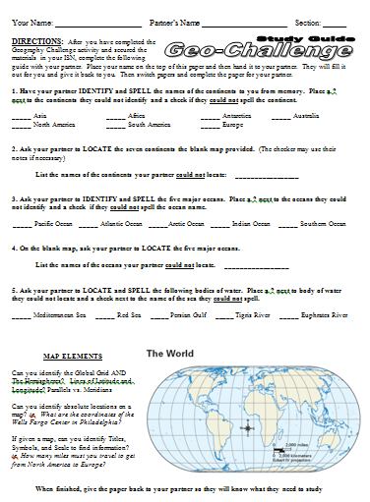
LETS PRACTICE
Now that we have completed the Geography Challenge activity and secured the materials in our ISN…
Complete the following guide with your partner.
Place your name on the top of this paper and then hand it to your partner.
They will fill it out for you and give it back to you. Then switch papers and complete the paper for your partner.

Slide 43
LETS PRACTICE
1. Have your partner IDENTIFY and SPELL the names of the continents to you from memory. Place a ? next to the continents they could not identify and a check if they could not spell the continent.
_____ Asia
_____ Africa
_____ Antarctica
_____ Australia
_____ North America
_____ South America
_____ Europe

Slide 44
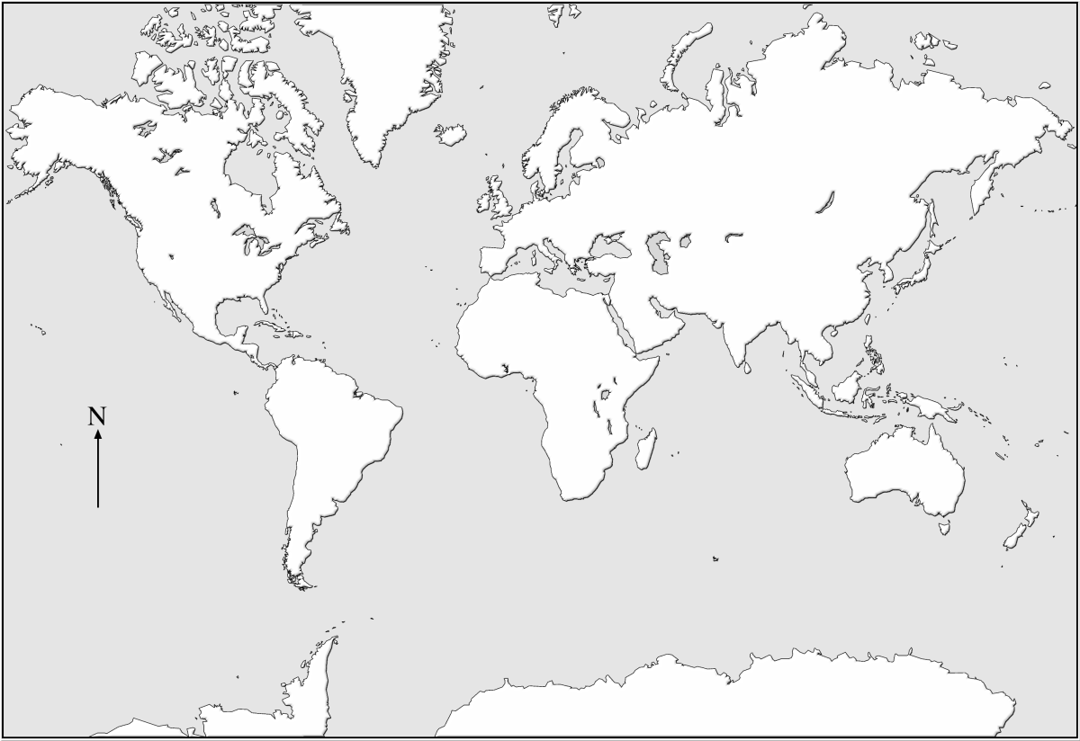
LETS PRACTICE
How much of this practice map could you fill in from memory???

