Slide 1
Definitions of Technology Review lesson
7th Grade Design and Engineering

Slide 2
Definition of TECHNOLOGY
TECHNOLOGY is the process whereby human beings use tools, machines, materials and knowledge to solve problems which extend human capabilities.

Slide 3
Areas of Technology
Construction
Manufacturing
Communication
Transportation
Bio-Technology

Slide 4
Construction
Construction is the process whereby human beings convert raw materials into finished products or useful goods.
The intention is to produce only one product at a time which is built on site.

Slide 5
Manufacturing
Manufacturing is the process whereby human beings convert raw materials into finished products or useful goods.
The intention is to produce more than one product at a time which can be shipped from where it is made.

Slide 6
Communication
Communication is the process whereby human beings transfer information through graphic or electronic means from one place to another.
Sender → Message → Receiver

Slide 7
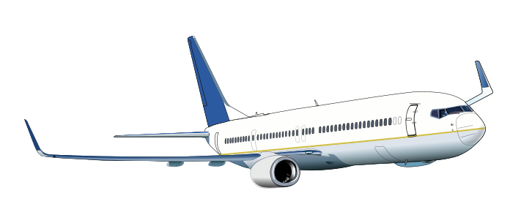
Transportation
Transportation is the process whereby human beings transfer people and or goods from one place to another.
Modes of Transportation
Land
Water (marine)
Air
Space

Slide 8
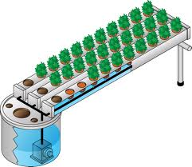
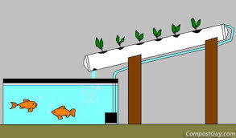
Bio-Technology
Bio-Technology is the process whereby human beings use living organisms to develop products or processes.

Slide 9
Definition of ENGINEERING
The use of technological and scientific knowledge to solve problems is known as engineering.

Slide 10
Invention vs. Innovation
An invention is a new product, system, or process that has never existed before which has been created by study or experimentation.

Slide 11
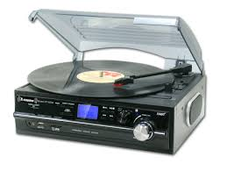
Invention vs. Innovation
An innovation is a new product, system, or process that has been developed through the modification of an existing invention.

Slide 12
Design Brief
The written plan that identifies the problem to be solved, it’s criteria, constraints and parameters is called a Design Brief.

Slide 13
Brainstorming
The method of shared problem solving in which all members of a group generate ideas.

Slide 14
Developed 9/2/14

Slide 15
Extra Slides

Slide 16
Did You Know?
90% of all technologies have been developed within the last 25 years
From 1980 to 2030 it is predicted that there will be a 3200% increase in the amount of knowledge known to humankind
This increase will represent 97% of all of the knowledge learned since the beginning of recorded history

Slide 17
Fields of Bio-Technology
Ergonomics
study of how humankind works
Agrobiotech
agriculture with a twist
Cryogenics
freezing 6th graders?
Hydroponics
farming without soil

