Slide 1
NHS/Bucks Senior Year Experience
Andrea Dent: Assistant Director, Dual Enrollment
Steve McAloon: NHS Assistant Principal

Slide 2
Neshaminy Graduation Requirements
Discipline | 1 Credit | 2 Credits | 3 Credits | 4 Credits
English
Social Studies
Math
Science
World Language
Health
PE
Arts/Humanities
Electives
Total | 21.0 Credits
Keystone Requirement

Slide 3
Remaining Senior Year Requirements
Discipline | 1 Credit | 2 Credits | 3 Credits | 4 Credits
English
Social Studies
PE
Total | 19.5 Credits

Slide 4
Program Requirements:
Students cannot be credit deficient.
Students must currently have a cumulative GPA of 2.75 or higher.
A. If unsure, please check with your Guidance Counselor (215-809-6101)
All students must take and meet the proficient levels of the 3 placement exams (math, reading and writing) as established by Bucks regardless of your current GPA.
All Bucks courses must be taken in person on NHS and BCCC Campuses. (No virtual courses permitted)

Slide 5
Program Highlights/Expectations:
Neshaminy will pay tuition for up to 6 credits per semester.
Students must earn a C or higher in order for tuition to be paid by Neshaminy.
Neshaminy will pay the cost of required textbooks.
A. Students will return all Bucks textbook to NHS at the end of each semester.
Students/parents are responsible for any additional course/lab/material fees.
Neshaminy will provide transportation to and from BCCC if needed.
Students must take English Composition 110 or higher & a Humanities/Social Studies
Course at Bucks.
6. Students must take 2 additional courses at Bucks.
7. Students must maintain 3.5 credits at NHS.

Slide 6
NHS/BCCC Dual Enrollment
 | Day 1 | Day 2 | Day 3 | Day 4 | Day 5 | Day 6
1
2
3
4
5
6
7
8
FULL COURSE at NHS
FULL COURSE at NHS
PE
PE
PE
BCCC - ENGLISH/SOCIAL STUDIES
BCCC - ENGLISH/SOCIAL STUDIES
BCCC - ENGLISH/SOCIAL STUDIES
Lunch
FULL COURSE at NHS

Slide 7
NHS/BCCC Dual Enrollment
 | Day 1 | Day 2 | Day 3 | Day 4 | Day 5 | Day 6
1
2
3
4
5
6
7
8
BCCC - ENGLISH/SOCIAL STUDIES
BCCC - ENGLISH/SOCIAL STUDIES
BCCC - ENGLISH/SOCIAL STUDIES
FULL COURSE at NHS
FULL COURSE at NHS
Lunch
PE
PE
PE
FULL COURSE at NHS

Slide 8
Bucks Senior Year Experience: Bucks View
Semester 1
 | Monday | Tuesday | Wednesday | Thursday | Friday
8:00 or 11:00 AM | Course A |  | Course A
8:00 or 11:00 AM |  | Course B |  | Course B
Semester 2
 | Monday | Tuesday | Wednesday | Thursday | Friday
8:00 or 11:00 AM | Course C |  | Course C
8:00 or 11:00 AM |  | Course D |  | Course D

Slide 9
1
Approved Bucks English Composition Course
English Comp 110 or higher
2
Approved Bucks Humanities/Social Studies Categories of Courses
Economics History Philosophy Political Science Psychology
Geography Criminal Justice Women’s Studies Sociology
3
College-level Elective Course
4

Slide 10
Typical Fall Course Offerings
8:00-9:15 English Composition I Intro to Adm Criminal Justice Principles of Economics: Macro U.S. History: Modern America Life and Health Nutrition(by Reg'd Dietitian) Survey: World Religions Introduction to Business Intro to Psychology Intro to Sociology | 10:50 – 12:05 Digital Literacy Communication Theory Effective Speaking English Composition I Introduction to Theater Principles of Economics: Macro Global History: Ancient/Mediev History of the Holocaust U.S. History: Modern America Responding to Emergencies American Lit to 1865 Mathematical Concepts I Intermediate Algebra Elementary Statistics Business Calculus Medical Terminology Introduction to Business Business Communication Introduction to Music Introduction to Philosophy Intro to Psychology Intro to Sociology Peoples of America Criminology Elementary Spanish I

Slide 11
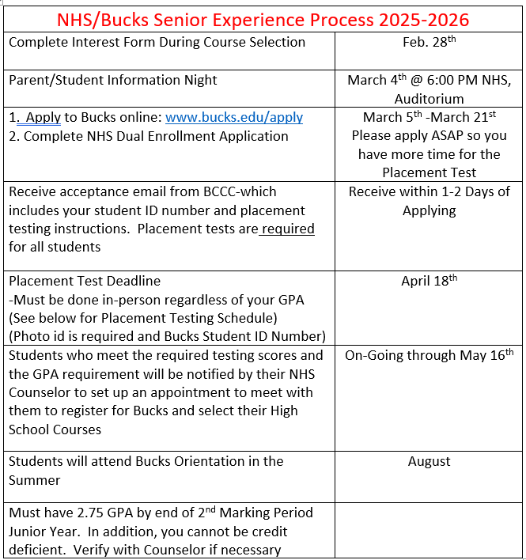

Slide 12
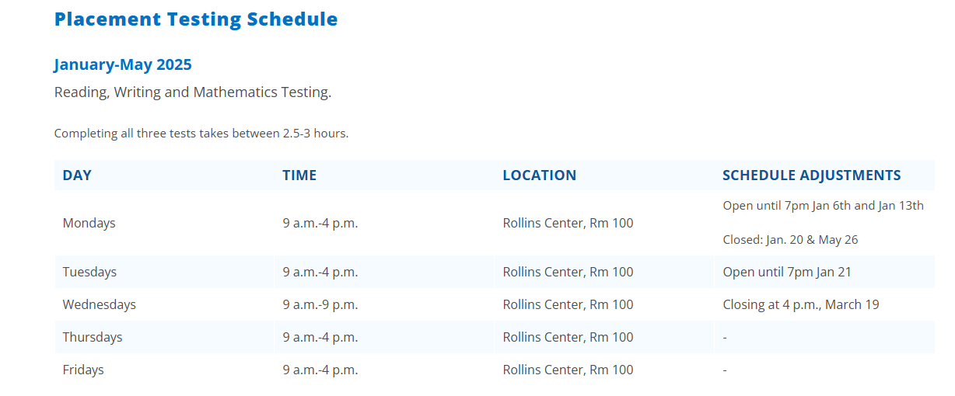
Neshaminy DE Placement Testing Days @ Testing Center
Monday, March 31: 8:30am and 12:30pm
Thursday, April 17: 8:30am and 12:30pm
Friday, April 18: 8:30 am and 12:30pm
Sign ups will be required to attend one of the above testing days
If you are unable to attend one of these days, walk-in testing is available during the times below:
275 Swamp Road, Newtown, PA 18940
Rollins Center Room 100

Slide 13
Common Questions
Do Bucks courses transfer to other colleges/university?
Yes, Bucks has agreements and relationships with many local colleges and universities.
See the Bucks website for a full list
How is Bucks time slot selected?
Depends on course offering at NHS and at Bucks
Must be flexible- Counselor will assist
What happens when the Bucks Calendar and the NHS Calendar differ?
You follow both. When one is closed you attend classes at the other.
Transportation is provided following both Calendars.
Can the students still participate in NHS co-curricular/social events?
Yes
Can I drive myself to and from Bucks?
Yes

Slide 14
Next Step:
Determine if the Bucks program is for you.
Determine if you qualify (check cumulative GPA)
If Yes to the above – Complete Neshaminy Application/Agreement and Apply to Bucks online (Deadline March 21st). Once you apply, you will receive an email with your Bucks Id. You will need this ID to take the Placement Tests. Placement Tests are administered at BCCC. (Deadline April 18th ).
Once you have completed the Placement Tests, setup an appointment with your counselor to register for classes. (Deadline May 16th)
Have questions reach out to your child's Guidance Counselor
at NHS by email or 215-809-6101.

Slide 15
Questions???

