Slide 1
Milk
What is the processing, grading, cookery methods, and nutritional value of milk products?

Slide 2
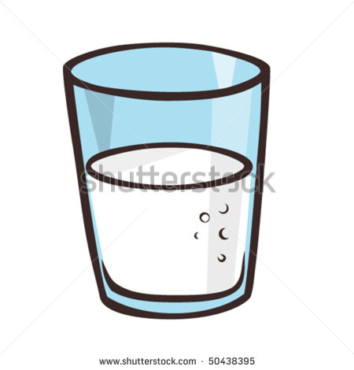
Processing and Grading of Milk
Milk is one of the most nutritious foods without substitutions. The nutrients are needed by people of all ages. It is used as a beverage and an ingredient in many recipes.
The sale of milk is controlled by the local health department. To insure safety , milk is pasteurized, which is a process of heating milk to destroy harmful bacteria. Raw milk is not pasteurized and therefore unsafe to drink.
Homogenization is a process that breaks up fat particles in milk so they will be uniformly distributed in the product.
Milk is fortified by exposing it to ultraviolet light, the process of irradiation , so fat changes to Vit D.
Most of our milk is pasteurized, homogenized, and fortified.
The grade of milk is based on bacterial count, the highest grade being ‘A’. Milk is composed of 13%
solids and 87% water.
Buttermilk is the liquid that is leftover after churning butter (a low-fat and high-protein substance that ferments to the point of tartness). You can add lemon juice or vinegar to regular milk, and these acids cause the protein to coagulate or gel. The milk will now have curds and whey.

Slide 3
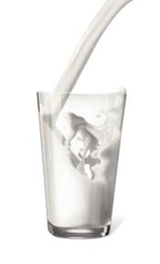
VOCABULARY
Raw milk
Pasteurized milk
Homogenized milk
Vitamin D milk
Skim milk
Low fat milk
Lactose
Whole milk
Evaporated milk
Sweetened condensed milk
Non-fat dry milk
Buttermilk

Slide 4
Cooking With Milk
Milk is used to add: Prevent this from happening:
Flavor Film Formation
Texture Boiling Over
Browning Scorching
Nutrition Curdling

Slide 5
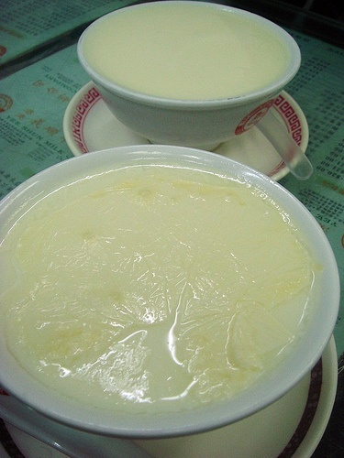
Film Formation
Protein solids clump together and form a tough, rubbery skin on the surface.
TO PREVENT: stir often
To Fix: whisk into mixture

Slide 6
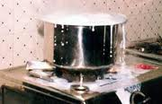
Boiling Over
Pressure develops under the film and forces milk to break through and boil over sides of pan

Slide 7
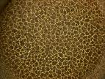
Scorching
Burnt milk
(scorch-torch)
TO PREVENT: use low heat and stir often
No Fix
Above is a picture of the bottom of a pan with scorched milk.

Slide 8
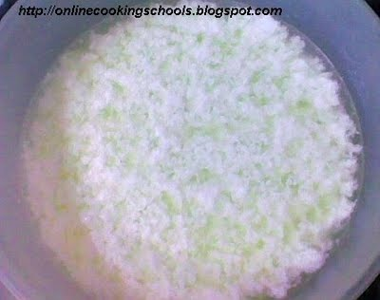
Curdling
Separates into curds and whey.
TO PREVENT: use low heat, stir often, and mix with acid foods slowly
TO FIX: might not be able to fix but can try whisking until smooth

Slide 9
Nutrient Contributions of Milk
Minerals
Calcium…builds strong bones and teeth, strengthens body cells, aids in blood clotting, assist in regulation of heart muscle, maintains normal nerve function
Phosphorus…needed by every body cell, combines with calcium to make bones and teeth, influences oxidation of food in body cells to release energy to the body

Slide 10
Nutrient Contributions of Milk
Vitamins
Fat soluble Vitamin A and D found in the fat portion of milk. Aids the body in growth, repair and maintenance. Keeps the body operating in efficient and orderly way.
Water soluble Vitamin B-complex found in the non fat portion of the milk. Helps the body use oxygen and keeps skin, eyes and mouth in good condition. Necessary for proper function of nerves and digestives tract.

Slide 11
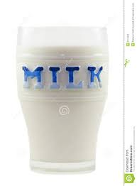
Nutrient Contributions of Milk
Carbohydrates provide energy.
Lactose, or milk sugar, is the carbohydrate found in milk. Lactose intolerance is the condition which prevents the digestion of milk.
Other nutrients found in milk are protein, water, and fat.

Slide 12
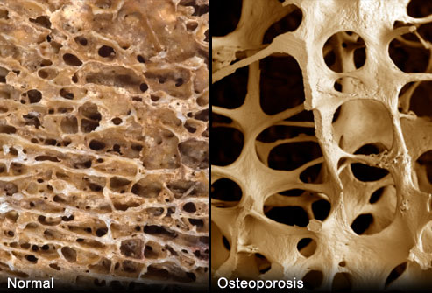
Missing Milk?
Osteoporosis..
Disease caused by lack of minerals
causing bones to become brittle
and break

Slide 13
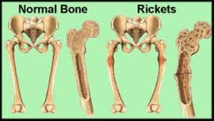
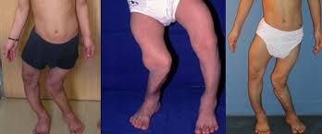
Missing Milk?
Rickets
Disease caused by lack of vitamins
found in milk, resulting in soft bones

